Slide 1
Operation IceBridge
Arctic 2014 Campaign
Sea Ice Planning
Sea Ice Team: Jackie Richter-Menge (lead), Sinead Farrell, Nathan Kurtz and Lora Koenig
Mapping: Sinéad Louise Farrell
Multi-agency Effort. Thanks to:

Slide 2
IceBridge 2014 Arctic Sea Ice Plan
Sea ice flight line recommendations - Summary of initial meeting, 13 Jan 2014
Draft flight line recommendations based on the 2013 Arctic campaign as a reference,
with the following modifications:
(1) 2013 flight lines 14 and 15 will be modified to incorporate over flights of the NRL (Barrow, AK) and CryoVEx (Canada Basin out of Sachs Harbor) in situ observations sites, respectively. It is estimated to take about 1 hour to make 5 passes over a 2 km by 60 m in situ sample area.
(2) Another Fairbanks-based flight line will be added to further increase coverage in the central Beaufort Sea, roughly targeting the area between 2013 flight lines 12, 14 and 15.
(3) The Thule-based 'Zig Zag West', last flown in 2012, will be added back into the mix and modified to increase observations of the ice thickness gradient off the northern coast of Greenland and Ellesmere Island.
(4) Another Thule-based line will be added to cover the more easterly region of Fram Strait.

Slide 3
IceBridge 2014 Arctic Sea Ice Plan
Assumptions used in planning surveys of in situ field work locations:
All field site locations are in draft format, and will depend on actual ice conditions in March 2014
The following assumptions are in use for IceBridge flight planning purposes (Jan 2014)
NRL:
Fast Ice Survey – Just east of Point Barrow
Pack Ice Survey – 50 miles due north of Point Barrow
(personal communication with J. Brozena, NRL, Jan 23 2014)
(2) ONR:
ONR MIZ Sea Ice Camp 2 – located at 73 N, 135 W
(per PPT slides from J Richter-Menge, Jan 14 2014)
(3) CryoVex:
CryoVex Camp 1 at ~ 83.6, 40 W
CryoVex Camp 2 at ~ 84.7 N, 52 W
(per map from Tania Casal, Jan 24 2014)

Slide 4
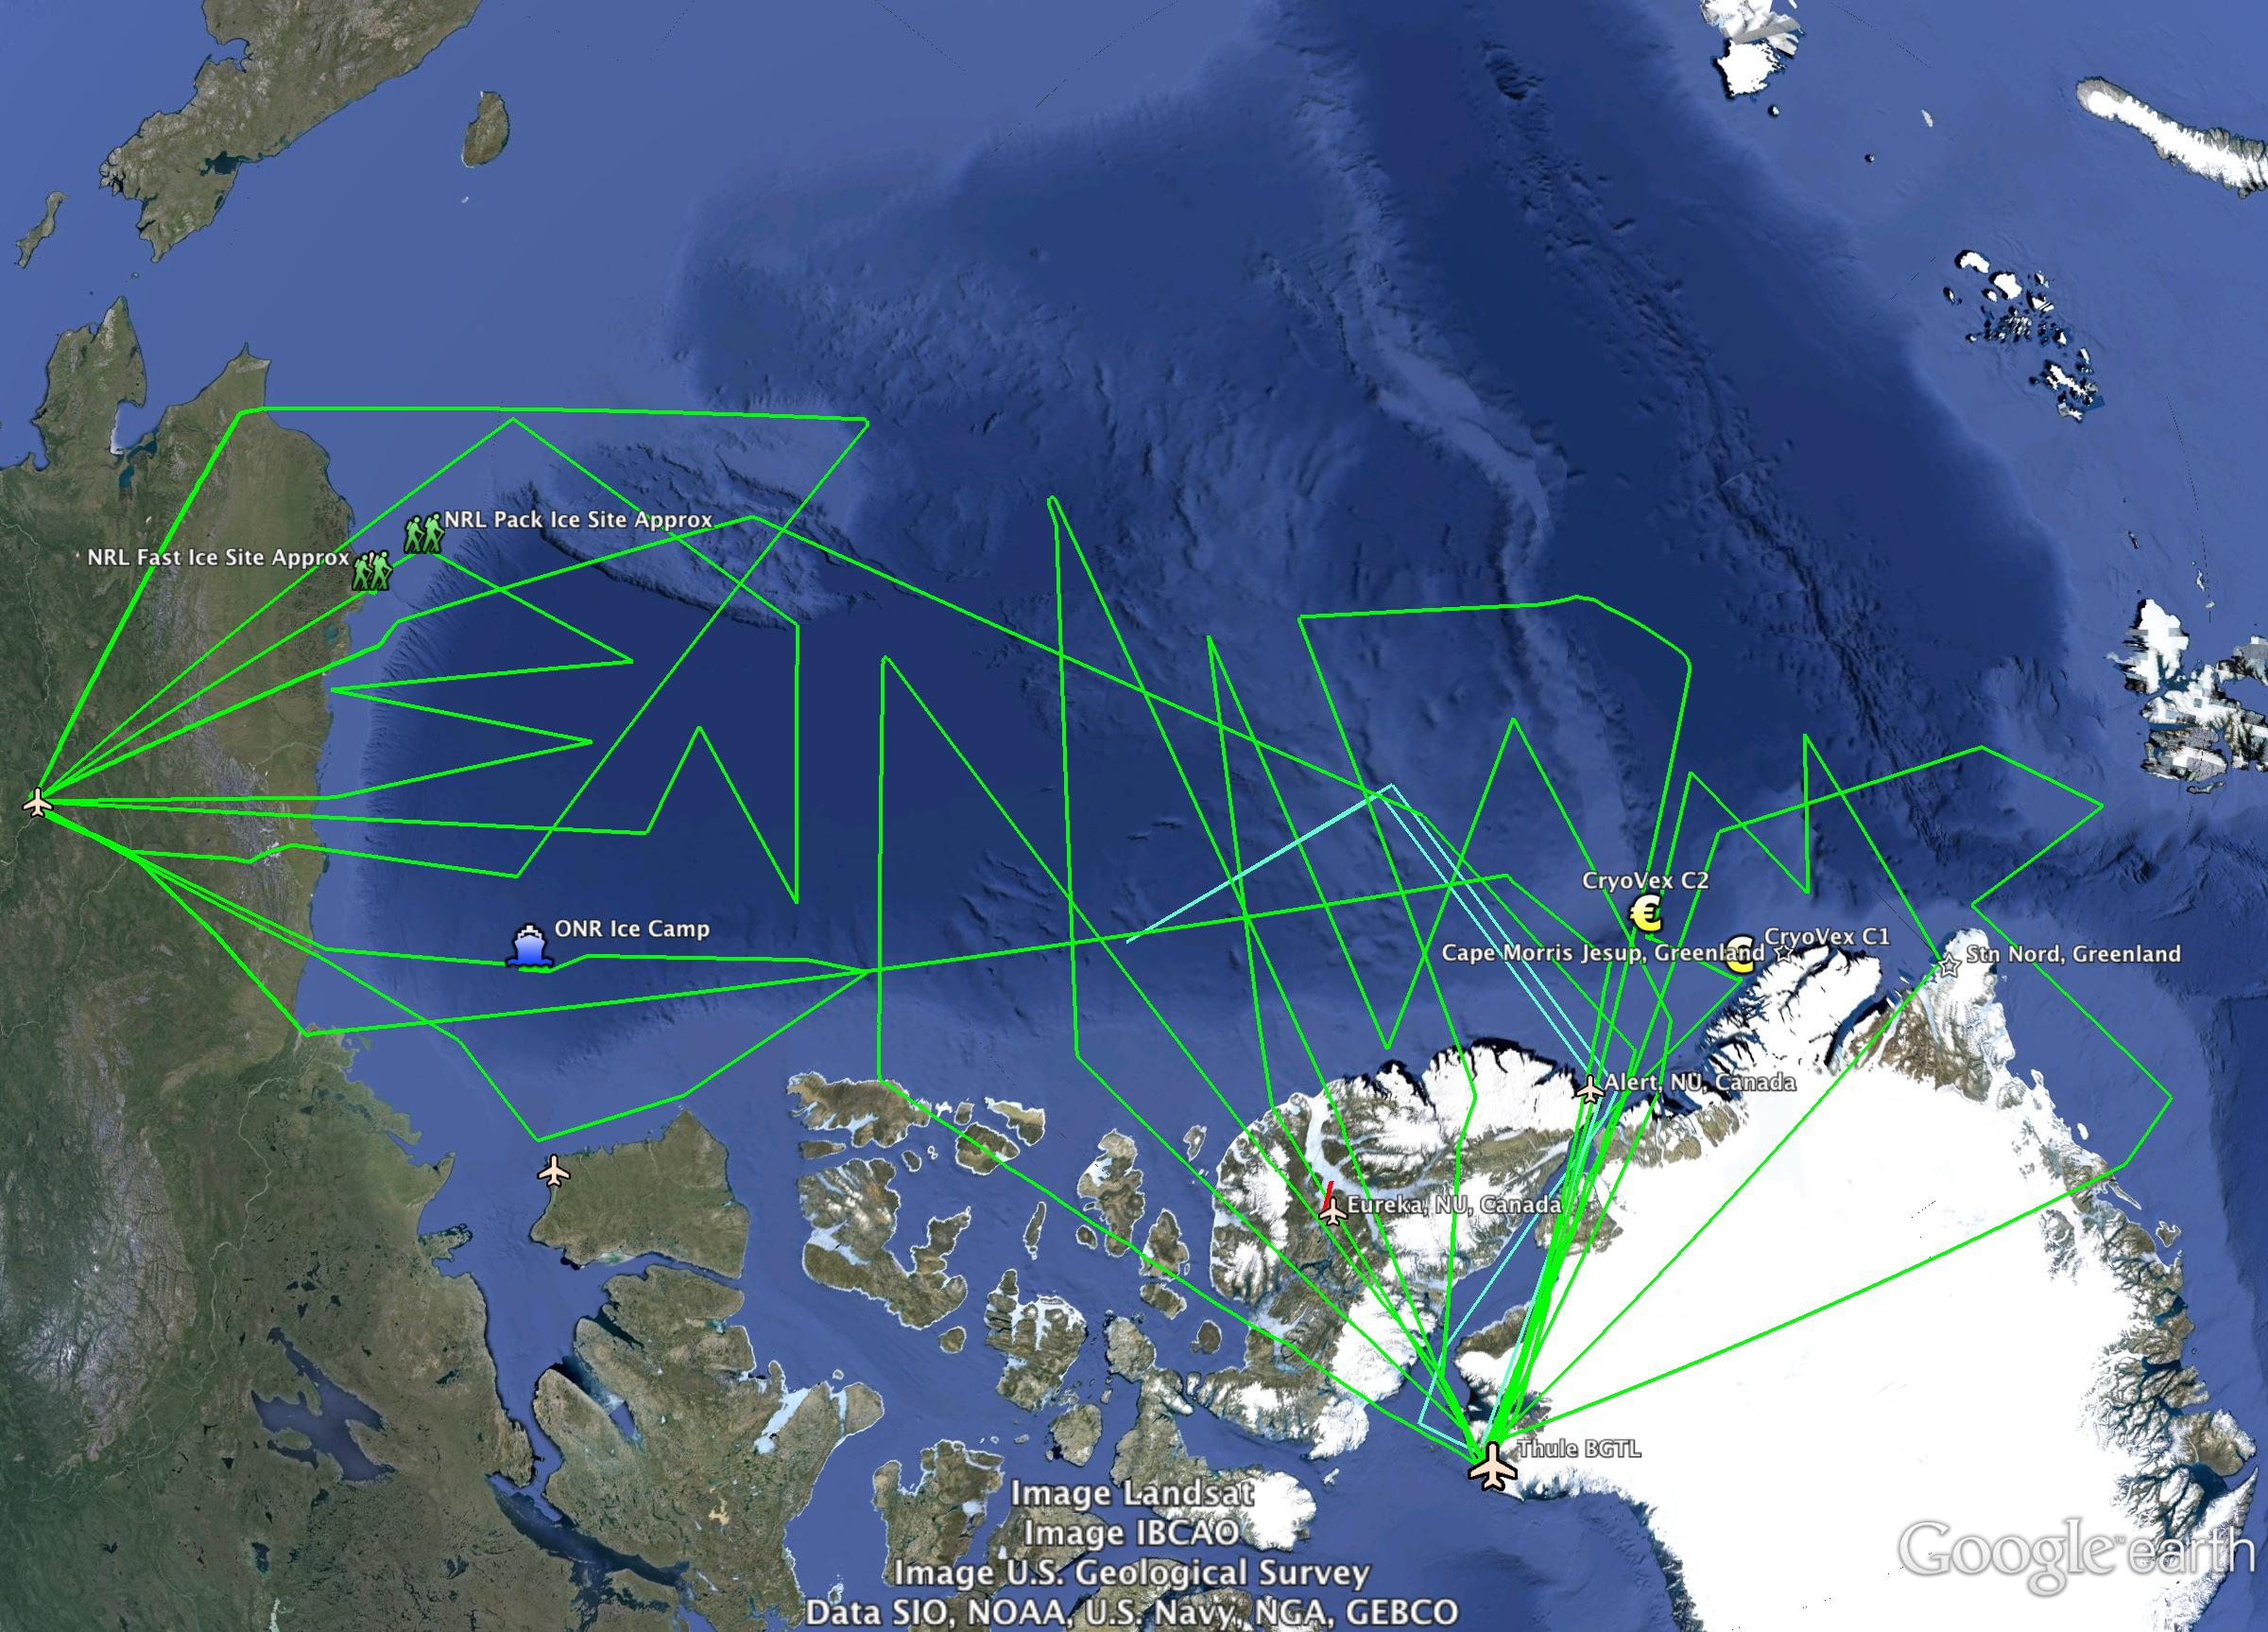
2014 Draft Sea Ice Flight Plan
9
7
1
5
10
8
6*
3*
11*
13
4
12
2

Slide 5
Recommended 2014 Arctic Sea Ice Missions
Name | Comments | Map Number | Base | Last flown | Priority (2013) | Priority (2014)
SIZRS ZigZag | NRL Barrow | 14 | Fairbanks | 2013 | M
Eastern Beaufort Sea | CryoVEx 2014/ ONR MIZ | 15 | Fairbanks | 2103 | H
Beaufort-Chukchi Diamond |  | 13 | Fairbanks | 2013 | H
South Basin Transect |  | 2 | Fairbanks | 2013 | H*
Central Beaufort ZigZag |  |  | Fairbanks | new
Canada Basin South, QE Is | MEDEA (?) | 12 | Thule | 2013 | H
Canada Basin North | MEDEA (?) | 11 | Thule | 2013 | H
North Pole Transect |  | 10 | Thule | 2013 | H
Laxon Line |  | 1 | Thule | 2013 | H*
Clipped Conner Corridor | EC (?) | 8 | Thule | 2012 | M
Giles Gateway | Modified to extend eastward in Fram Strait | 5a | Thule | 2102 | M
ZigZag East, Nares St | CryoVEx 2014/ Station Nord | 4a | Thule | 2013 | H
Cryosat underflight / Wingham Box |  | 6 | Thule | 2013 | H
ZigZag West | Modified |  | Thule | 2012 | Not recommended in 2013

Slide 6
IceBridge 2014 Arctic Sea Ice Draft Plan
Laxon Line, 2013 Repeat, from Thule
South Basin Transect, 2013 Repeat, From Fairbanks
Giles Gateway, 2014 New, Modified Fram Gateway, from Thule
Zig Zag East, 2014 Modified to fly CryoVex C1 and C2 (Yellow €), from Thule
North Pole Transect, 2013 Repeat, From Thule
Zig Zag West, 2014 Modified, from Thule
Canada Basin North, 2013 Repeat, from Thule
Canada Basin South, 2013 Repeat, from Thule
Beaufort Chukchi Diamond, 2013 Repeat, from Fairbanks
SIZRS Zig Zag, 2014 Modified to fly NRL field sites (Green skiers), from Fairbanks
Chukchi Borderland, 2014 New, from Fairbanks
Beaufort Sea East, 2014 Modified to fly ONR MIZ ice camp (Blue ship), from Fairbanks
CryoSat-2 Under-flight, inside Wingham Box, dependent on orbit, from Thule (line in cyan)

Slide 7
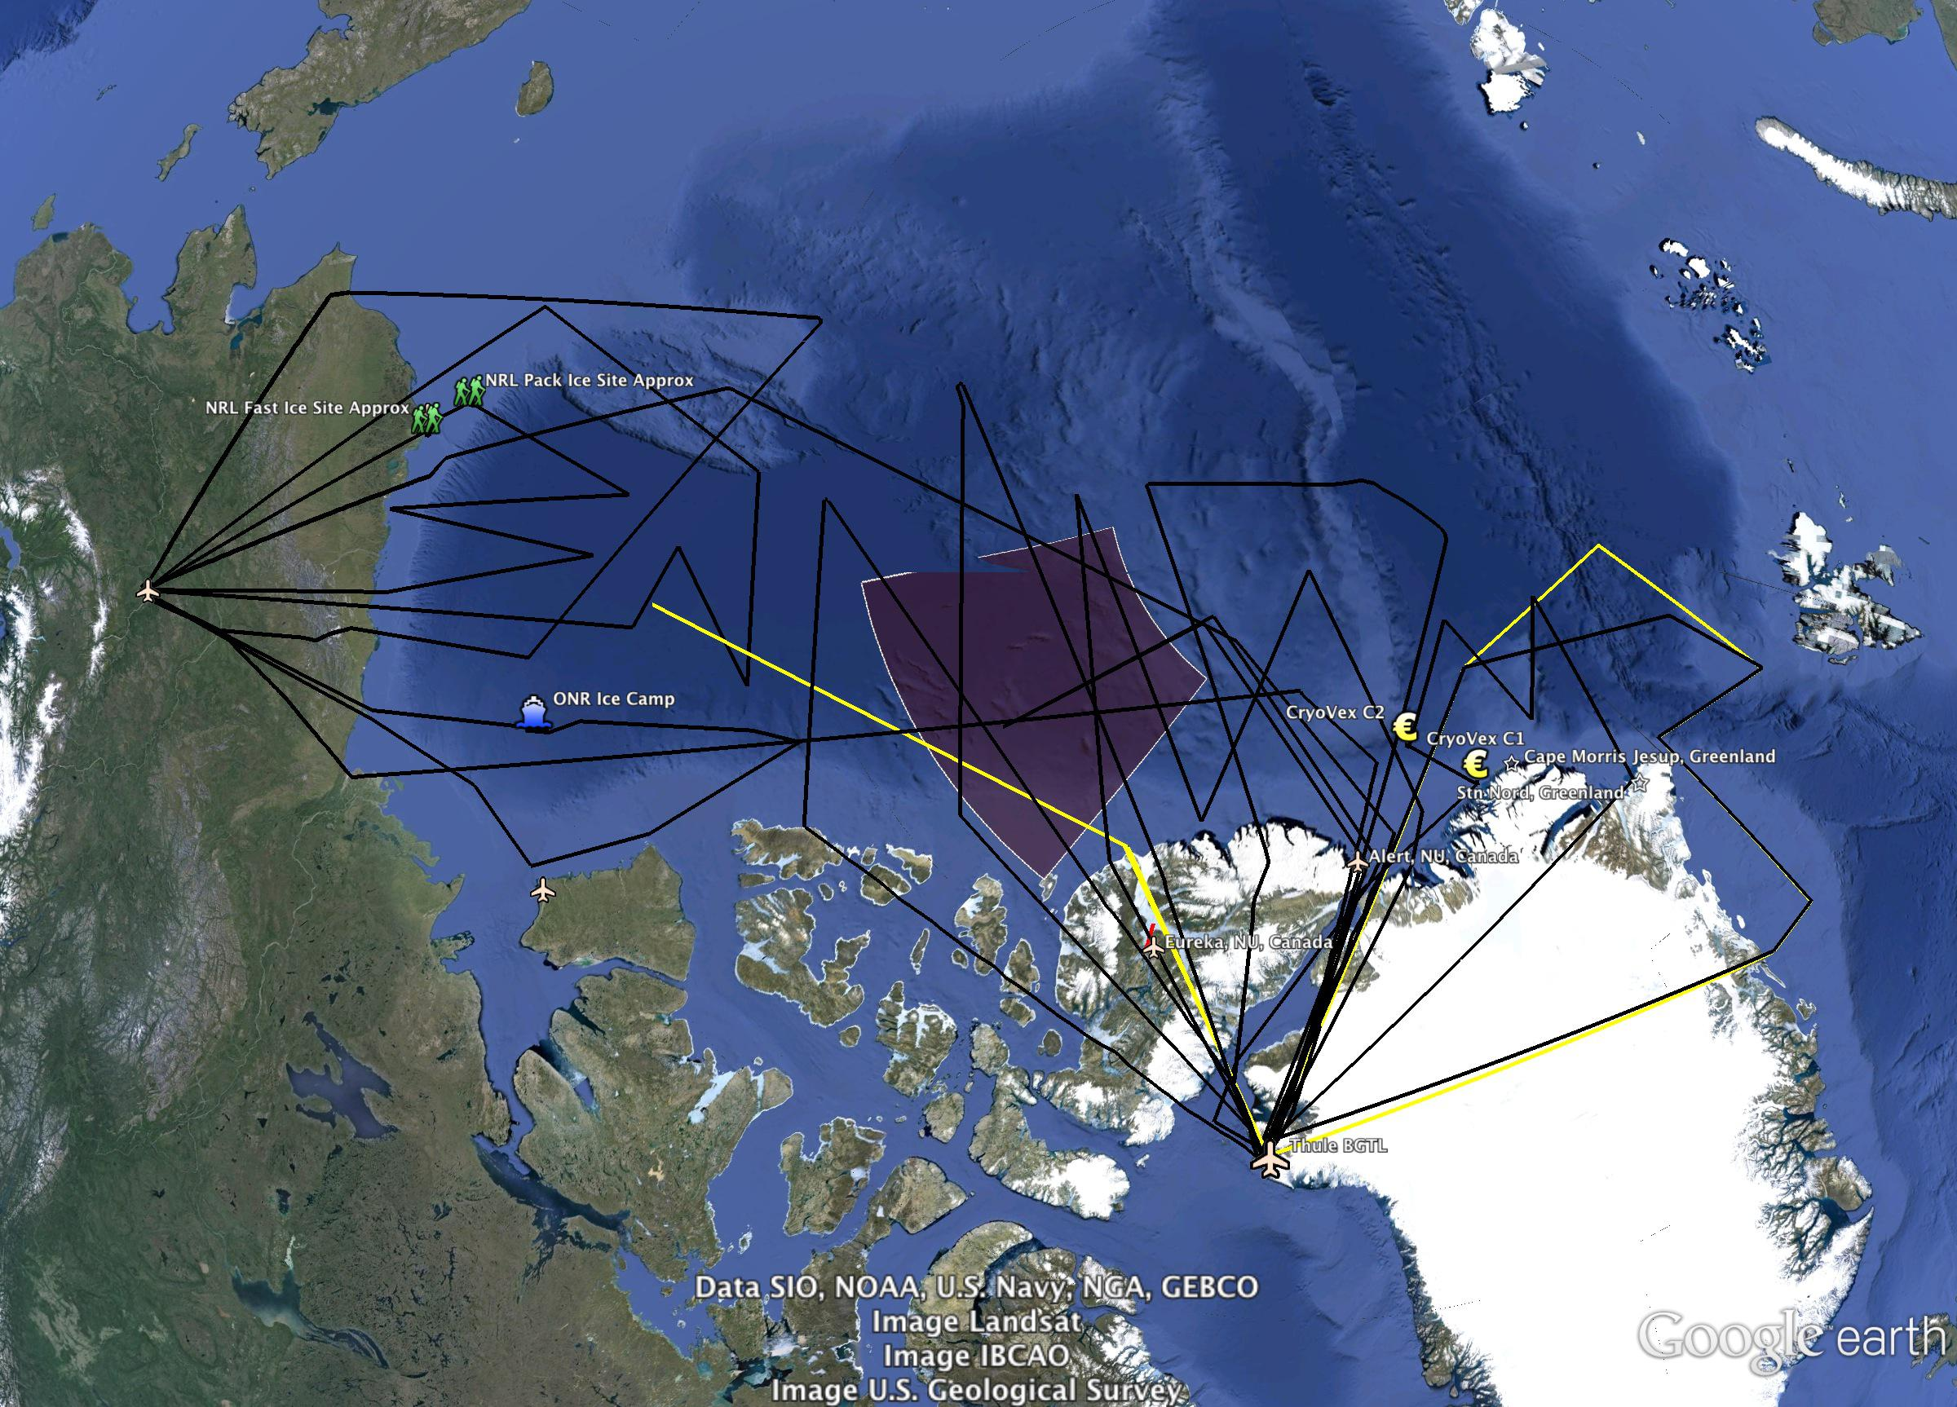
Modifications/Additions:
Connor Corridor (Altika Underflight)
Giles Gateway B (Northward Modification)
Notes:
This slide shows the modification I have made since the last slide set I sent early Monday AM:
Connor corridor in yellow
Giles Gateway B – a modified version of the Giles Gateway that would sample some interesting, thick ice in the transpolar drift north of Svalbard – don’t know if we can make it there from Thule though = discussion topic!

Slide 8
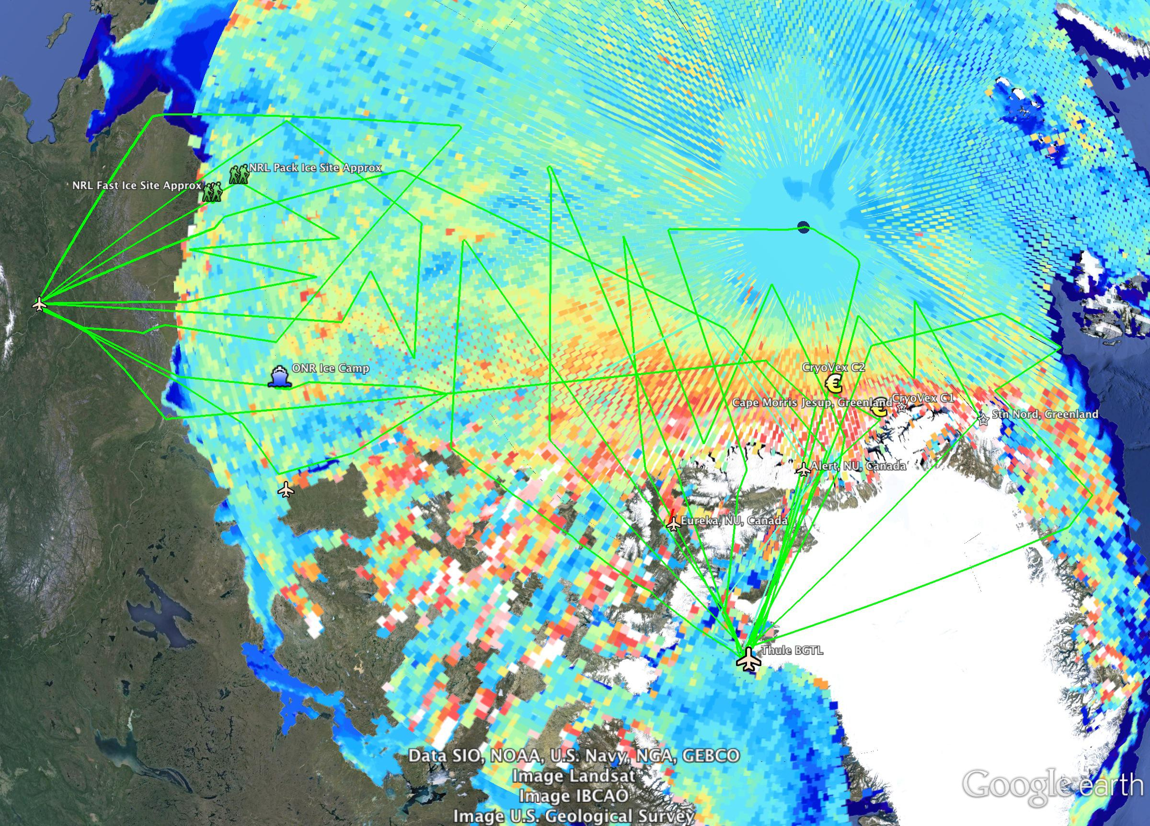
2014 Draft Sea Ice Flight Plan
Mar 2013 CryoSat-2 Ice Thickness (AWI)

Slide 9
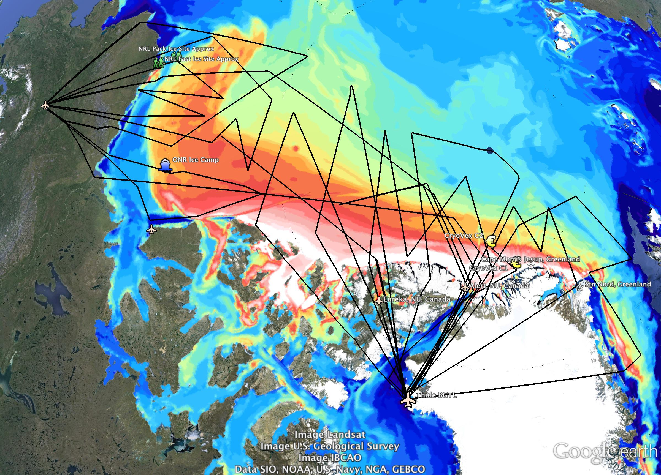
2014 Draft Sea Ice Flight Plan
Jan 2014 ACNFS Ice Thickness
Notes:
USE THIS SLIDE!
This now includes all the lines (14 in total) – i.e. 13 original slides plus Connor Corridor. The Giles Gateway is the original plan (Giles Gateway B is not included here)
Flights lines are in black –easier to see against the NRL/ACNFS map
I popped a tiny NRL logo on here too since this is actual data they’ve shared with us for planning purposes.

Slide 10
2013 Flight Lines

Slide 12
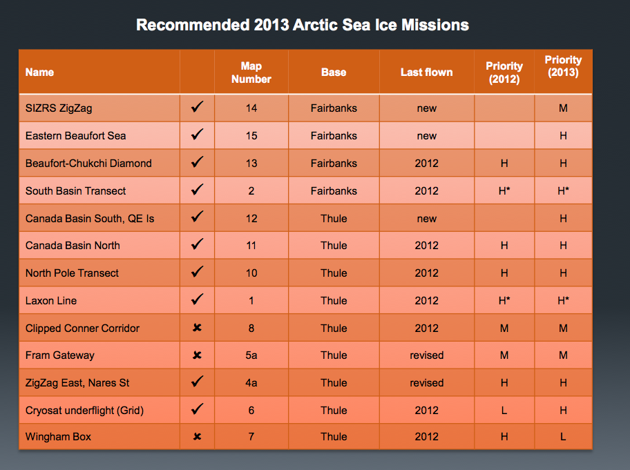
List of Recommended Sea Ice Flight Lines for Arctic 2013

Slide 13
Breakdown of Current Conditions

Slide 14
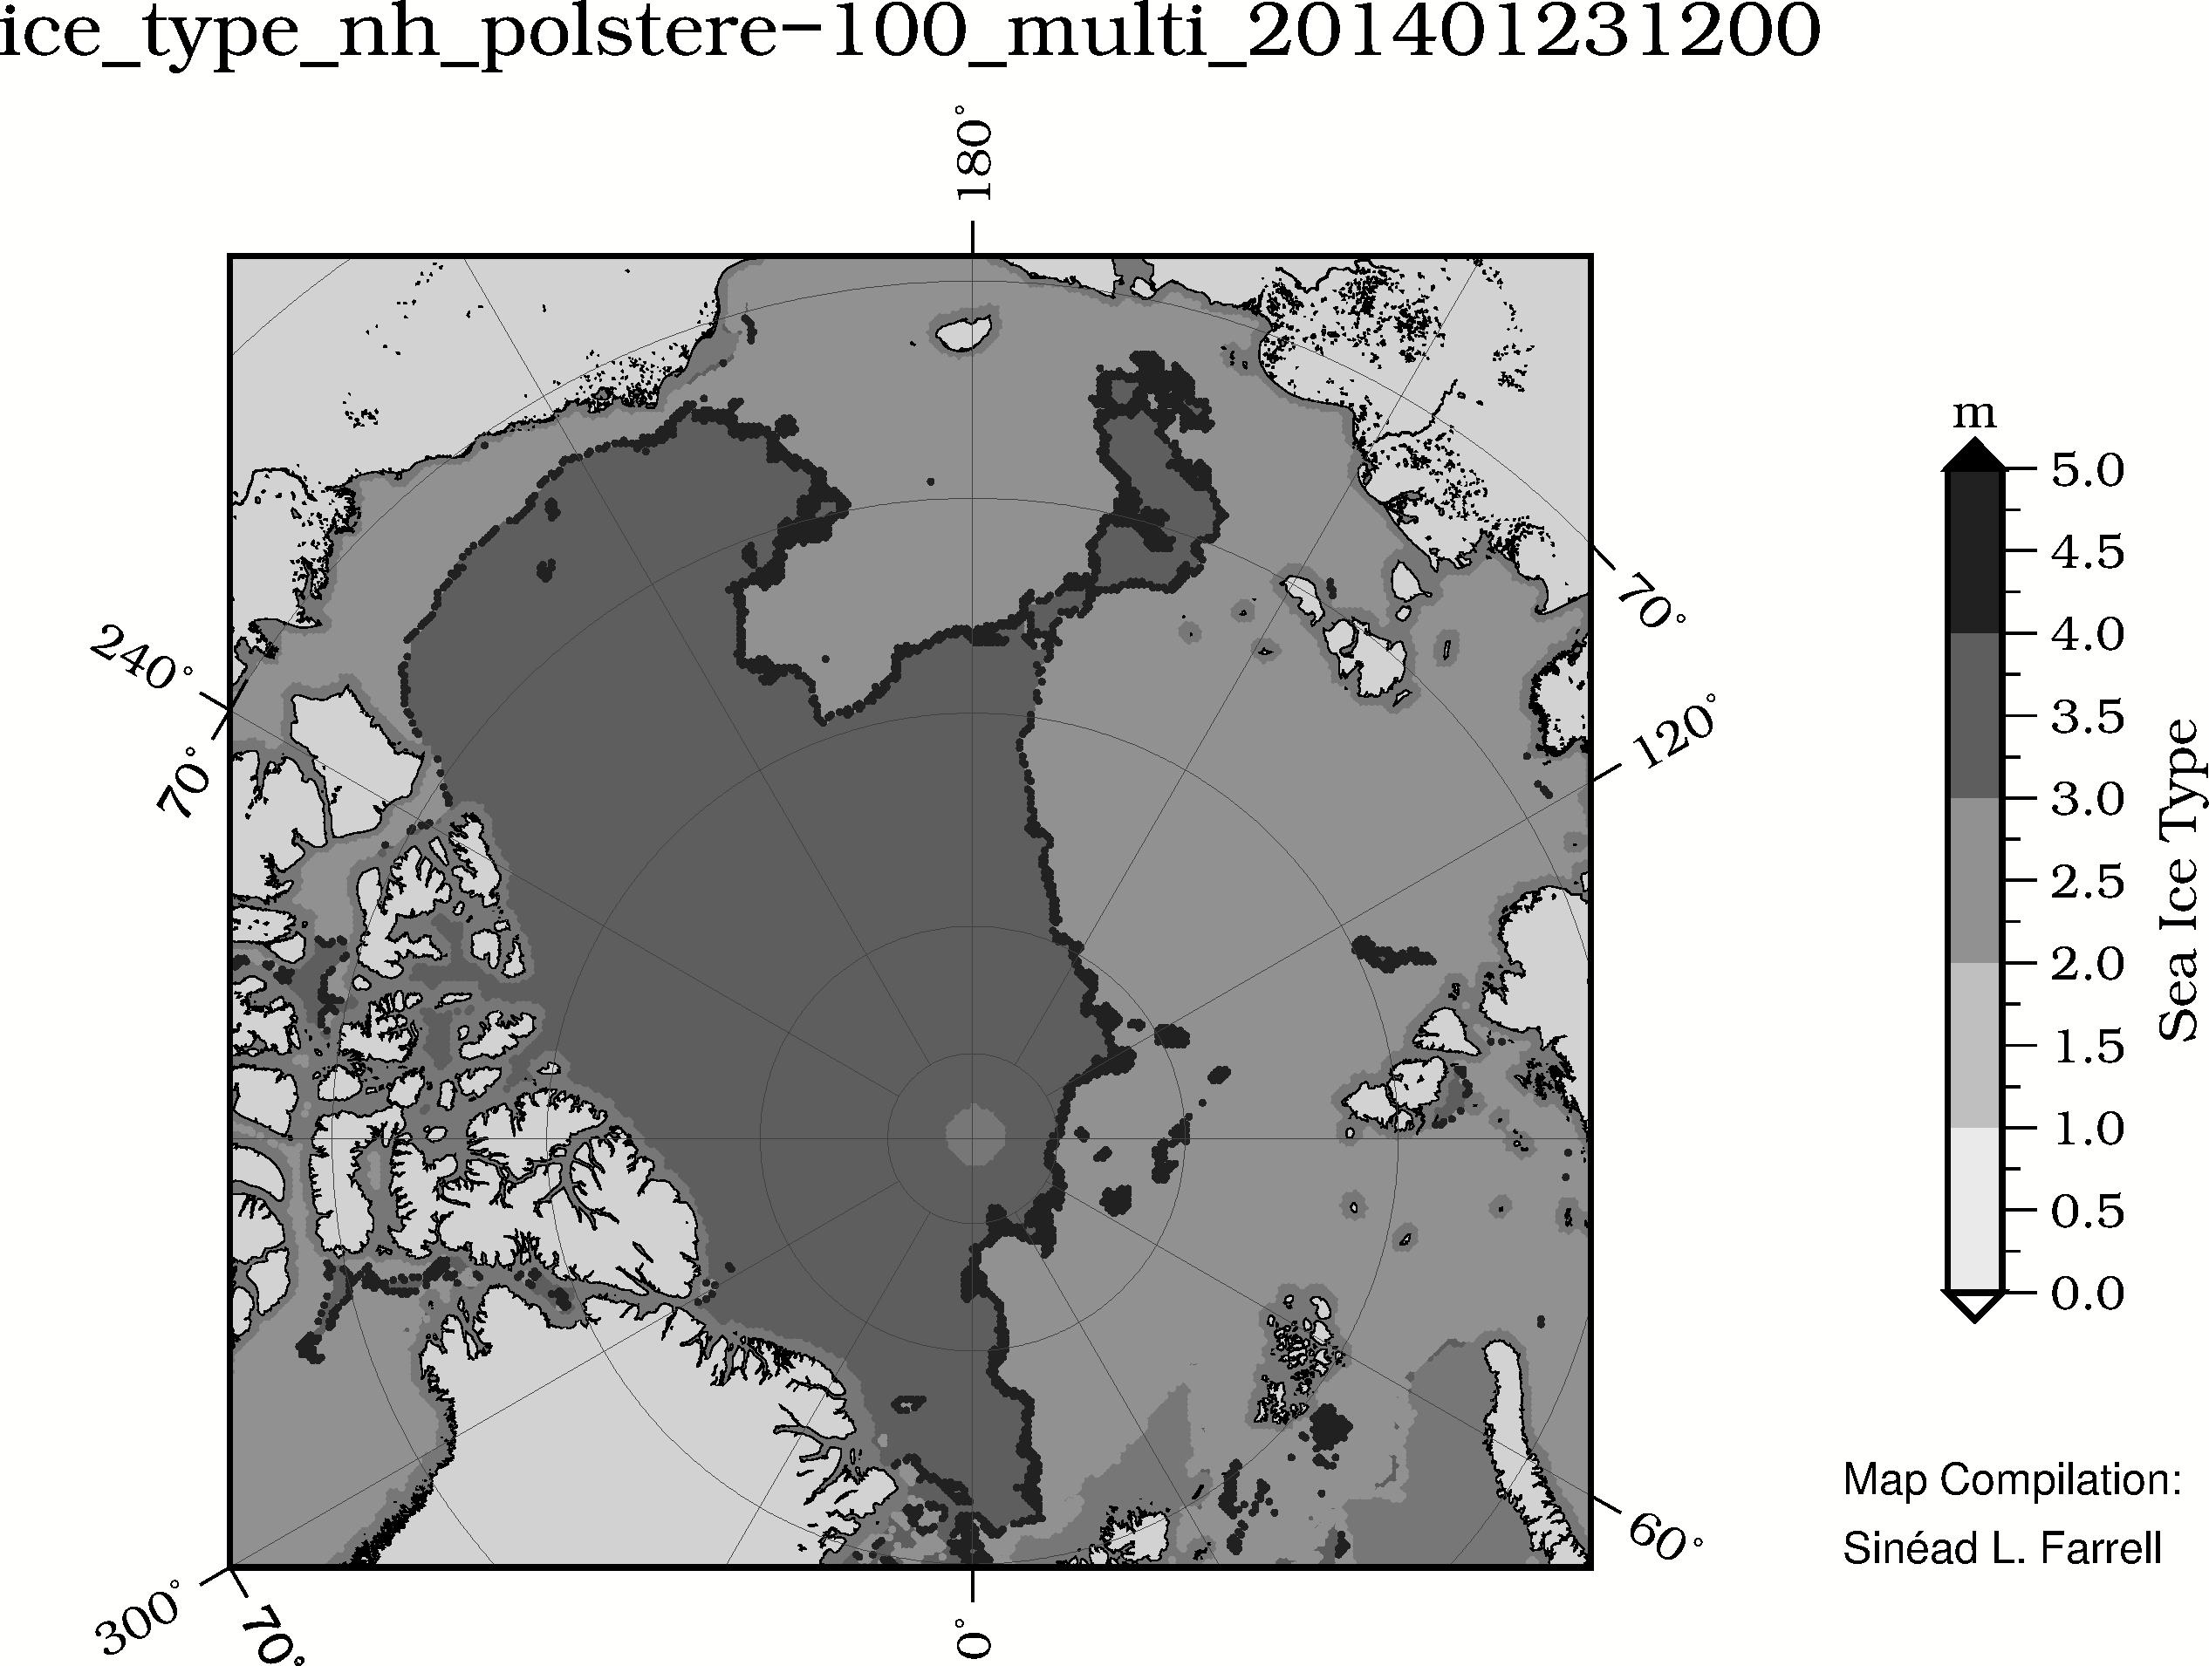
Sea Ice Type - OSI-SAF
(Dark Grey = Multi-year Ice)
January 2014
ftp://osisaf.met.no/archive/ice/type/2014/

Slide 15
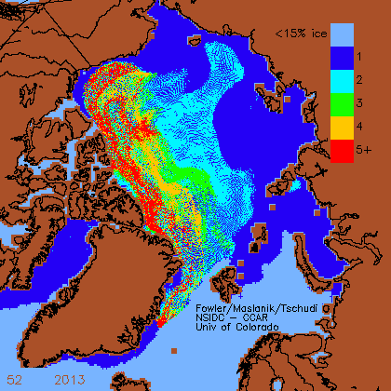
Sea Ice Age
December 2013
(week 52, 2013)
Credit: Fowler, Maslanik, Tschudi: University of Colorado, Boulder

Slide 16
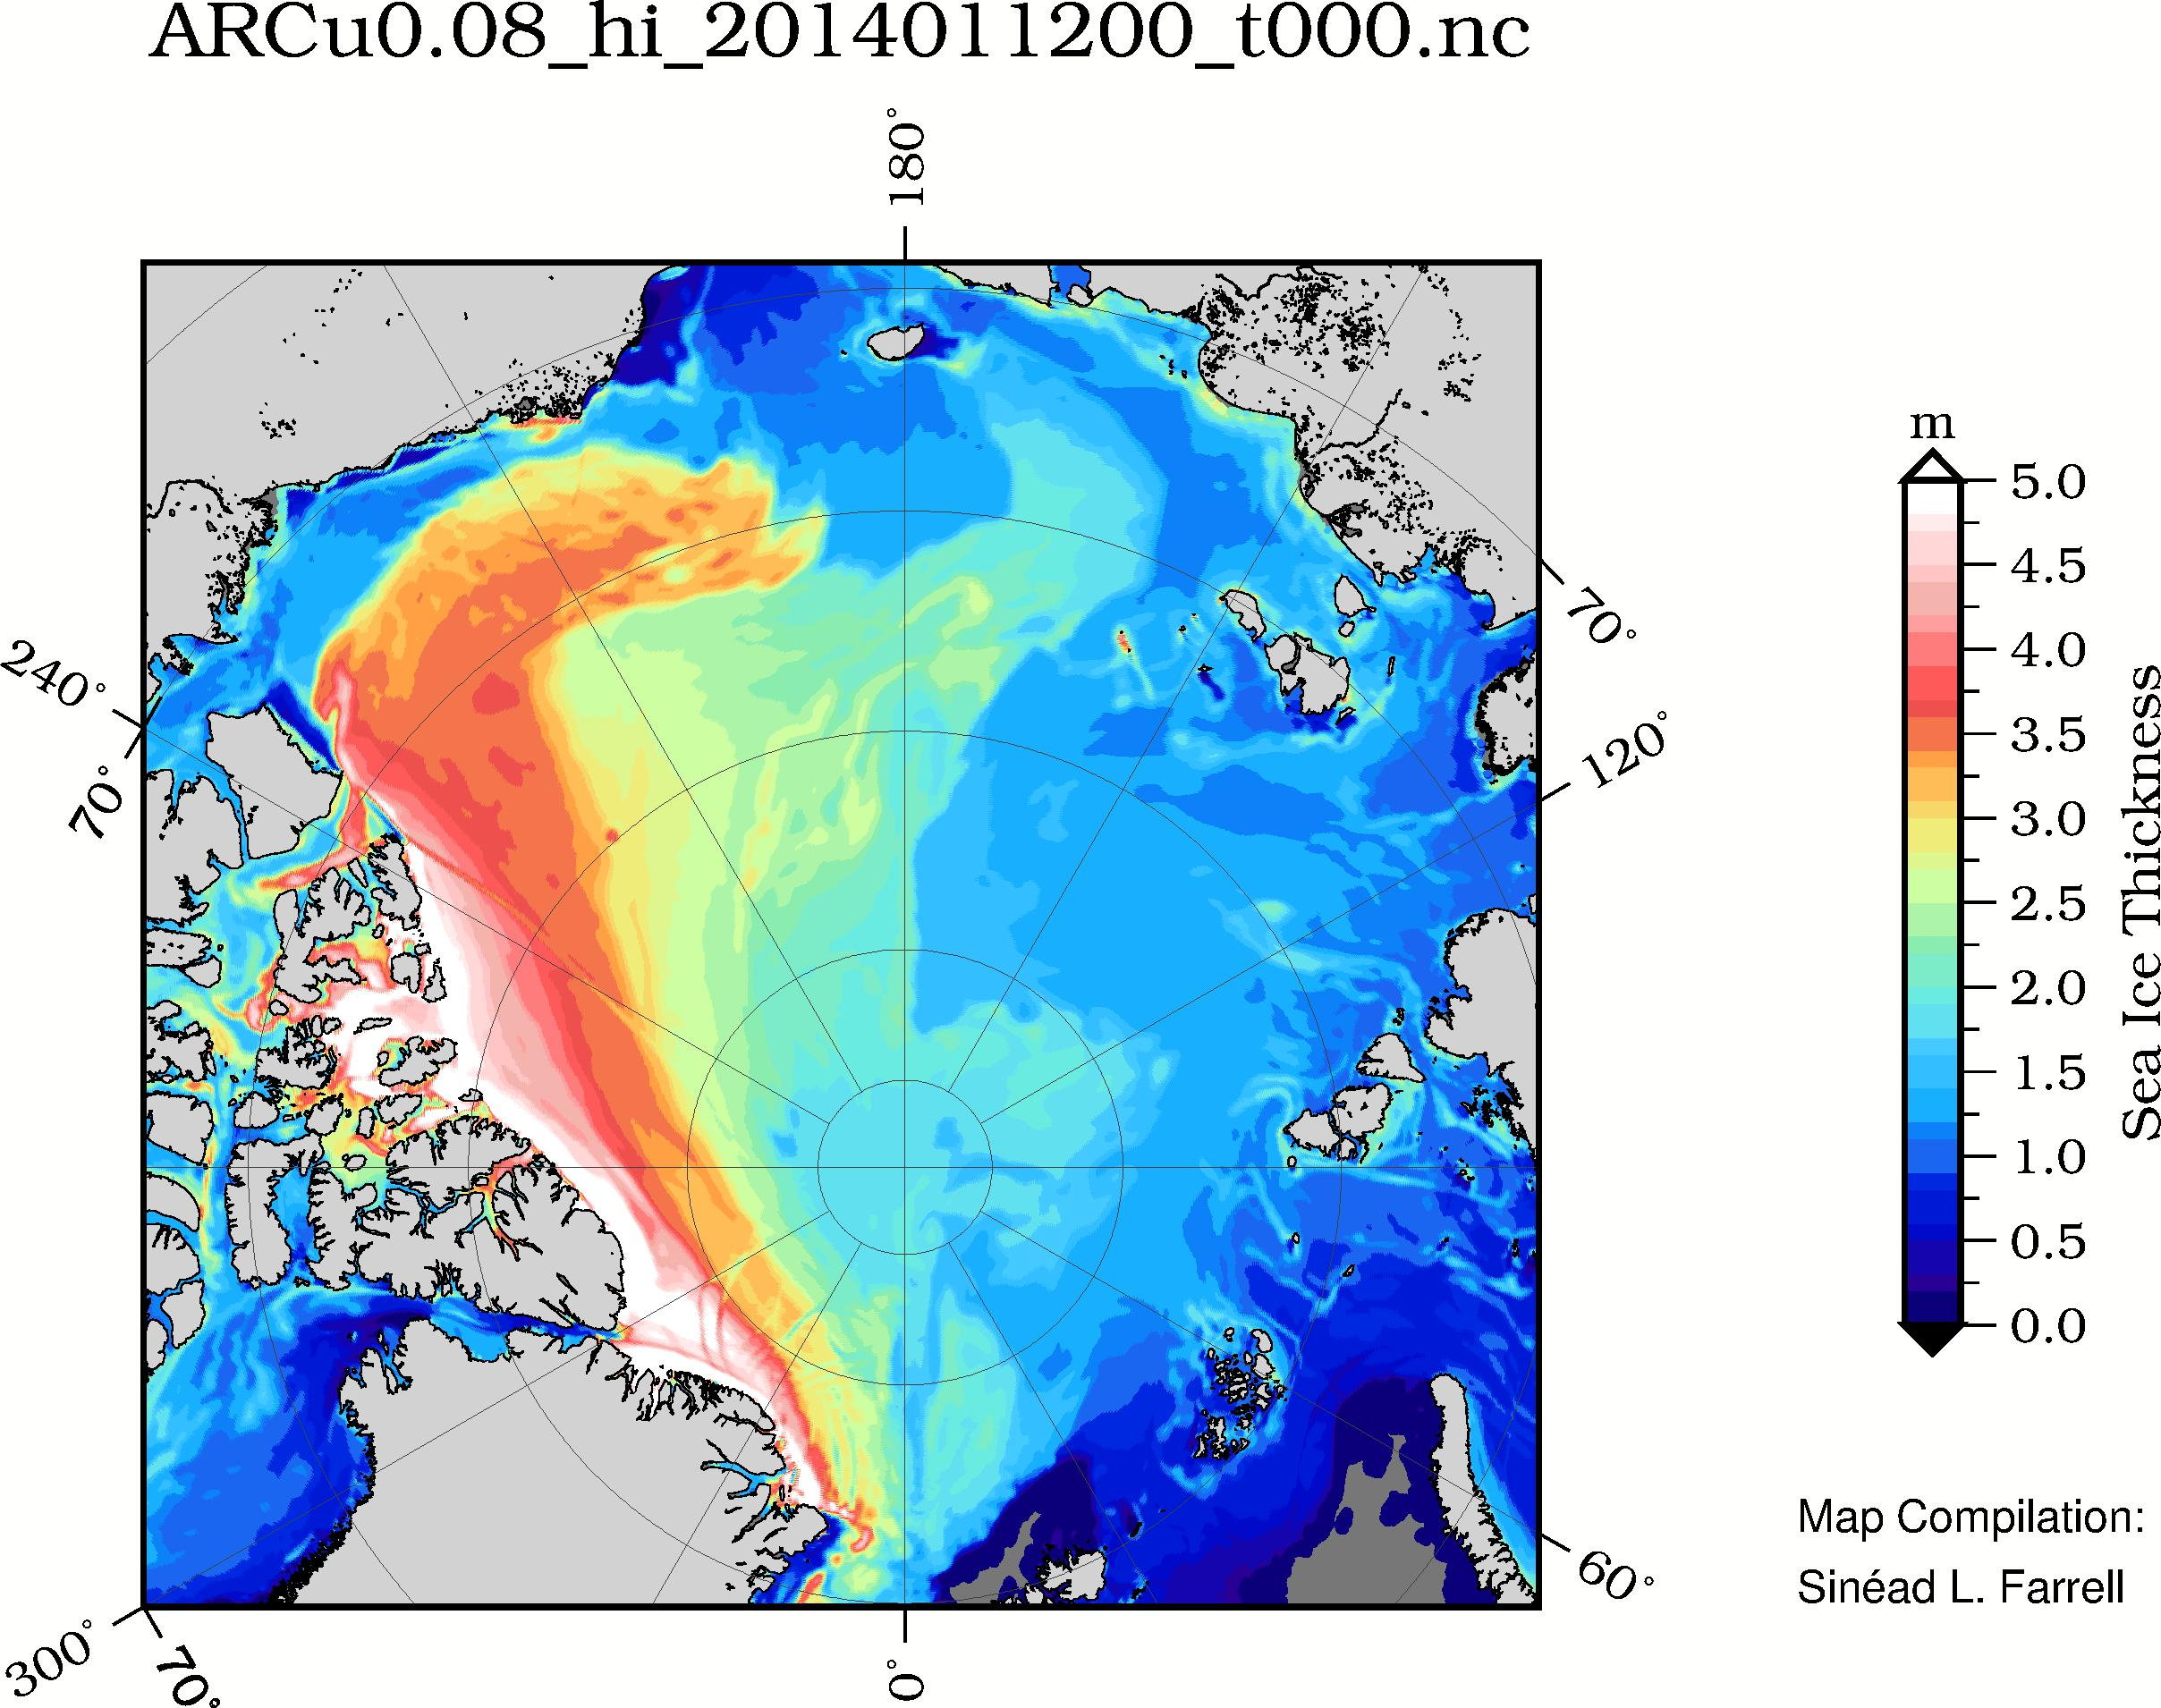
ACNFS Ice Thickness – NRL Stennis
January 2014
Thanks to P. Posey, R. Allard, et al., NRL-Stennis

Slide 17
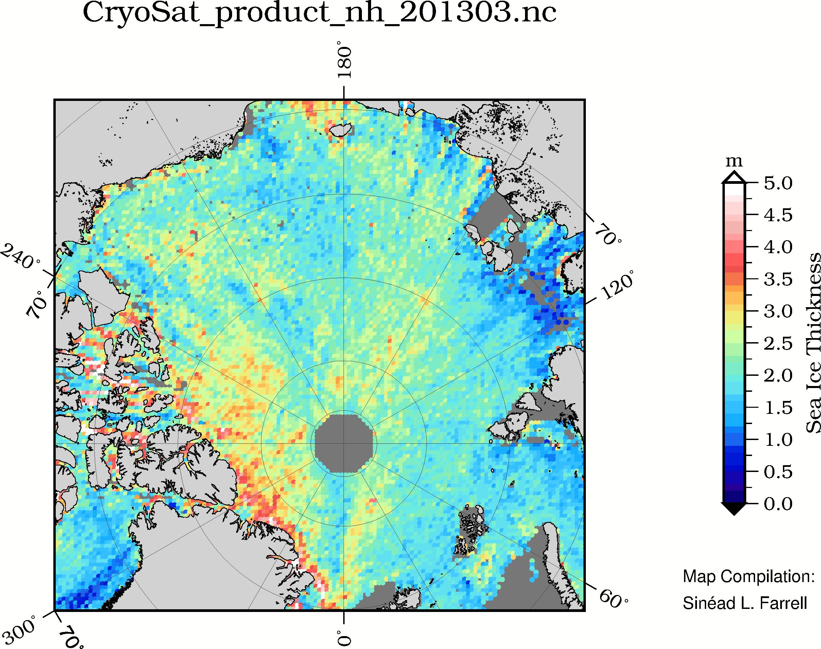
AWI Sea Ice Thickness – CryoSat-2
March 2013
http://www.meereisportal.de/de/datenportal/karten_und_datenarchiv/

Slide 18
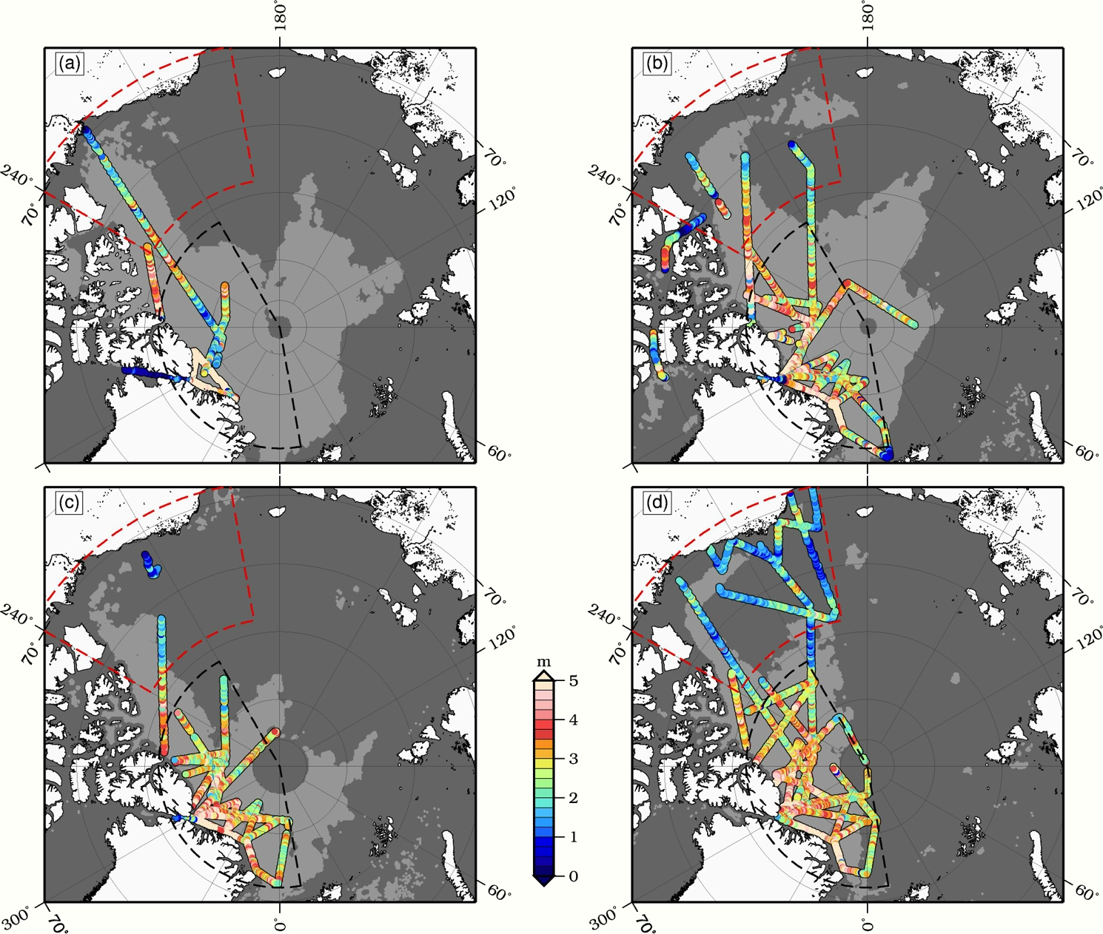
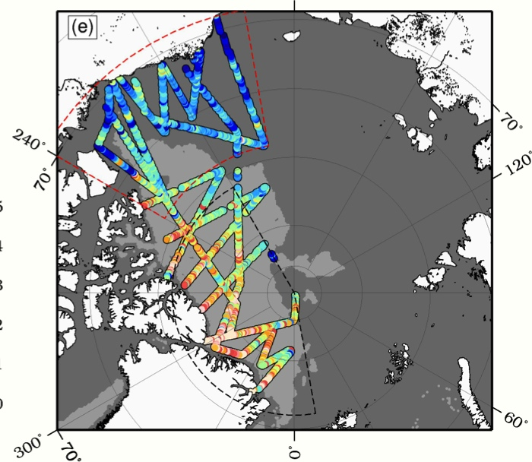
OIB Sea Ice Thickness in the Western Arctic: 2009 - 2013
IceBridge coverage limited (spatially & temporally)
Thickness gradient from Alaskan coast towards northern Greenland
Regional analysis:
Central Arctic (Black dash)
Beaufort Sea (Red dash)
2009
2010
2011
2012
2013
From: Richter-Menge and Farrell (2013), GRL
Sinéad Louise Farrell

Slide 19
Field Activities

Slide 20
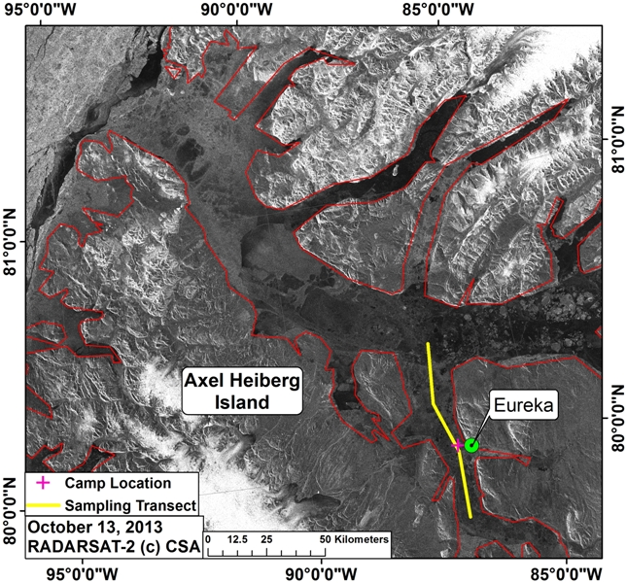
Environment Canada

Slide 21
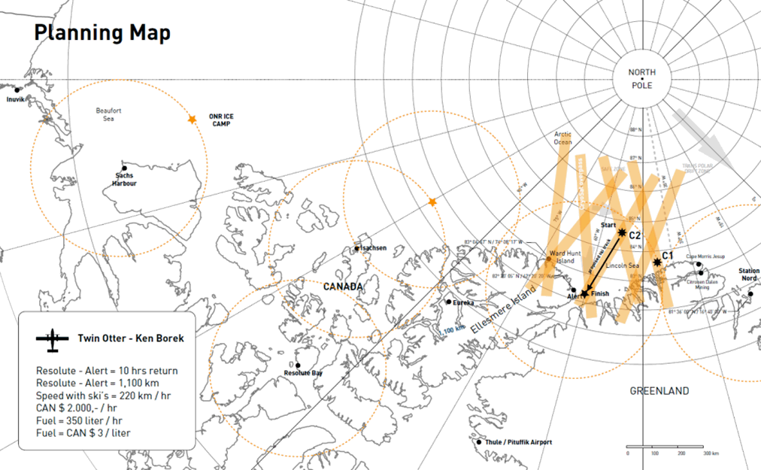
ESA CryoVex: 25 March - 1 April, 2014

Slide 22
Locations and logistics
ONR and ESA CryoVex
ONR ice camp in Beaufort Sea
March 15-21 at 73N, 135W, out of Inuvik and Sachs Harbor
Up to 6 people
ONR logistics
Will include several remote sites visited for few hours
ESA expeditionary ice camps north of Ellesmere Island
March 23-April 5
6 people + 2 camp managers
Survey flights over both regions by ASIRAS and EM Bird, coordinated with OIB
Transportation between Inuvik and Alert by Basler aircraft (Kenn Borek – KBAL)

Slide 23
ONR MIZ Ice Camp
Camp 4: March 21
4
Camp 3: March 20
3
NASA/ESA Team
arrives at
Sachs Harbor 14 March2014
~180 – 225 NM to Sachs
NASA/ESA@ Camp 2: March 15-20
2
40 nm
1
2 NM
11 NM
= Twin Otter deployments
= Helo deployments

Slide 24
ONR MIZ Ice Camp
NASA/ESA field party: 4-6 people
12 March: Arrive in Inuvik
14 March: Arrive Sachs Harbor via Twin Otter
15-21 March: Deploy to ice camp, returning to Sachs on 21 March
22 March: Transition to Resolute
Equipment: Yellowknife: NLT 15 Feb 2014
Aircraft:
Commercial High Capacity Cargo (e.g., Hercules, Buffalo): Two flights from Yellowknife to Sachs Harbor for transport of equipment and fuel
Twin Otters: Transport of equipment, fuel and personnel, runway scouting, and well possible science missions.
Helicopter (Bell 412 or 212): Deploy instrumentation
Ground based operations: NASA/ESA
Snow machines
Sleds
Power (camp dedicated): 1 Honda 2KW generator at each mini-camp
Safety:
Radios: 4 provided
Polar bears: watch, dogs, guns

Slide 25
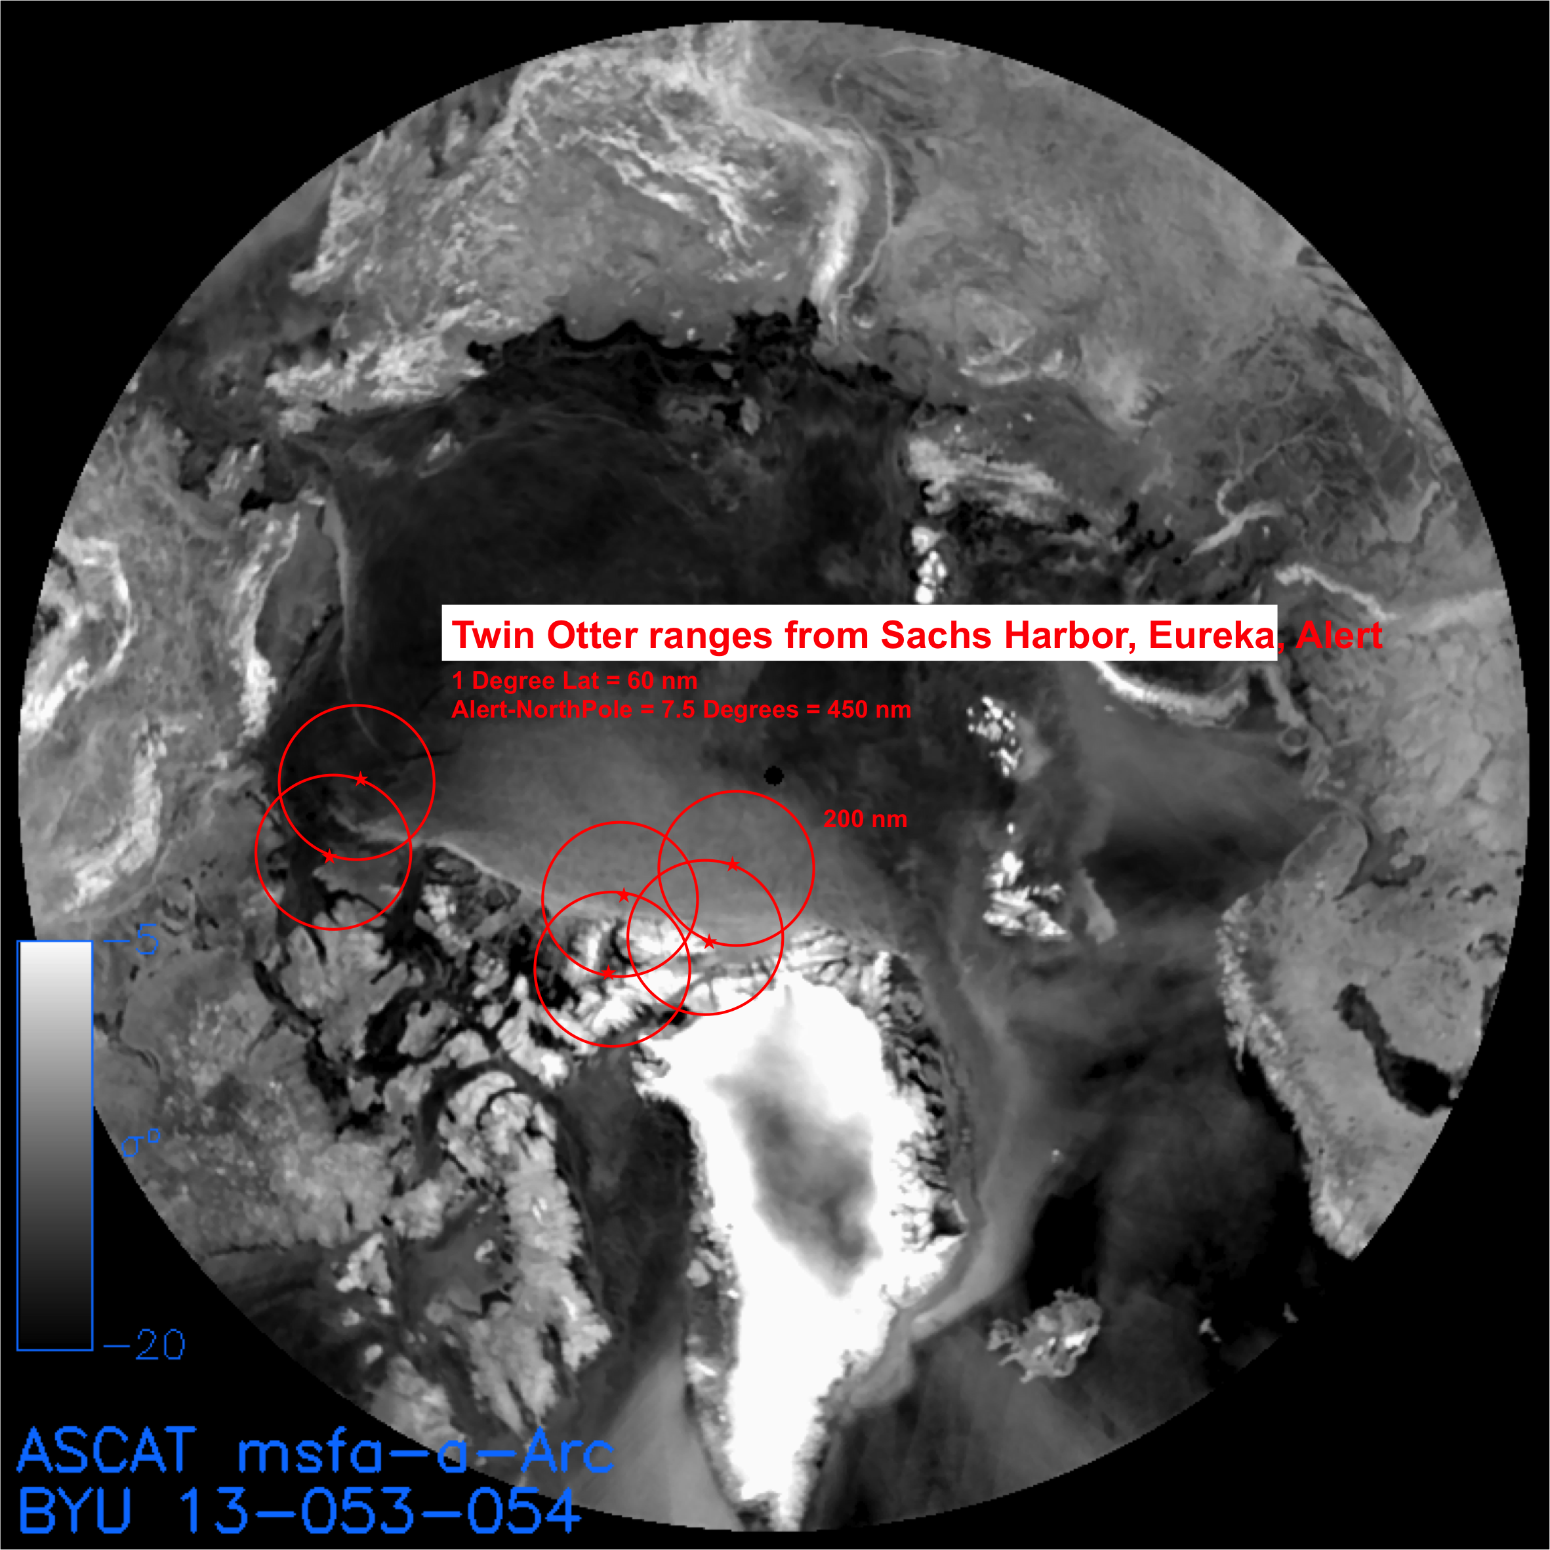
ESA CryoVex

Slide 26
Previous IceBridge Flight Campaigns

Slide 27
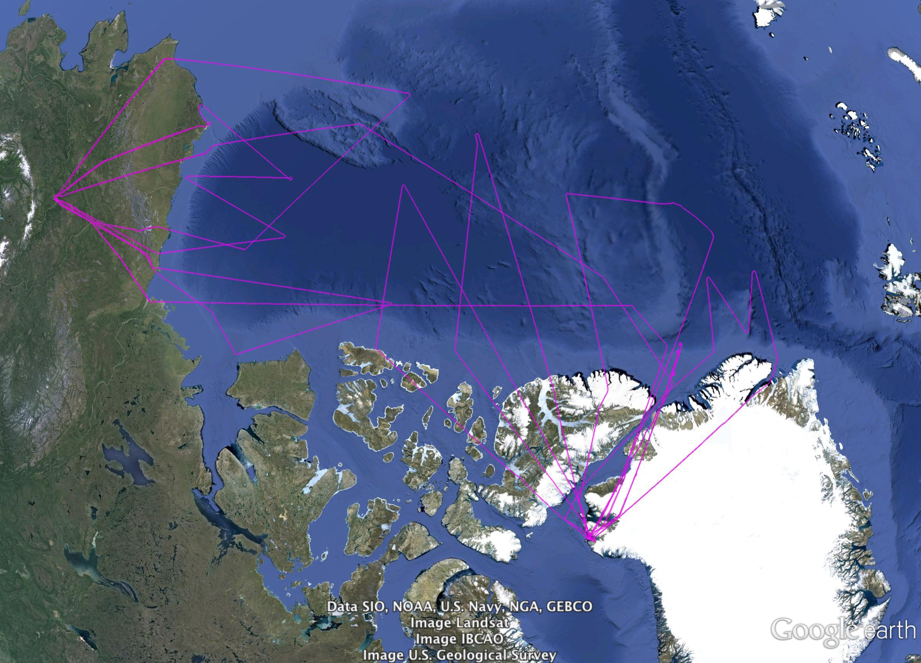
2013

Slide 28
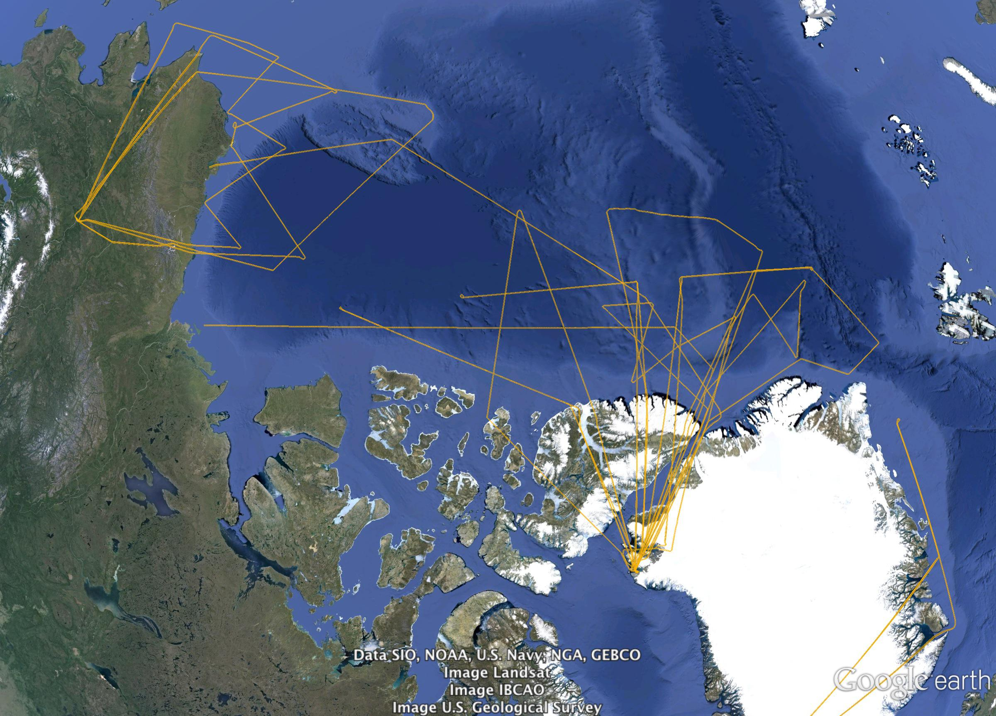
2012

Slide 29
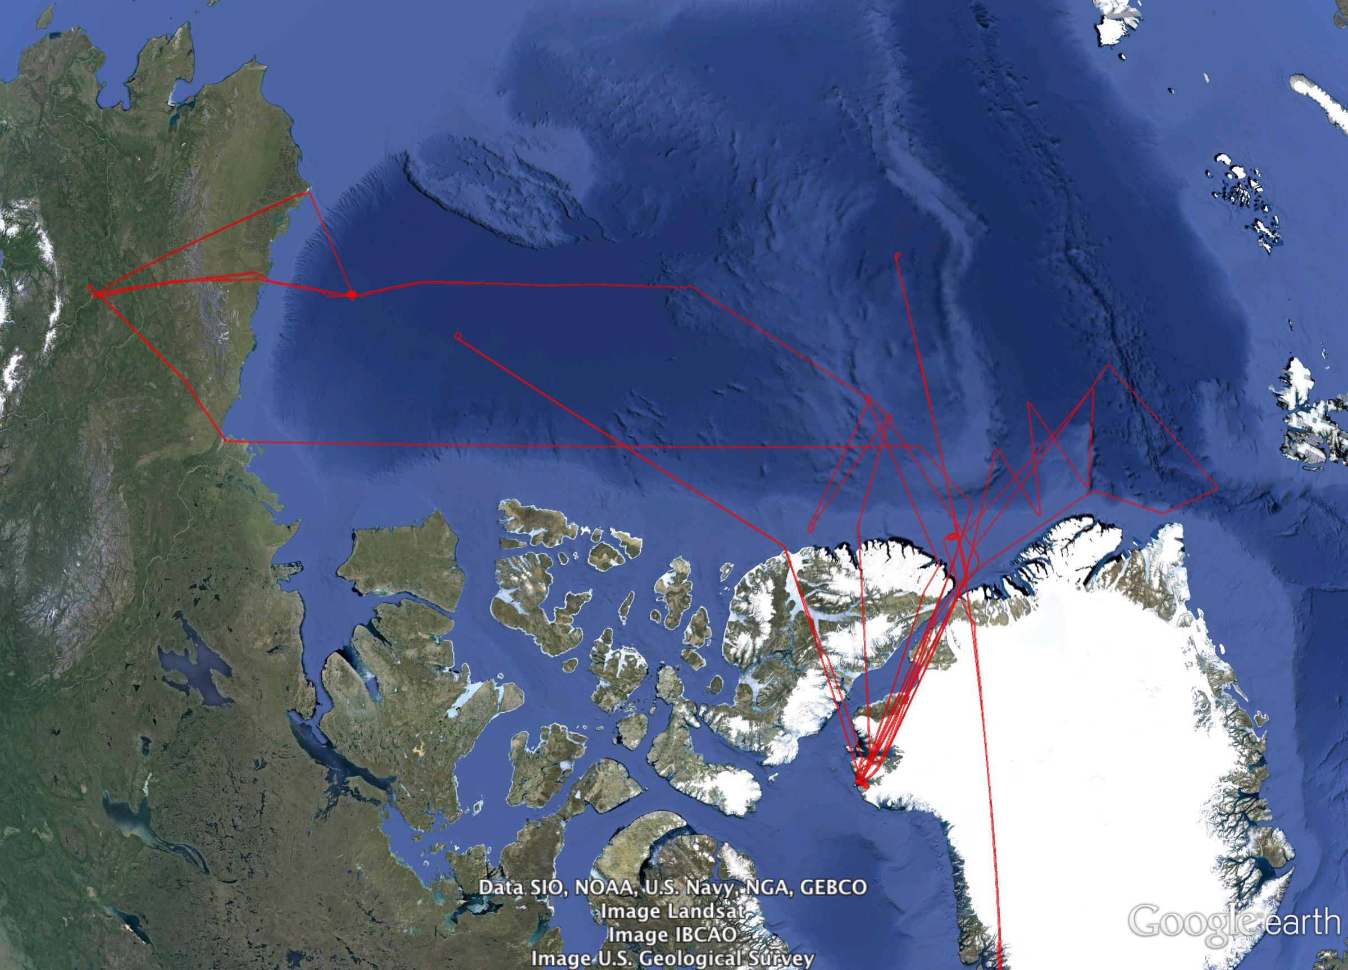
2011

Slide 30
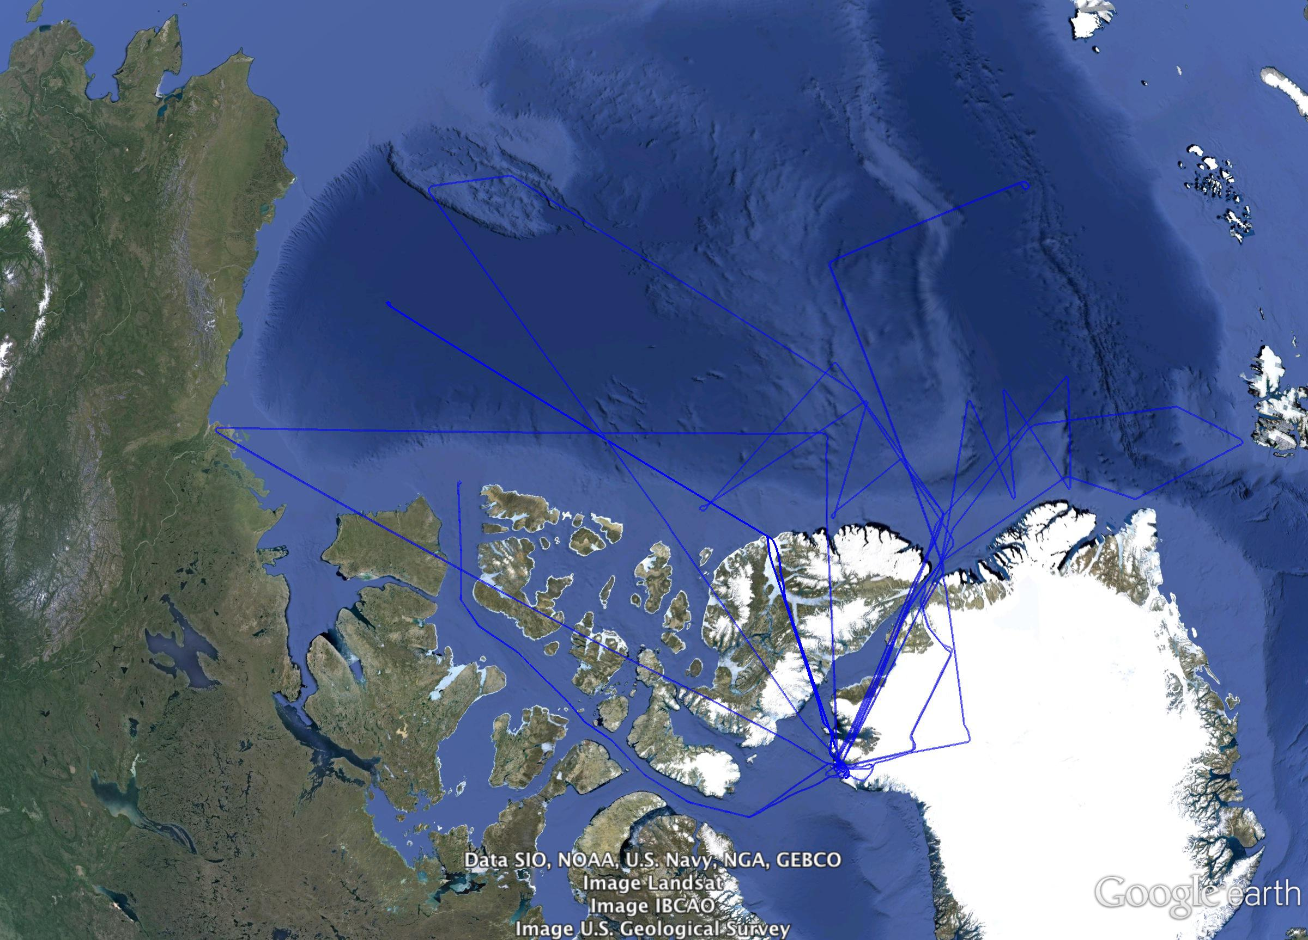
2010

Slide 31
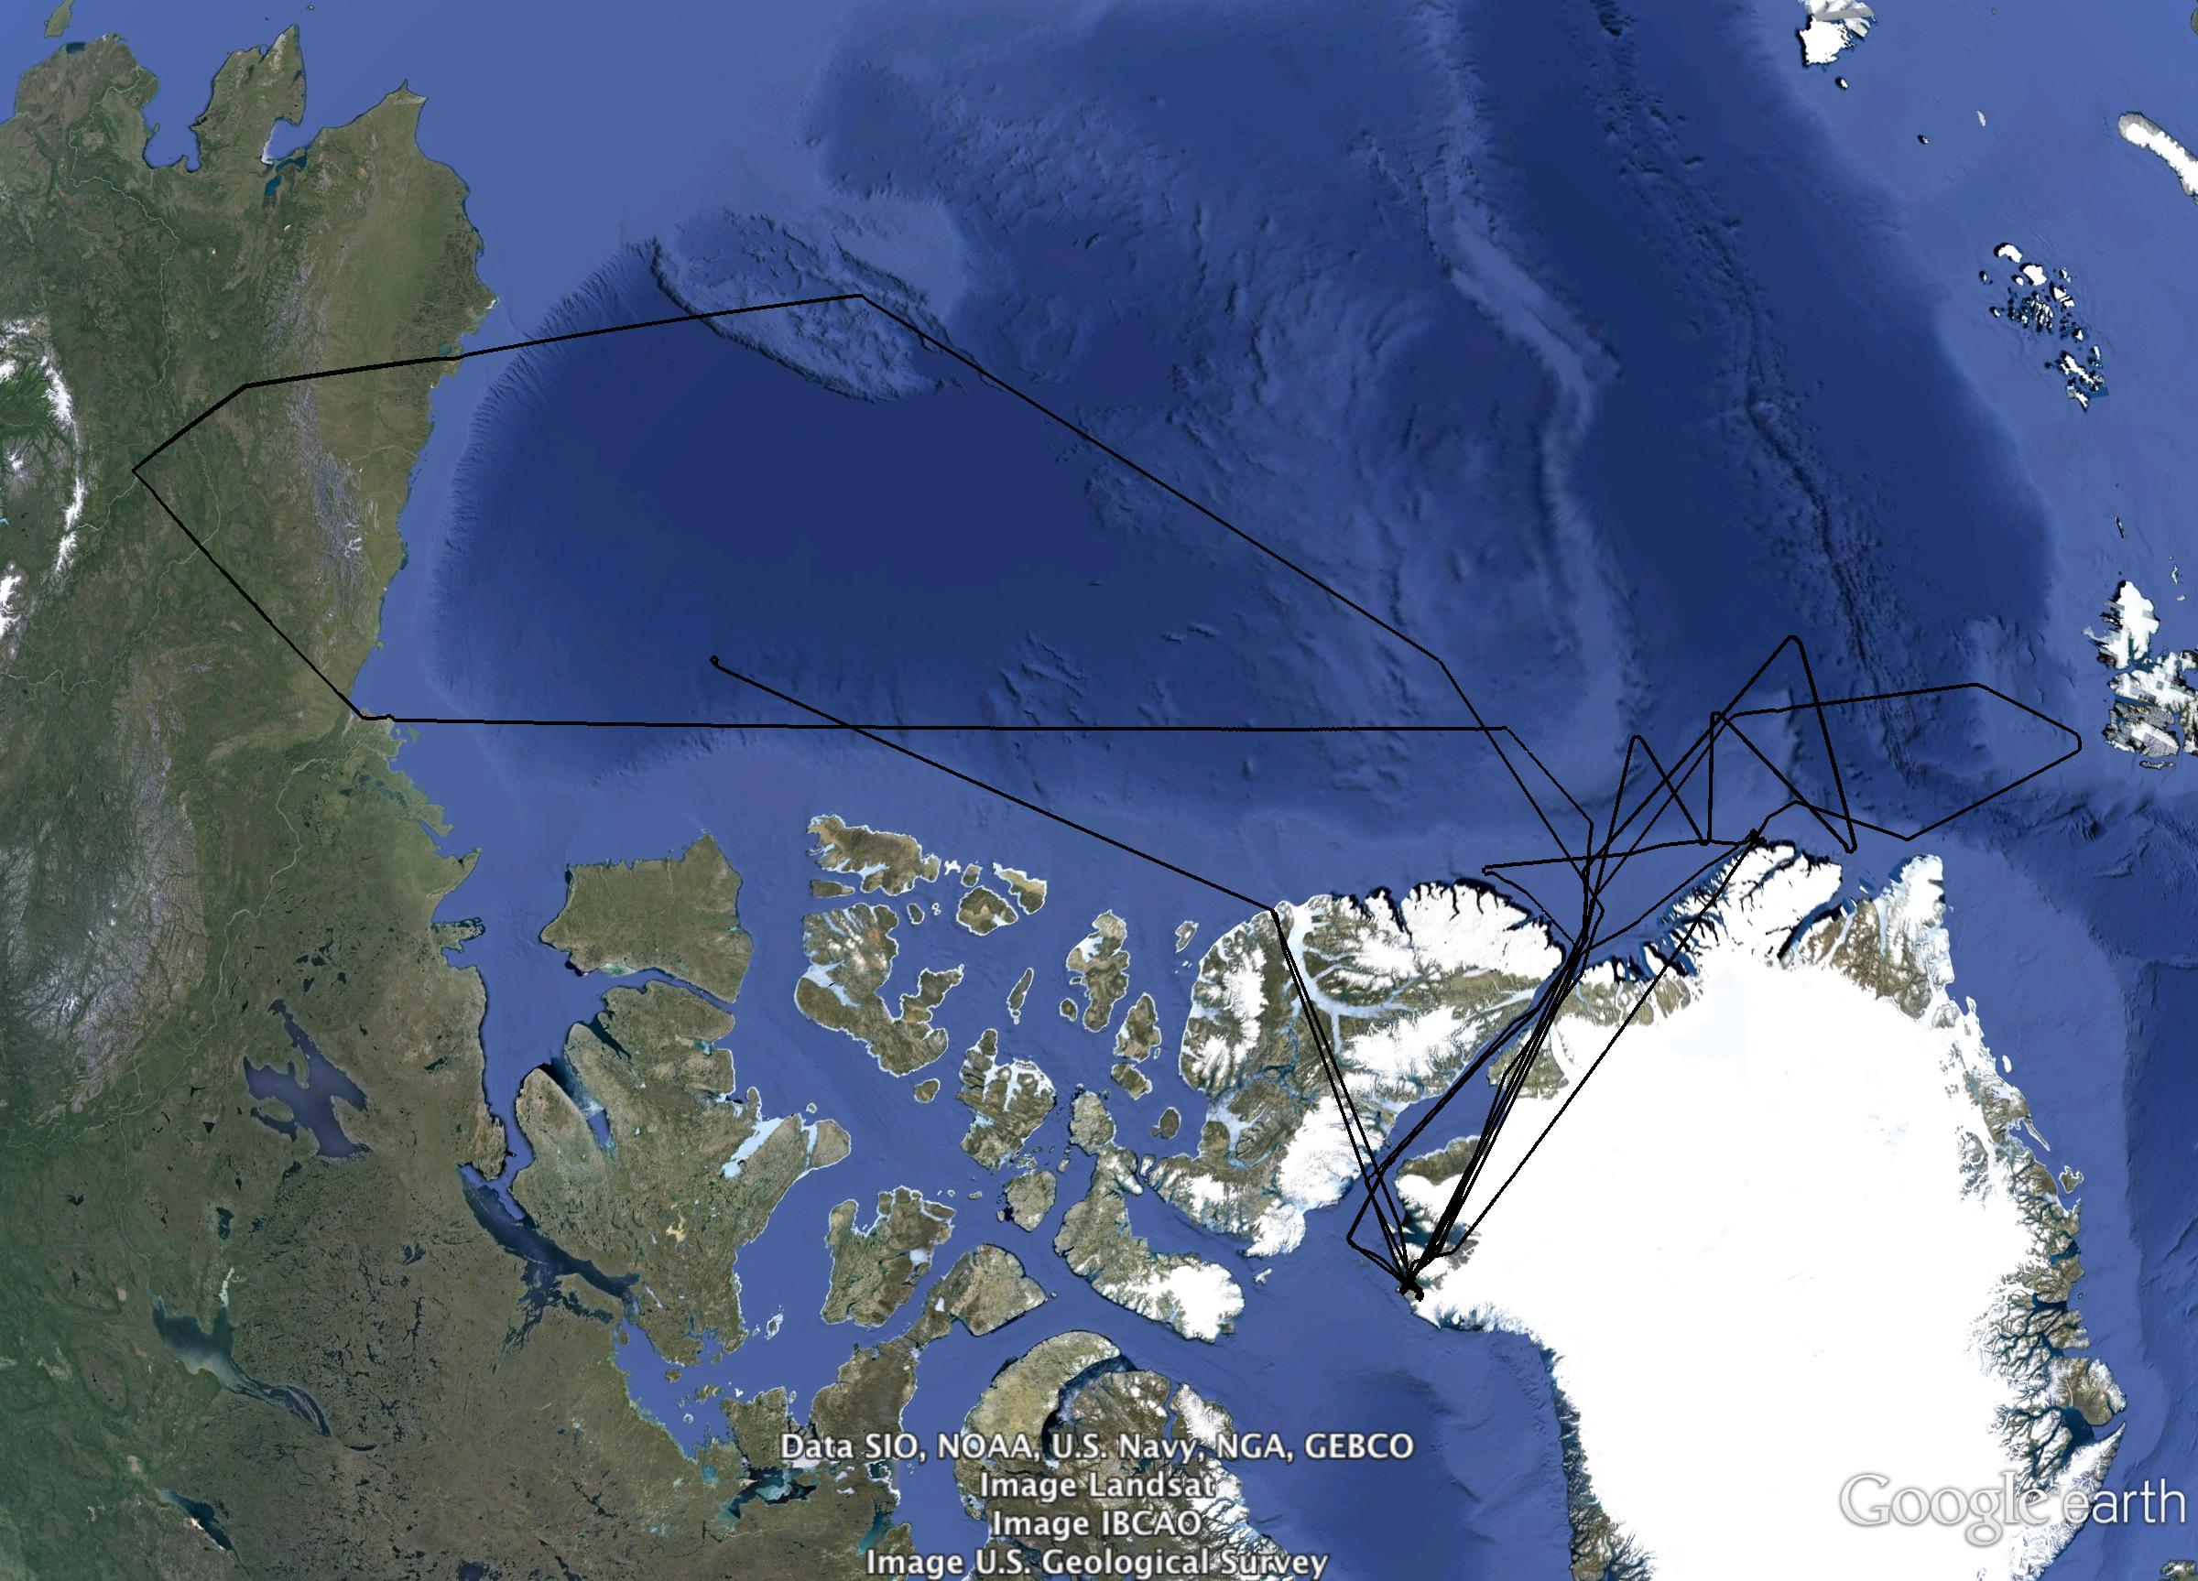
2009

Slide 32
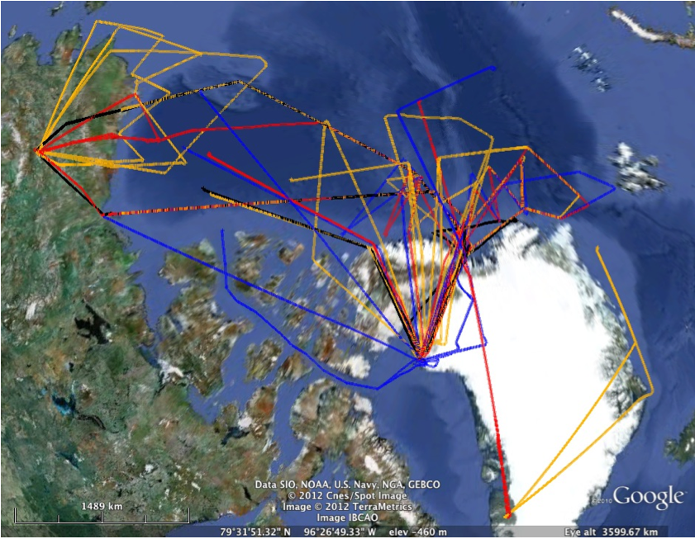
Flight Lines : 2009 - 2012

Slide 33
LVIS Summer 2013

Slide 34
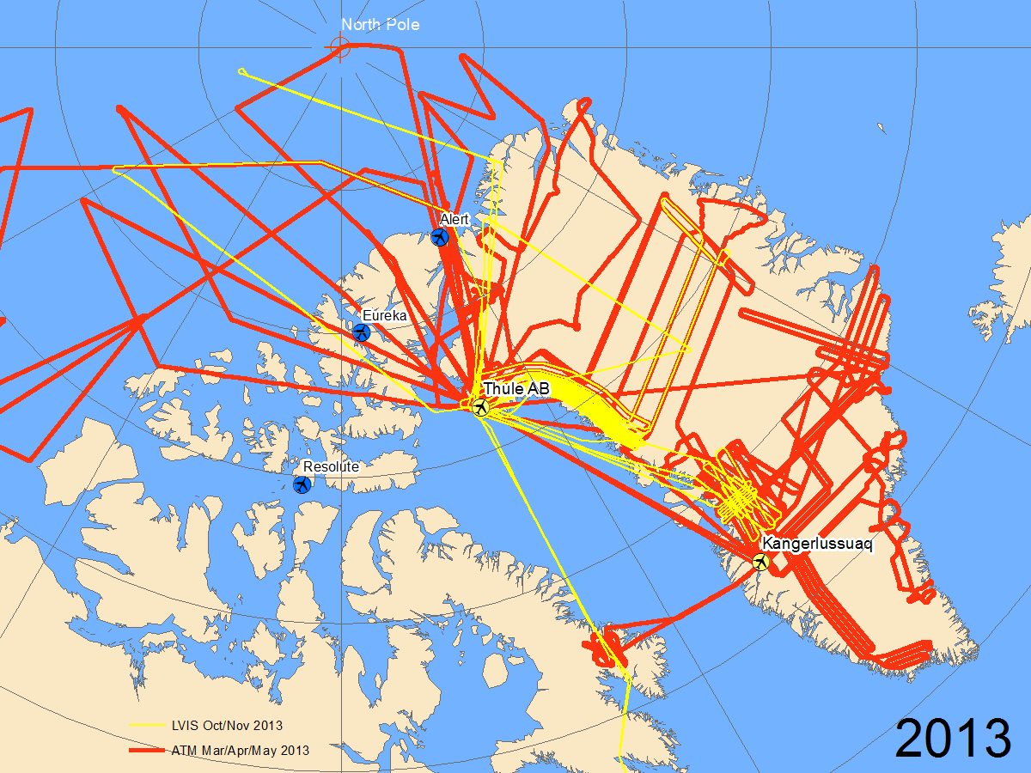

Slide 35
Back Up Slides

Slide 36
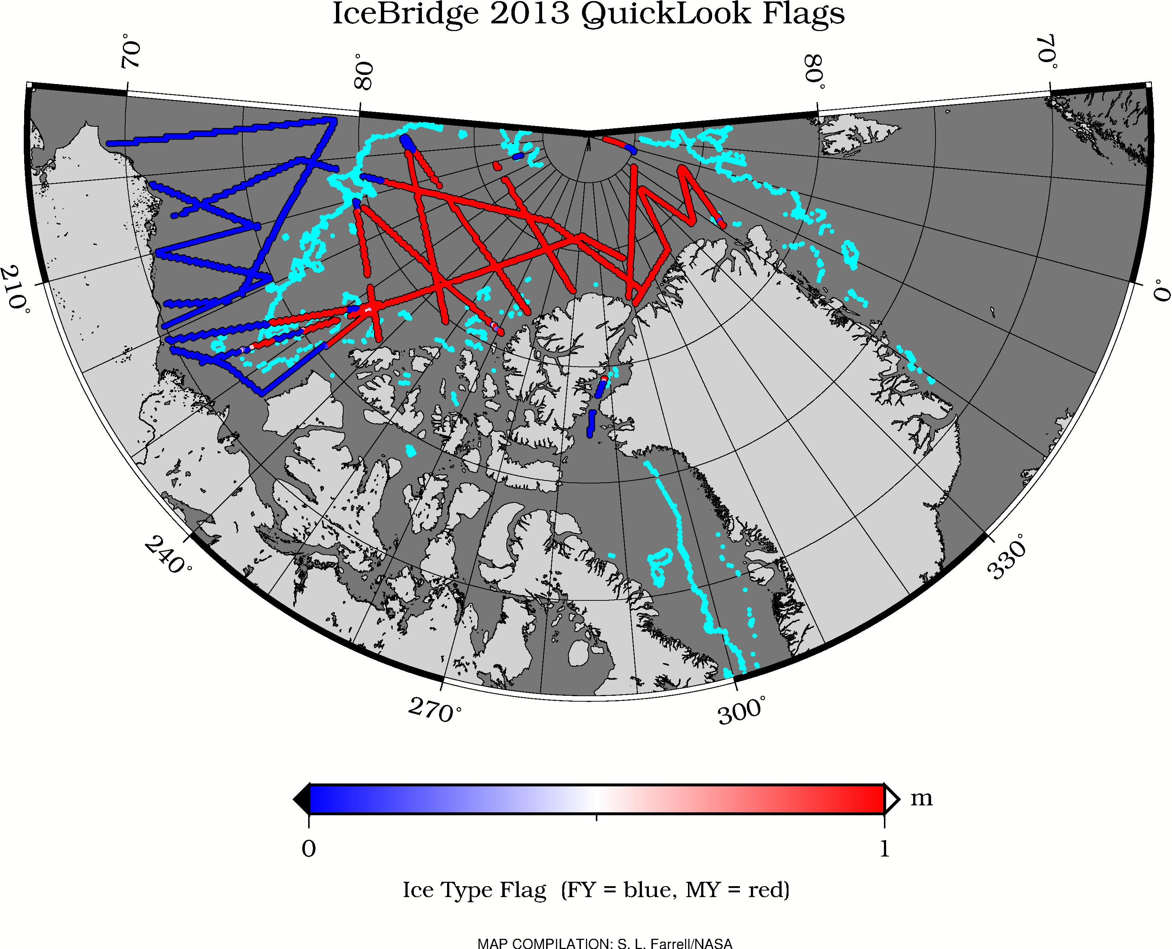
2013 IceBridge Flight Lines – MY ice (red); FY ice (blue)
Ice Type Mask 24 Mar 2013 (cyan)
Map Compilation: S. L Farrell

Slide 37
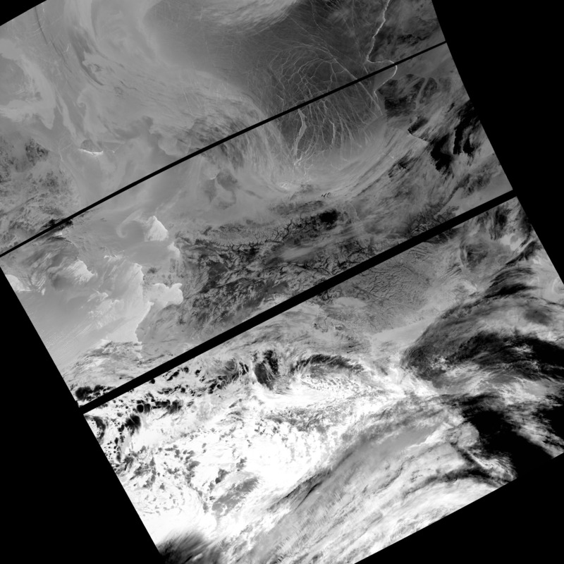
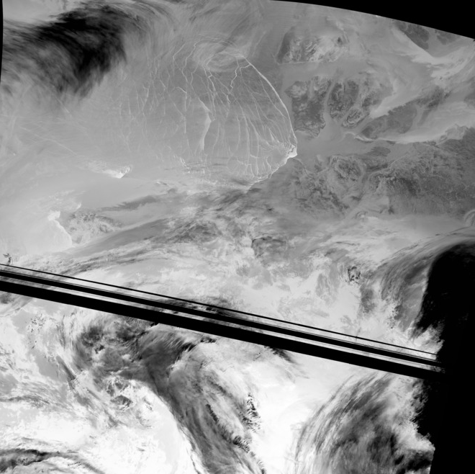
SNPP I05/VIIRS (GINA)
2014-01-12 21:54 UTC
2014-01-06 12:12 UTC
Banks Is
Banks Is
Pt. Barrow

Slide 38
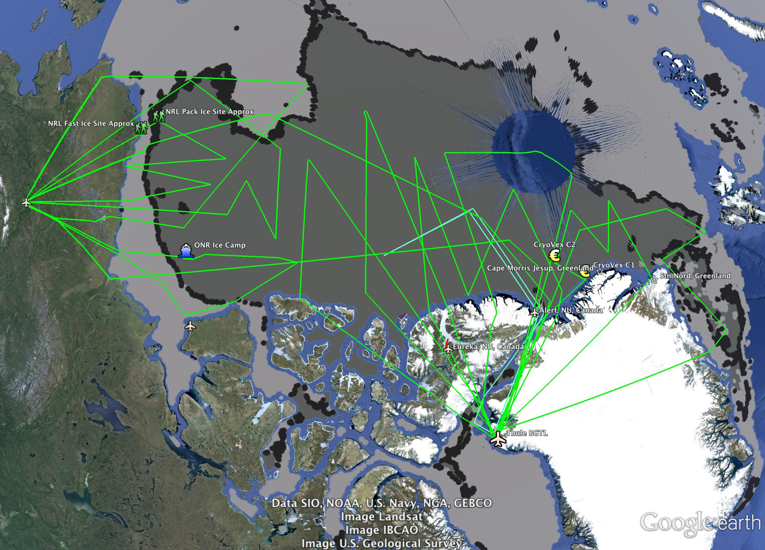
2014 Draft Sea Ice Flight Plan
Jan 2014 OSI-SAF Ice Type

Slide 39
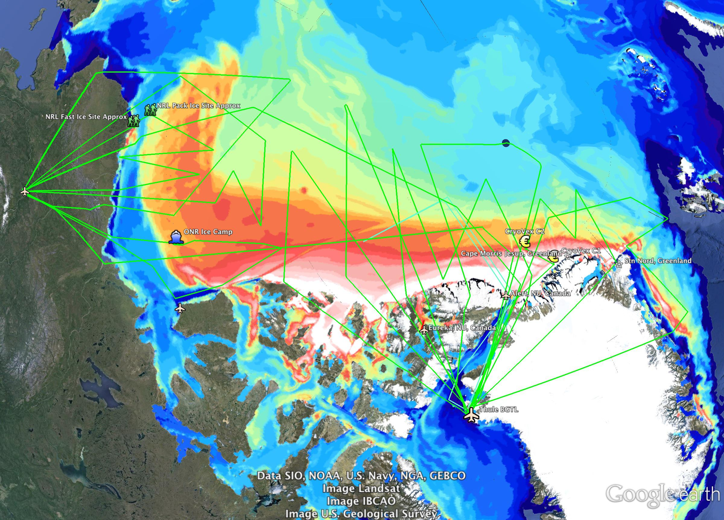
2014 Draft Sea Ice Flight Plan
Jan 2014 ACNFS Ice Thickness

Slide 40
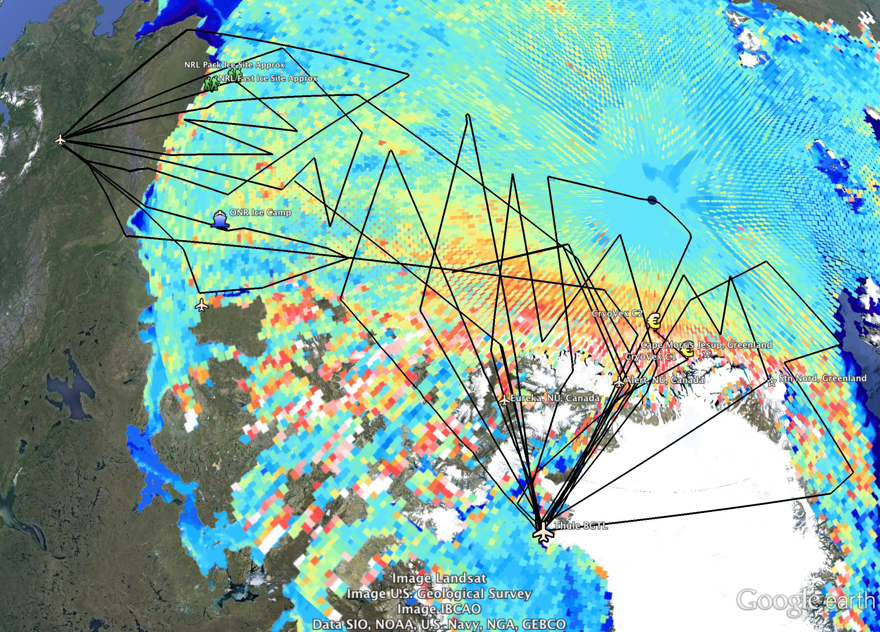
2014 Draft Sea Ice Flight Plan
Mar 2013 CryoSat-2 Ice Thickness (AWI)
Notes:
Same as slide 3, but with CS-2 ice thickness from AWI group.

