Slide 1
Subsurface scattering bias:
  Green-light altimetry can have a bias due to photons scattering many times below the surface before returning to the satellite
  Bias depends on grain size and impurity content
  Modeling shows the bias, data mostly don’t exist
  Two-wavelength ATM will help – but where and o

Slide 2
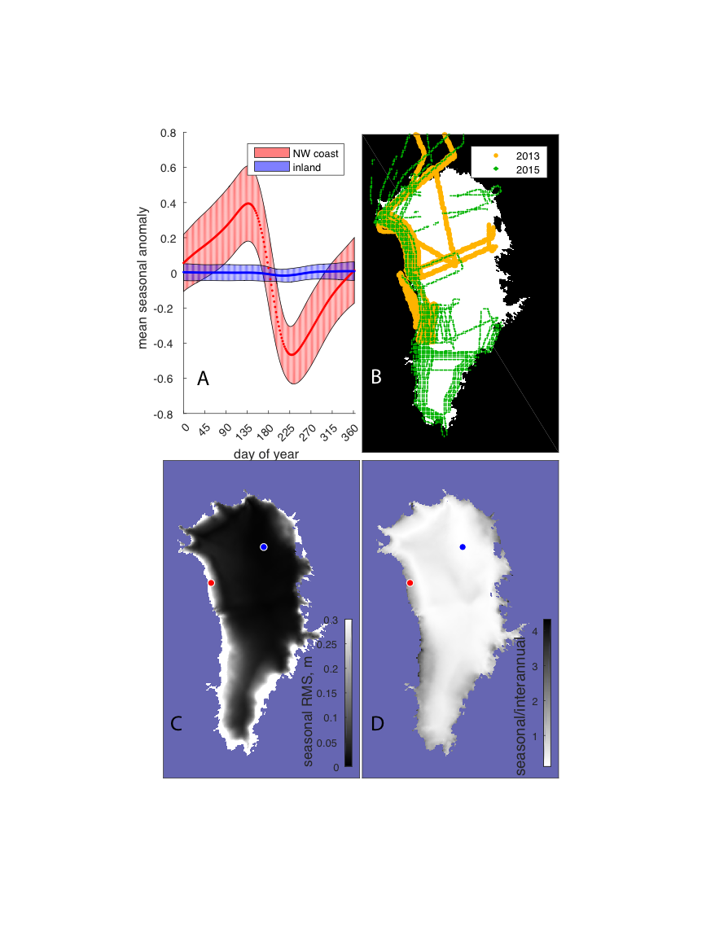
Seasonal differencing all time time/everywhere from ICESat-2, soon
Where should we begin the time series?
How do the measured signals relate to modeled signals? Where to we fly to calibrate the models?

Slide 3
Gridded dh estimates
Existing software can generate annually-resolved, gridded elevation-change estimates
How/when should we distribute these?

