Slide 1
CReSIS Radar Modifications
Spring 2017 and future
OIB Science Team Meeting
Jan 2017 GSFC

Slide 2
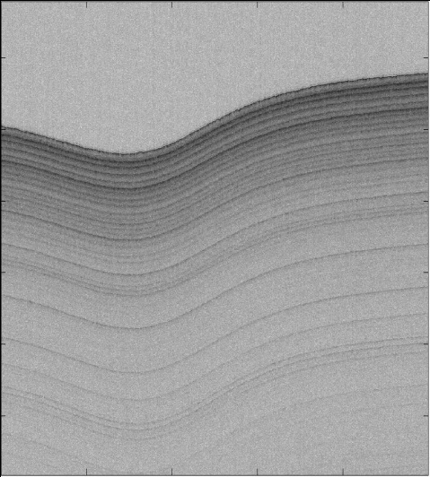
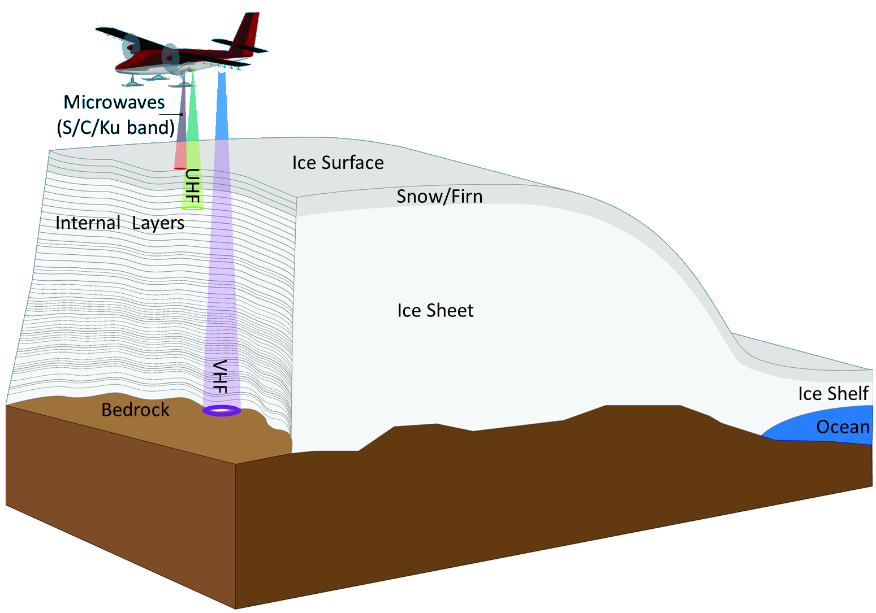
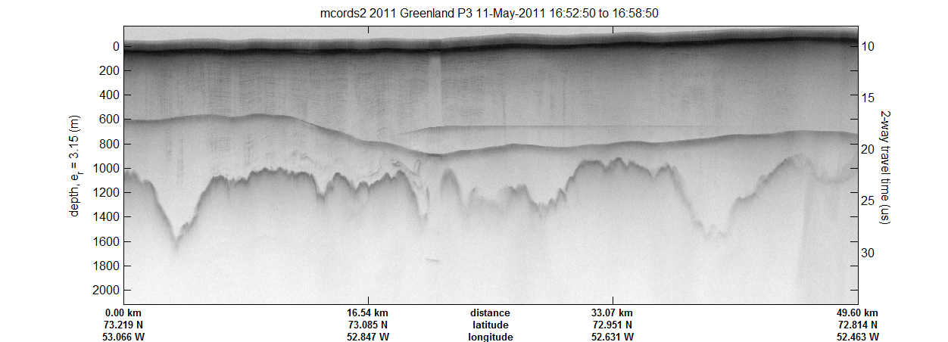
Radar Sounding/Imaging
Instruments operating from HF to Ka

Slide 3
Radar Sensors
Radars that cover frequencies from 14 MHz to 38 GHz
Investigate entire ice sheet at very fine resolution at the surface and
progressing to coarser resolution with deeper sounding capabilities.
Instrument | Measurement | Freq./ Wavelength | BW/ Res. | Depth | Power | Altitude | Antenna | Installs
HF Sounder | Ice Thickness Bistatic | 14 MHz 35 MHz 10,20m | 1/5 MHz 20 m | 4 km? | 50 W | 1500 ft | Integrated | In-situ/UAS
MCoRDS/I Radar Depth Sounder | Ice Thickness Int. Layering Bed Properties | 195 MHz 1.5 m | 30 MHz 4 m | 4 km | 800 W | 30000 ft | Dipole Array Wing Mount Fuselage | Twin-Otter P-3/DC-8/ C-130
UWB | Ice Thickness Int. Layering Bed Properties | 150 to 600 MHz .5-2 m | 450 MHz 30 cm | 3 km | 800 W | 10000 ft | Wing Mount Fuselage | Basler
Accum. Radar | Internal Layering Ice Thickness | 750 MHz 40 cm | 300 MHz 40 cm | 300 m | 10 W | 20000 ft | Patch Array Vivaldi Array | Twin-Otter P-3
Snow Radar | Snow Cover Topography Layering | 5 GHz 7.5 cm | 6 GHz 4 cm | 80 m | 200 mW | 4000 ft | Horn | P-3/DC-8 Basler/ C-130
Ku-Band | Topography Layering | 15 GHz 2 cm | 6 GHz 4 cm | 15 m | 200 mW | 4000 ft | Horn | Twin-Otter P-3/DC-8 Basler/C-130
Ka-Band | Topography | 35 GHz ~1cm | 6 GHz 4 cm | 1 m | 200 mW | 4000 ft | Horn | C-130

Slide 4
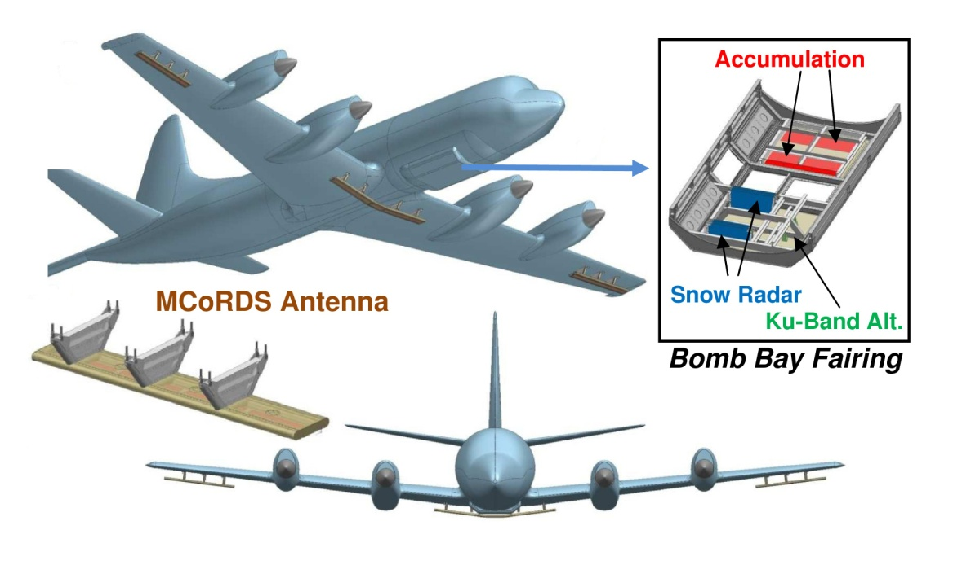
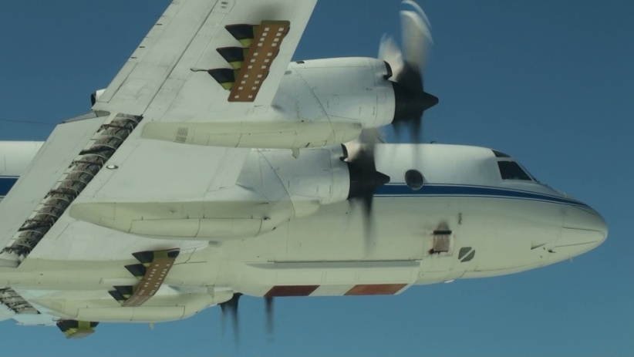
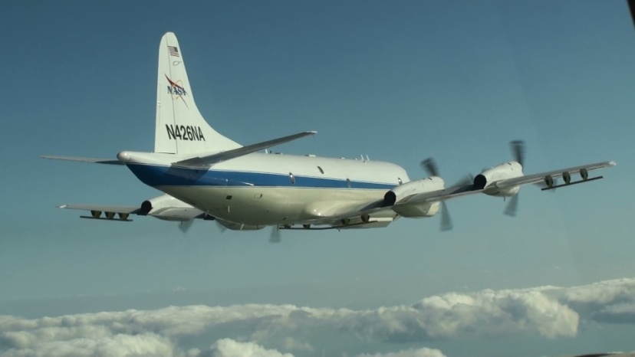
Original P-3 Installation
First flown in Spring 2010.
Instrument configuration included MCoRDS/I, Accum, Snow, Ku Band Radars.
Improvements in sensitivity, power, and bandwidth since initial flight.
This seasons instruments involve major changes to Accum and FMCW systems and minor additions to MCoRDS/I.

Slide 5
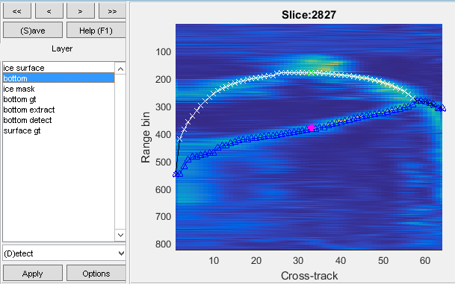
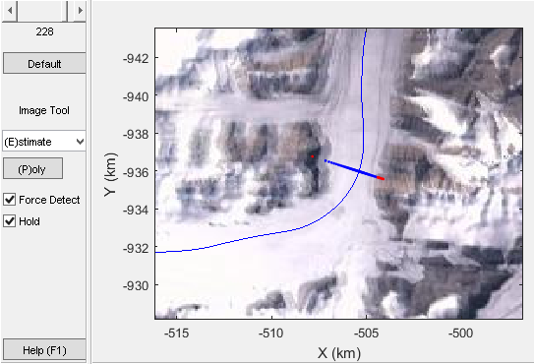
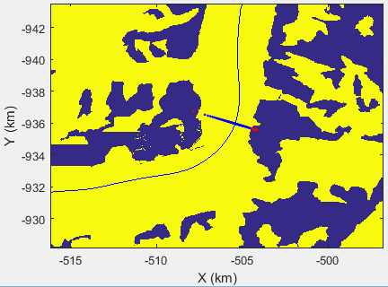
3D Imaging: Progress
Above: results from 3 individual beams.
Below: Screen shot from quality control tools for 3D imaging.
Processing: Jordan Sprick, Sravya Athinarapu, Mohanad Al-Ibadi
Optimization and Computer Vision: David Crandall, Mingze Xu

Slide 6
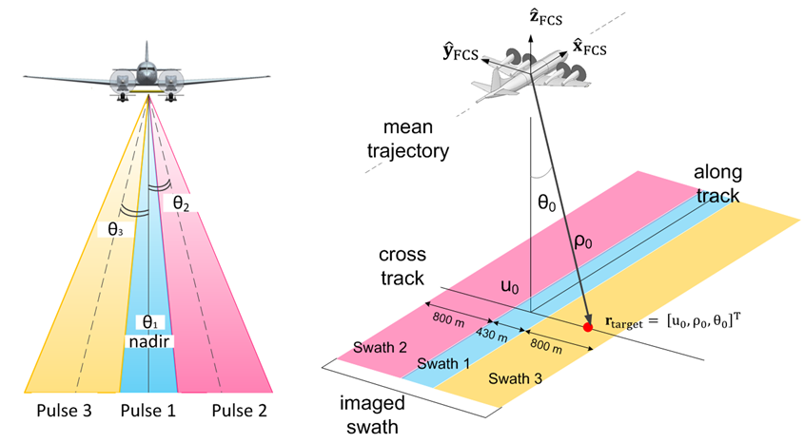
3D Imaging: Observations
Current 3D Efforts:
Automation of surface tracking and improving array processing algorithms.
Wing flexure measurements.
Wideband array processing.
2 and 3 are needed to take the best advantage of the three P-3 antenna arrays.

Slide 7
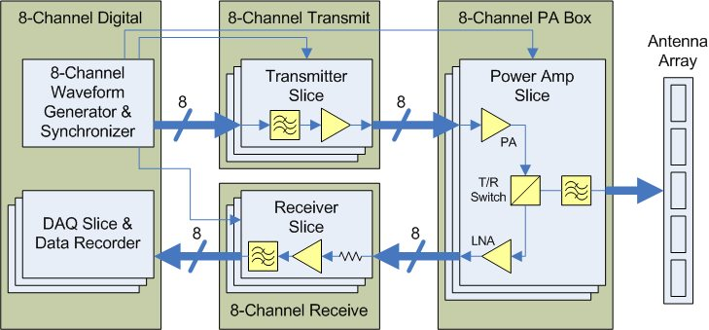
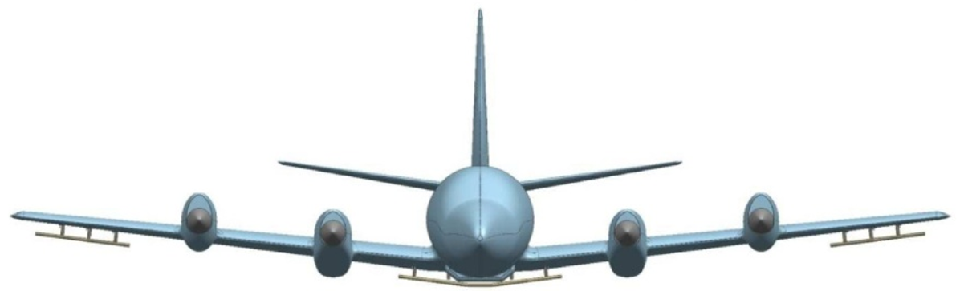
MCoRDS/I Modifications
Array element cross calibration shows additional movement other than measured attitude changes.
Wingtip GPS receivers to measure wing flexure.
Increase PA outputs to approx. 500W per channel on the center array.

Slide 8
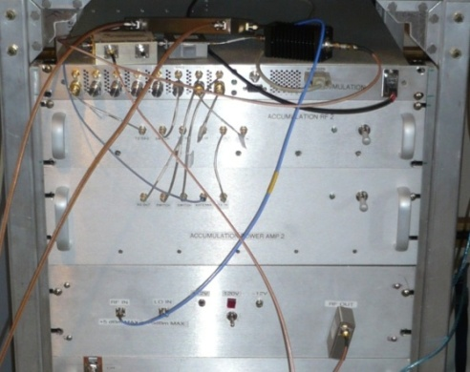
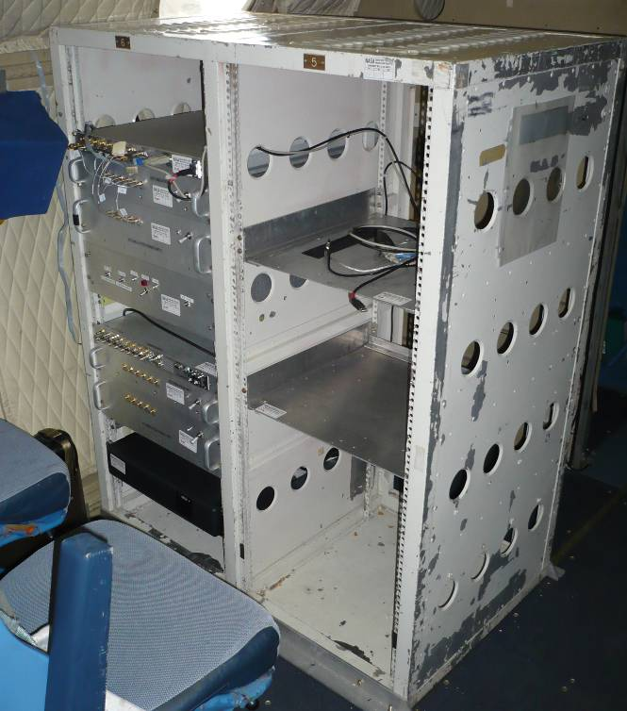
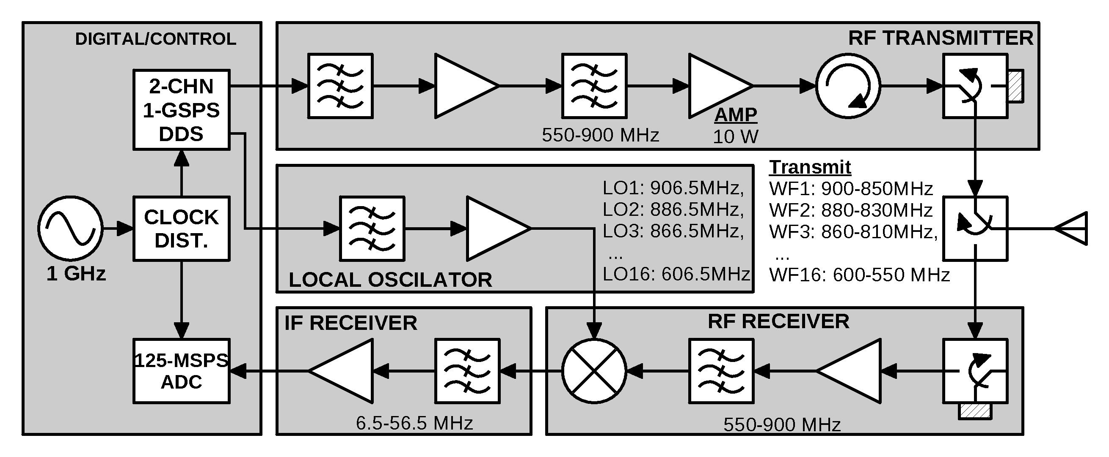
Accumulation Radar
Limitations (Previous System).
  Limited Power Output ~10W total.
  Record window limited achievable observation depth.
  Single Waveform (~2us).
C-130/NOAA P-3 used the new UWB System.
  Based on MCoRDS Design with increased bandwidth.
  Has the necessary bandwidth: 150-450.
Modification for Spring 2017.
  Use this hardware at the Accum frequencies (600-900 MHz).
  Up to 50W output per channel and sufficient range window.
  Multiple waveforms for near surface and deep sounding.
  Independent receive elements for array processing.

Slide 9
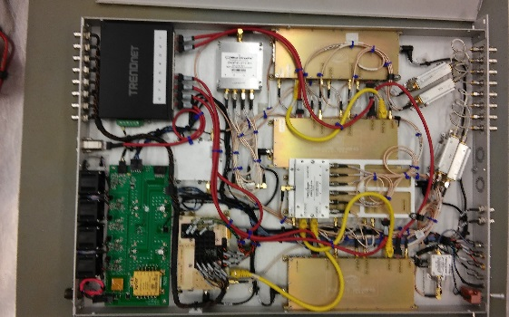
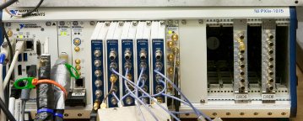
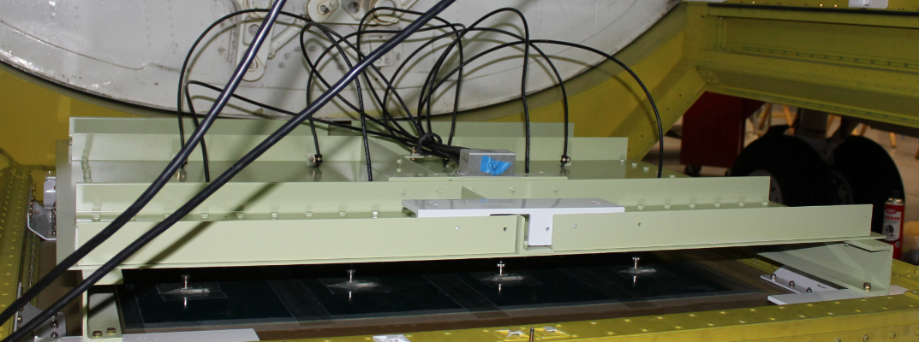
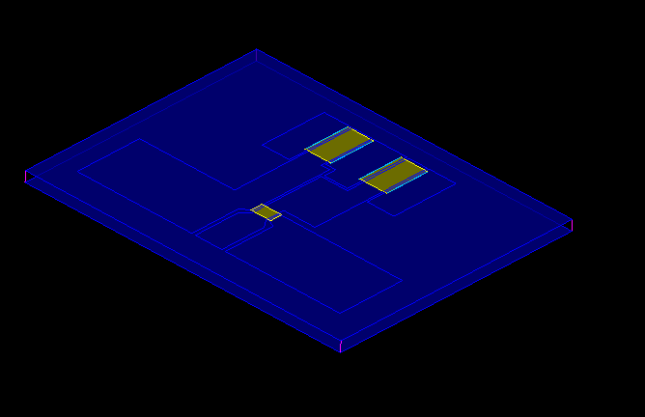
Accumulation Radar Upgrades
2.4 GSPS AWG and 1.6 GSPS with I/Q sampling for direct synthesis and data acquisition.
Balun upgrade for higher power handling (>50-W peak).
3W Balun
>50W balun

Slide 10
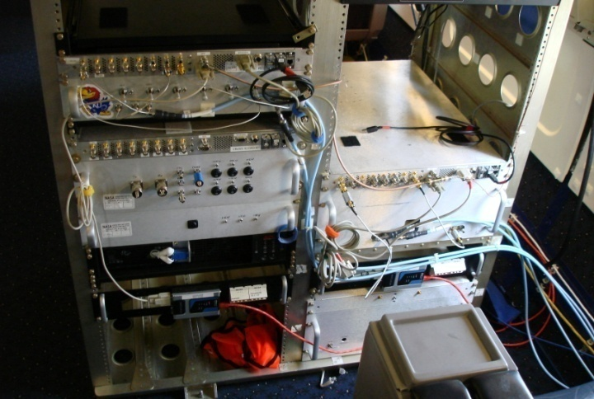
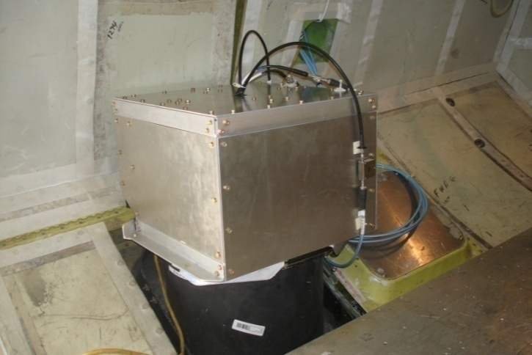
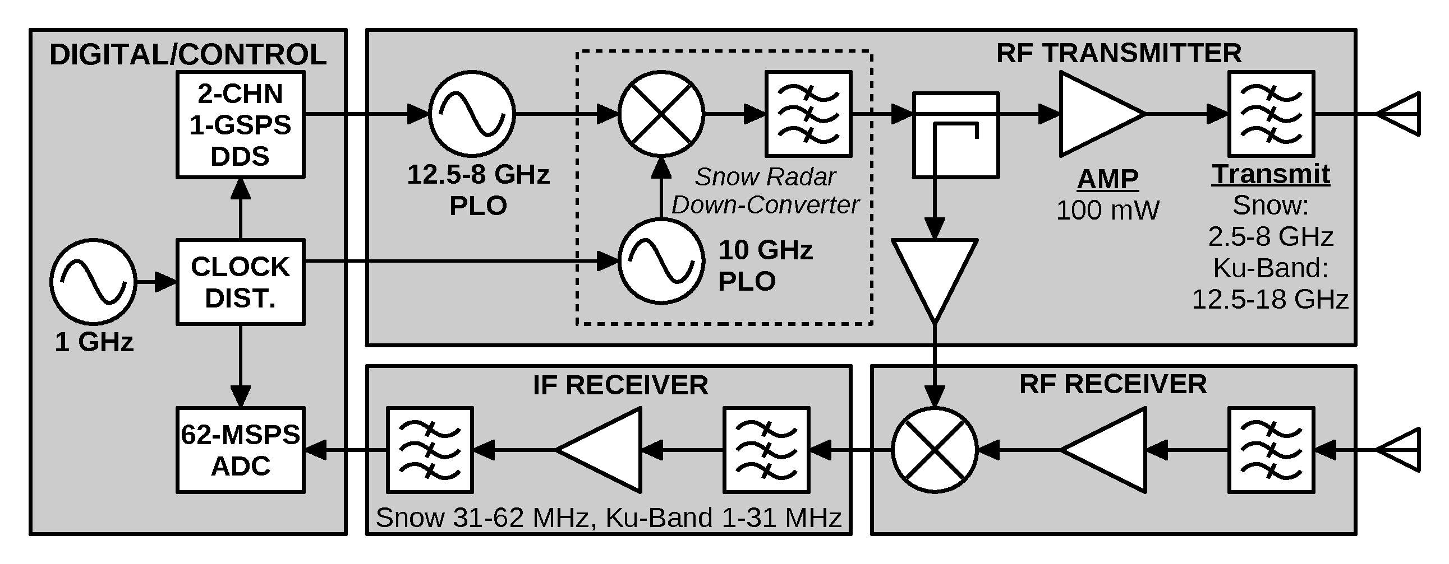
Snow and Ku-Band Radars
Limitations (Current Systems).
  Two independent systems (2-8GHz) & (12-18GHz).
    Difficult to combined to get better resolution.
  Chirp Linearity and Bandwidth.
    PLL and Multiplier Designs.
  Nyquist Zones, Sampling Rate, Data Rate.
    Data rates were too high w.r.t. usable range window.
    Crossing Nyquist Zones would interrupt data quality.
  DDC was a partial solution (introduced problems).
    Deconvolution was more difficult.

Slide 11
FMCW Systems: Current Architecture
Same Tx and Rx Reference Chirp.
  Cause for many of the limitations.
  Altitude changes causes larger IF frequencies.
  Nyquist Zones.
  Linearity errors become more obvious.

Slide 12
FMCW Systems: New Architecture
Global Hawk, New Chirp Generator
Different Tx and Rx Reference Chirp.
  Adjust Reference to the aircraft altitude.
  Results in a fixed IF signal.
  Spring 2017 will test the systems and functionality.

Slide 13
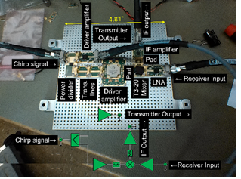
2-18 GHz FMCW Radars
Two Hardware Systems
1. Direct Waveform Generator:
  Directly Generate 2-18 GHz Chirp (multi-channel).
  Use different Segments and Sequencing to adapt to altitude changes.
  Elimination Nyquist Zones changes allows for near seamless surveying to high altitude measurements.
  Other modes can be implemented.
  In development, 2-18 GHz has been tested.
  Also working on a miniaturized RF section using packaged and wire-bonded components.

Slide 14
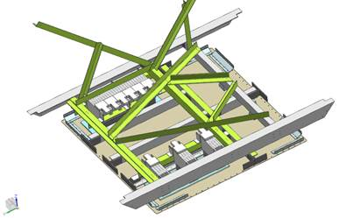
2-18 GHz FMCW Radars
Two Hardware Systems
2. UAV GH System
  Two Frequency Multiplier Systems.
  Multi-channel receiver for array processing.
  New bomb bay antenna structure (all systems).
  Designed to accommodate previous horn antennas.
    Revert back to previous configurations.

