Slide 1
ONR Sea State and Boundary Layer Physics of the Emerging Arctic Ocean
Directed Research Initiative
Ben Holt -JPL, Steve Ackley – U. Texas San Antonio
IceBridge Meeting, January 25, 2015
The Sea State DRI will use a combination of modeling, in situ observations, and remote sensing to address the following science objectives:
• Develop a sea state climatology for the Arctic Ocean
• Improve wave forecasting in the presence of sea ice
• Improve theory of wave attenuation/scattering in the sea ice cover
• Apply wave–ice interactions directly in integrated arctic system models
• Understand heat and mass fluxes in the air–sea–ice system
=> Consider IceBridge flights during Field Campaign in Beaufort Sea, Fall 2015
Institutions: Applied Physics Laboratory, University of Washington; University of Otago; University of Texas at San Antonio;
Naval Research Laboratory, Stennis; Swinburne University of Technology; Naval Postgraduate School; Woods Hole Oceanographic Institution;
Cambridge University; University of Colorado, Boulder; Laboratoire d'Oceanographie de Villefranche; University of Miami; Clarkson University;
University of Victoria; German Aerospace Center (DLR); Jet Propulsion Laboratory; Nansen Environmental and Remote Sensing Center;
University of Newcastle; European Centre for Medium-Range Weather Forecasts
Notes:
Red indicatives primary components of field campaign

Slide 2
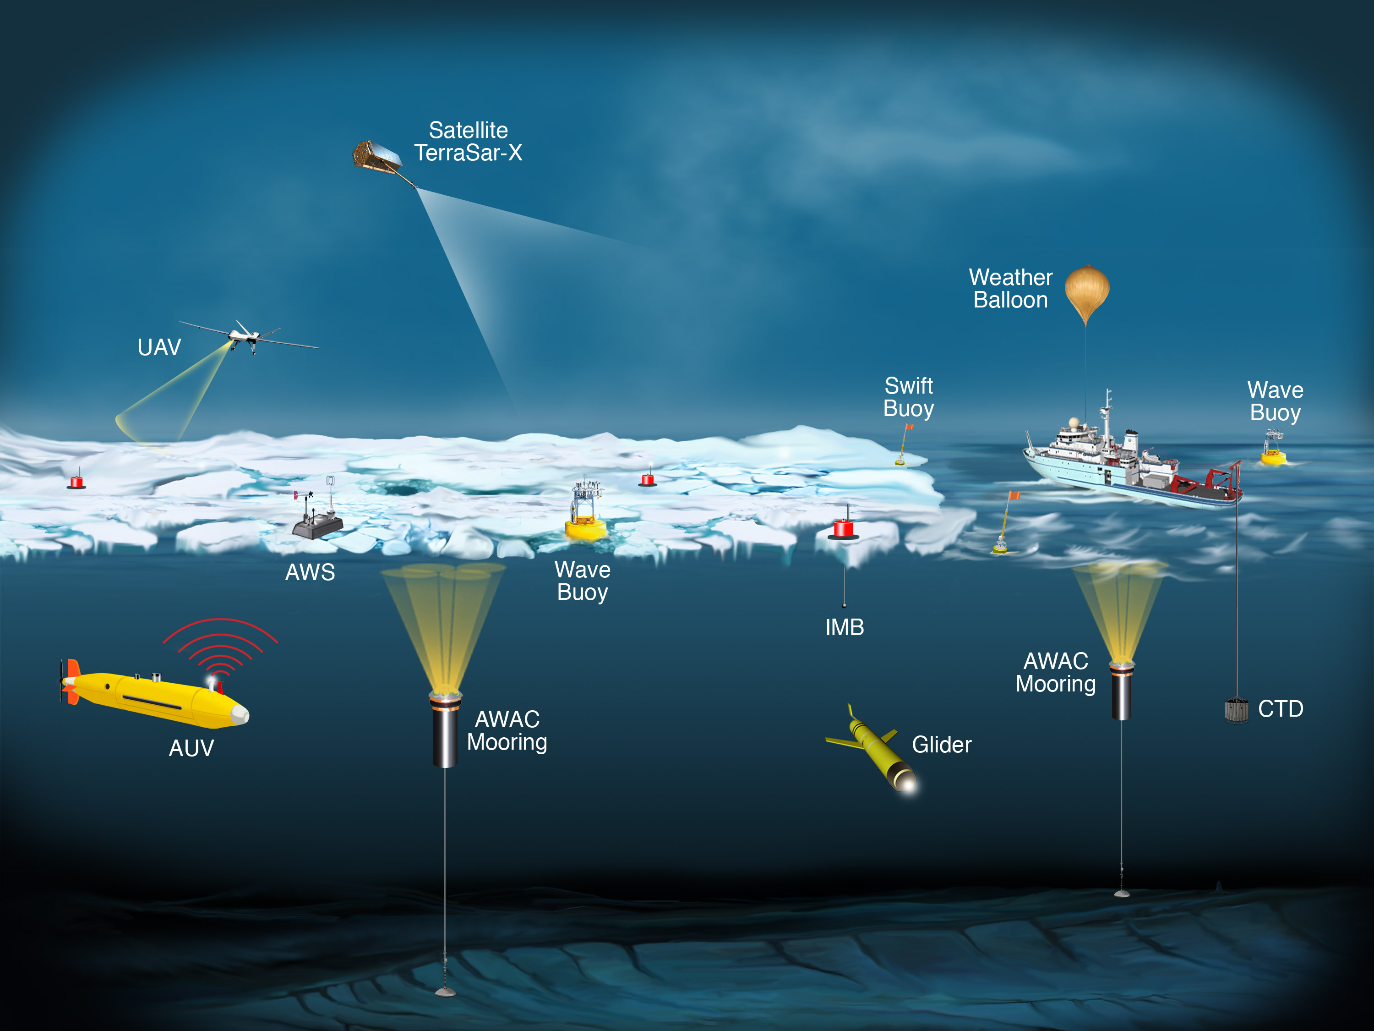
Sea State Field Campaign, Fall 2015

Slide 3
DRI SeaState Field Campaign: Sikuliaq, ~25 Sep - 4 Nov, 2015
Atmosphere boundary layer & surface ocean (underway ship met/flux, radar and TSG)
Open water, sea state / flux study (SWIFTs, wave buoys, CTDs, glider)
Solid ice edge, wave reflection study (wave buoys, CTDs, SWIFTs)
Advancing ice study (AUV under-ice transects, LiDAR, EMI, Ice Camera, CTDs, UpTempOs, AXIBs)
Ice pack/transect study (IMBs, AUV, LiDAR, EMI, CTDs, Snow Radar, Ice Camera)
500 m
Nome
Dutch Harbor
Notes:
Red font indicates in situ measurements most relevant to Icebridge overflights

Slide 4
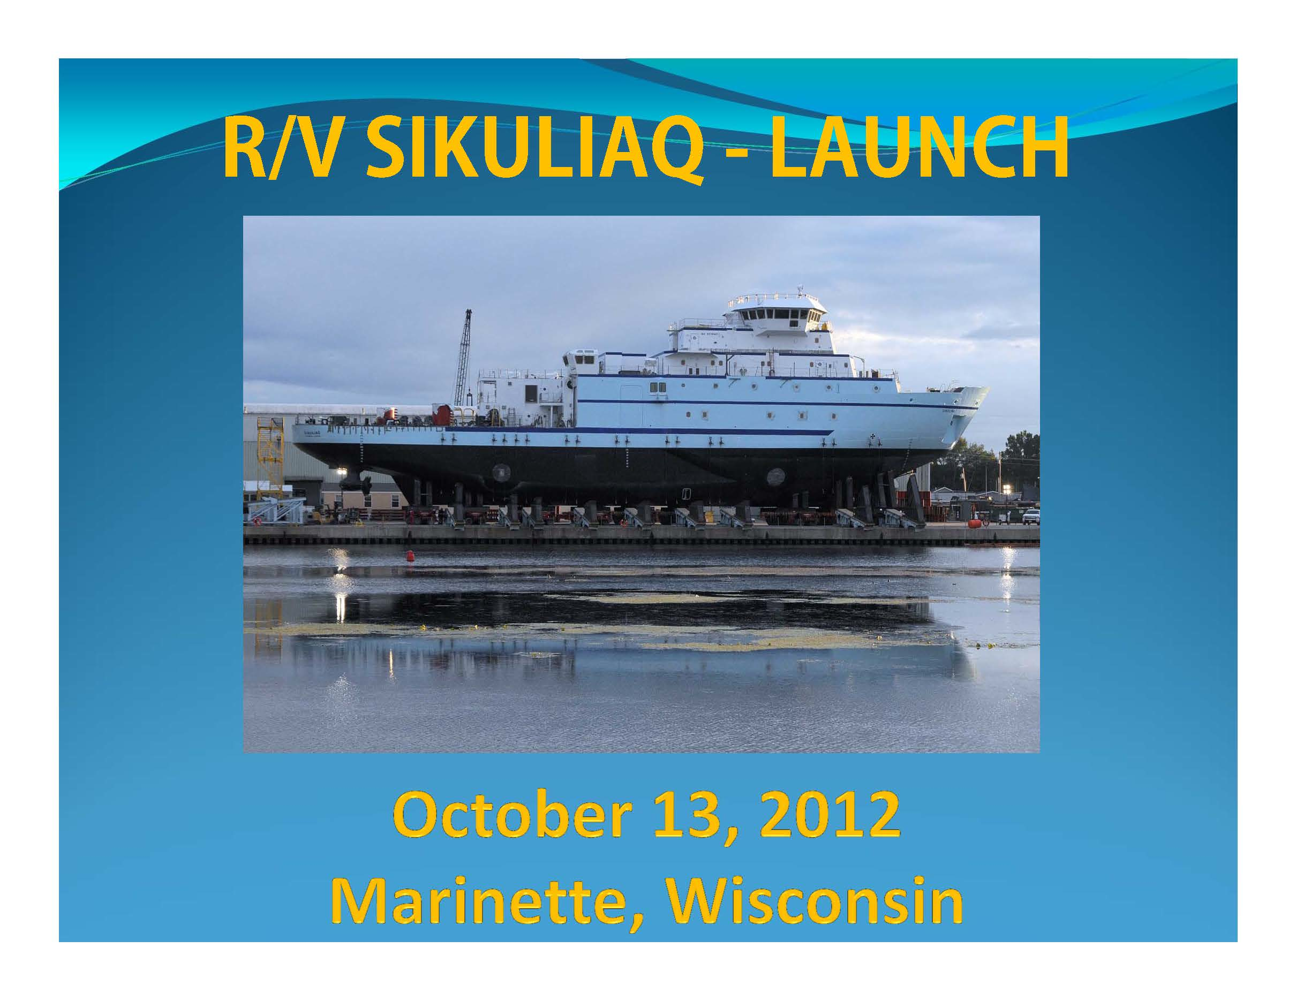
•261 feet
•Ice Capable, ~1 m sea ice thickness

Slide 5
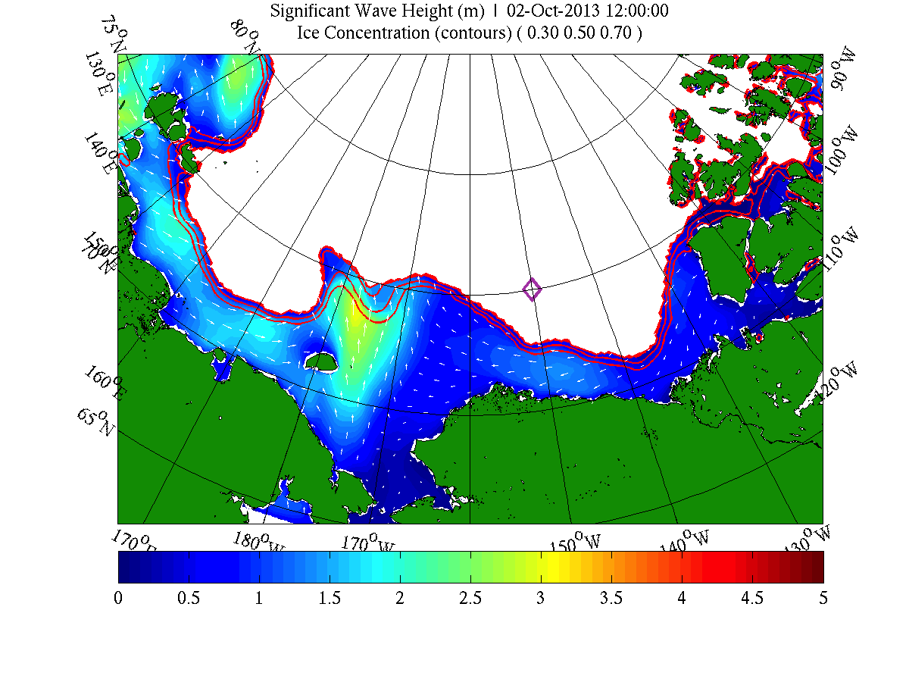
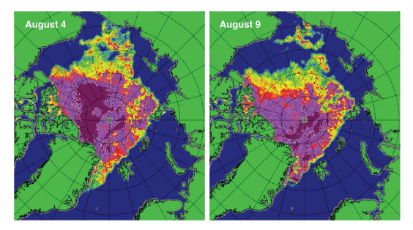
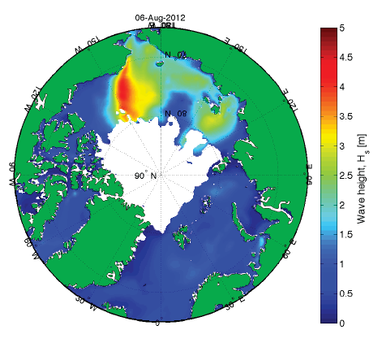
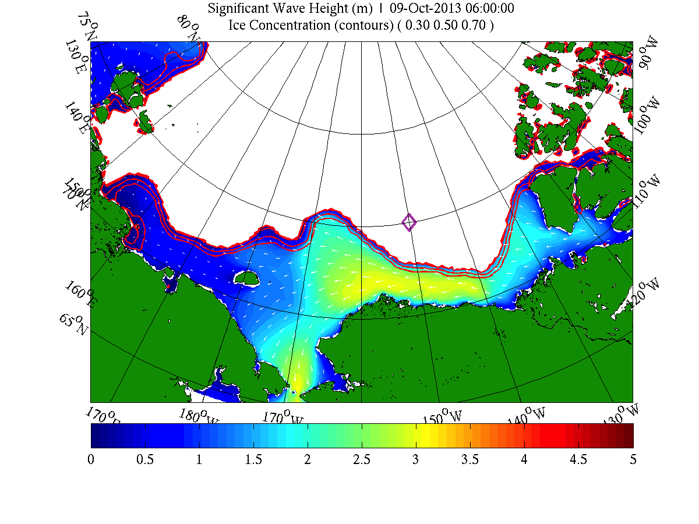
Arctic Cyclone, August 2012
Top left – sea ice concentration
Bottom left – model wave height
Top right – model, waves entering ice plus off-ice winds
Bottom right – model off –ice wind/waves, advancing ice edge
Arctic Cap Nowcast/Forecast System (ACNFS) Model runs: Erick Rogers, NRL

Slide 6
Sea State 2015 - Opportunity with IceBridge
• Campaign during a unique season, wave & sea ice conditions
•IceBridge sensors of interest for synoptic view: ATM/LVIS, Snow Radar, Camera
-observe ice surface height, early snowfall, wave height in ocean and ice
•Ship / in situ instruments include Lidar, EMI, Snow Radar, Ice Camera, Wave buoys
-confirm, validate IceBridge sensors for snow depth, ice surface height,
open water, derived ice thickness, wave height
•Satellite remote sensors will include SAR (TerraSAR-X, potentially Sentinel-1 &
ALOS-2), Optical (Landsat8, Recon), expect to coordinate with Cryosat flight lines
•Notional plan: Icebridge transects into and out of ice 100-200 km associated
with buoy line, multiple flight days optimum
•There may also be interest in MABEL overflights from IceSAT2 SDT.

Slide 8
Ice Edge Ship and Autonomous Instrumentation

Slide 9
Ship-Based Ice Measurements on Sikuliaq, ONR Sea State DRI
Ice Observations, Ice Camera (EISCAM) and EMI

Slide 10
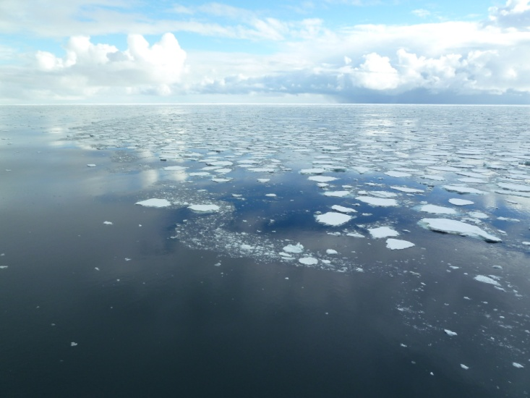
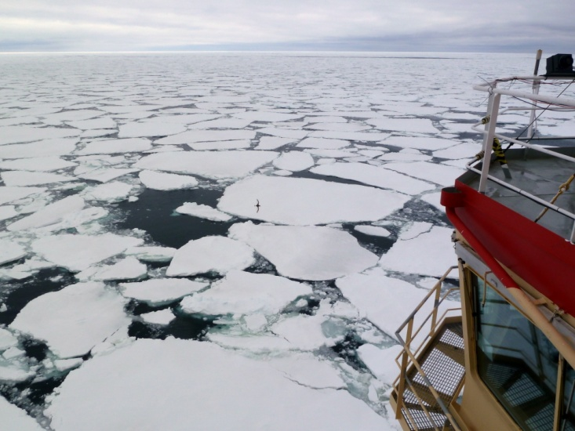
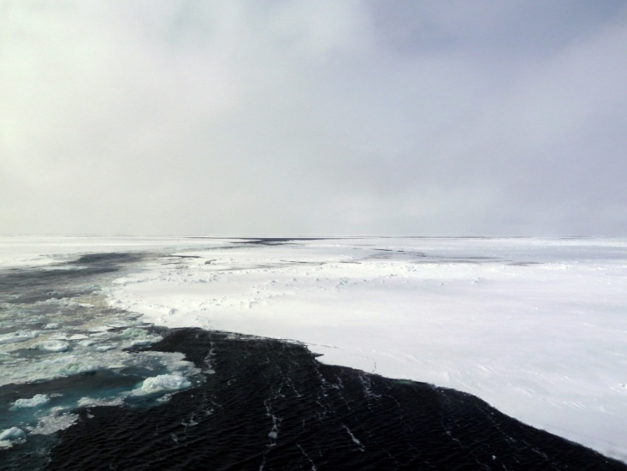
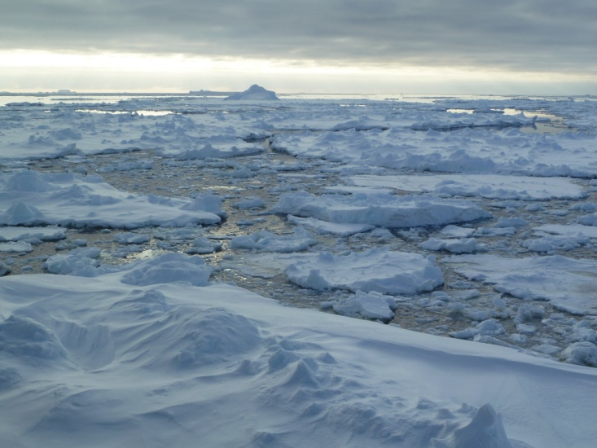
ASPeCt Sea Ice Observations

Slide 11
Snow and Ice Thicknesses from Ice Observations

Slide 12
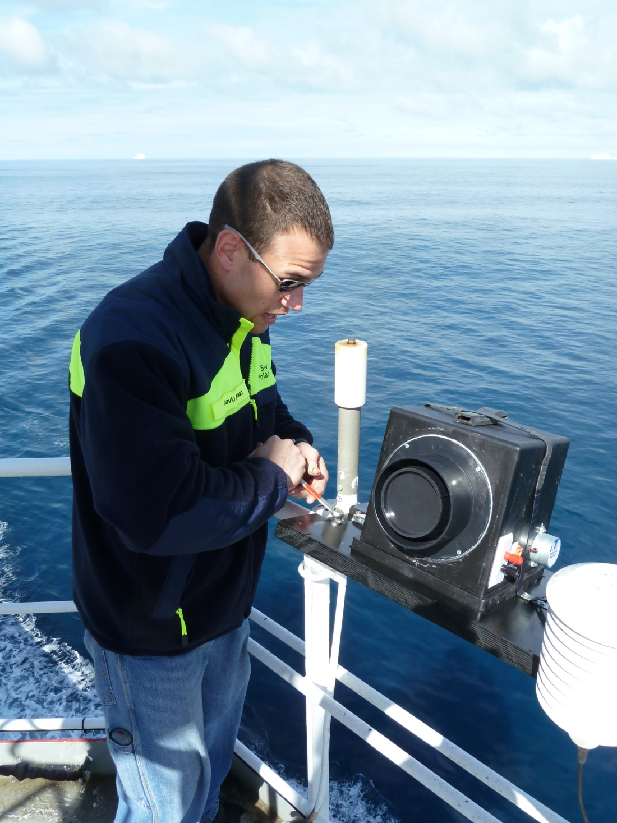
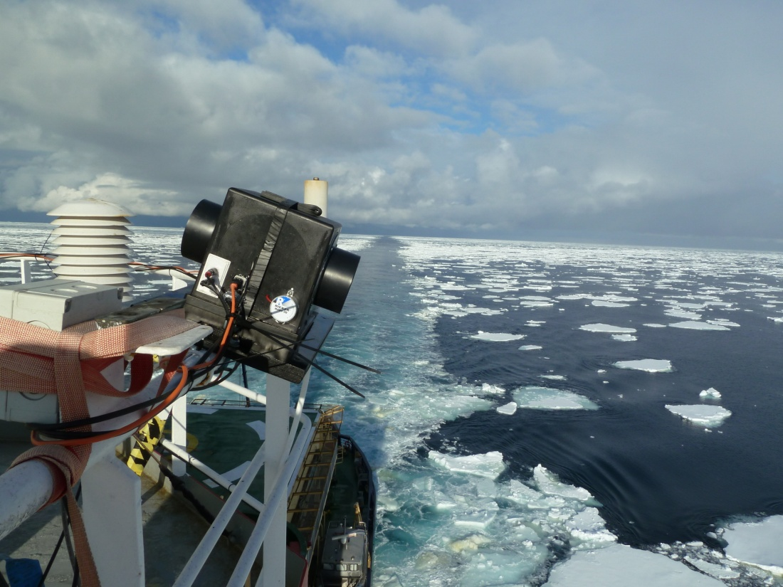
EISCam sea ice digital ortho-photography
Acquired oblique-view digital imagery is reprojected (orthorectified) to a nadir view
Nadir true-scale images can be analyzed for sea ice spatial/physical parameters

Slide 13
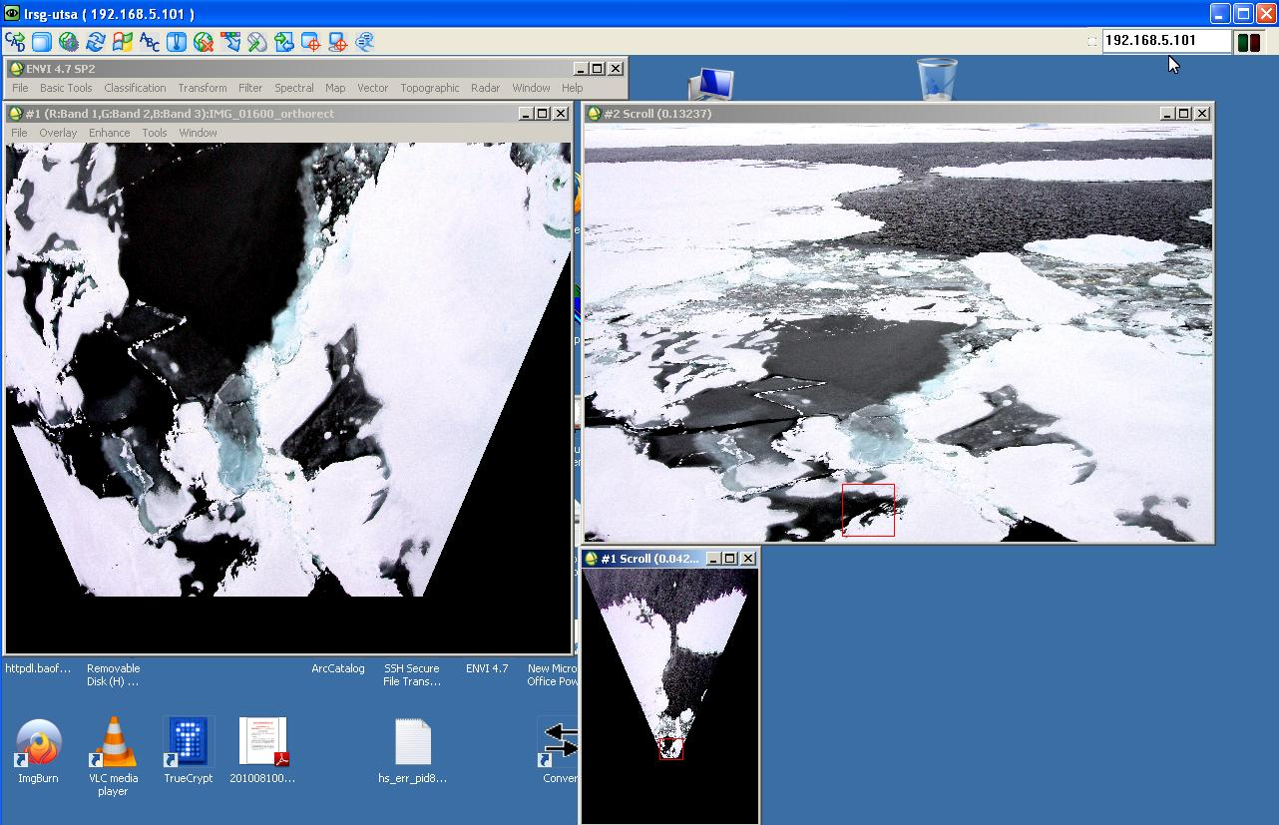
Evaluation of the orthorectification
Orthorectified Original Image
Notes:
Original Image on Right, same image after orthorectification (conversion to Nadir looking with true scale) on Left. True areal fractions of concentration and ice type can be
Computed by image processing on the orthorectified image.

Slide 14
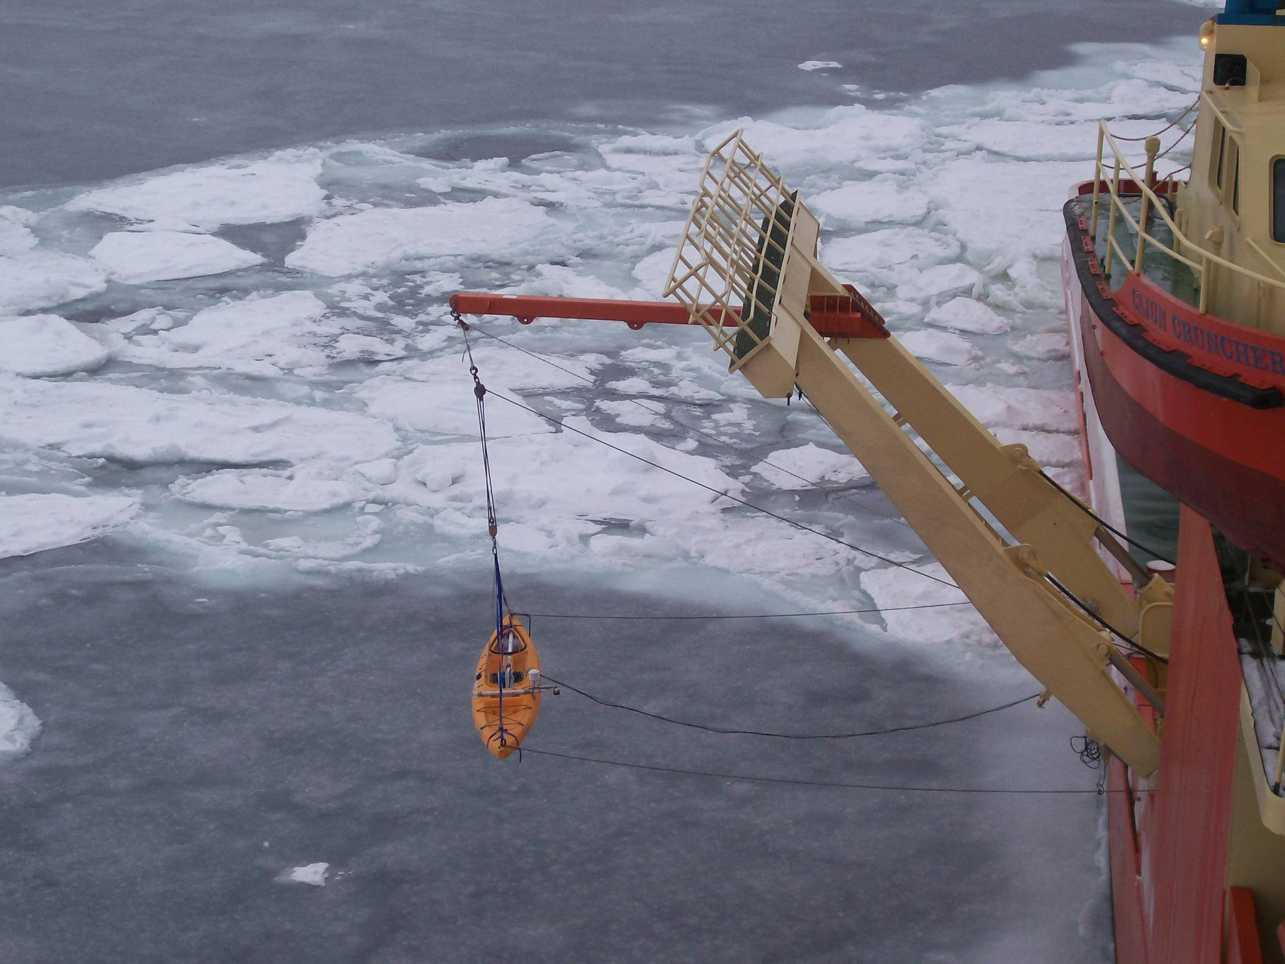
Ice Thickness from Ship-borne EM-31

Slide 15
Summary of EMI Snow and Ice Thickness Data
(SIMBA, Bellingshausen Sea, 2007)
Inbound Track (n = 957, ~90km)
Outbound Track (n = 1471, ~216km)

Slide 16
New Snow and Ice Instrumentation on the Sikuliaq for SeaState DRI
Snow Radar-Continuous Line Track mounted in Tandem with Ship-Based EMI (KU new construction based on IceBridge design, currently under DURIP review)
Ship-Based LIDAR-Continuous side-looking Swath along Track (Either purchased (under DURIP review) or contracted LIDAR rental)
Both measured simultaneously (line tracks) with EMI. EMI and Snow Radar on approximate center line of swath.
Simultaneously imaged with EISCAM visual photography and spot monitored with Ice Observations (half hour to hourly intervals).

