Slide 1


OIB Sea Ice Workshop
Wednesday, 29 January 2014
NASA Goddard Space Flight Center (GSFC)
Radar Waveform Simulations
of Sea Ice Surface Roughness
Li Li (202) 767-0849
li.li@nrl.navy.mil
Remote Sensing Division
Peter Gaiser, David Truesdale (NRL Remote Sensing Division)
Pamela Posey, Richard Allard (NRL Oceanography Division)
John Brozena, Joan Gardner (NRL Marine Geosciences Division)
Chris Polashenski, Jacqueline Richter-Menge (CRREL Terrestrial & Cryospheric Sciences)

Slide 2
Measuring Sea Ice Thickness
Using Combined Radar/LiDAR Data
LiDAR measures total freeboard
Radar measures ice freeboard
Their differences give snow depth
Indirect measurement using isostatic equilibrium
Require open water calibration
Ice thickness uncertainty:
  Ice freeboard; Snow density, depth and grain size; Snow and sea ice Surface roughness.
Surface is always rough – how sensor sees the surface?
  Convolution of surface roughness with sensor impulse response
Radar backscattering has strong dependence on sea ice type, surface roughness, and snow parameters
Snow and ice properties are not statistically uniform over the entire footprint.
  The knowledge of snow/ice surface roughness is very limited.
LiDAR Altimeter
Snow Surface
Radar Altimeter
Ice Surface
Snow
S
Snow Depth
I_{f}
Radar freeboard
Sea Surface
I
Sea Ice
D
Ice Thickness
Ice Draft
Reference
Ellipsoid

Slide 3
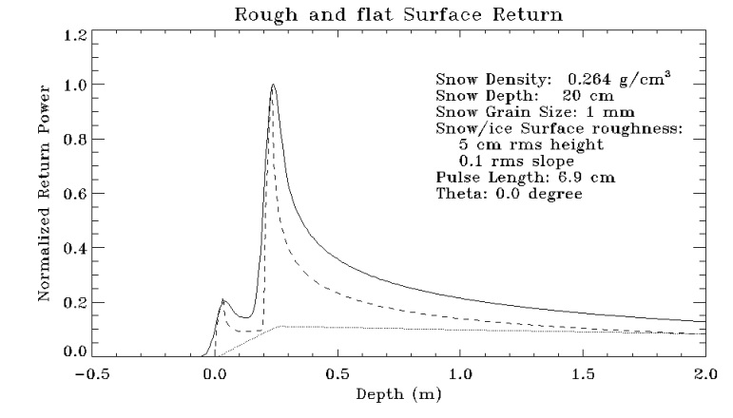
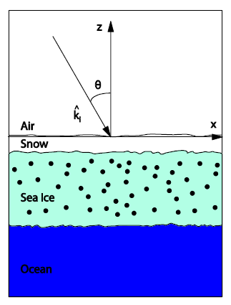
Waveform Model for Combined
Snow volume and Ice Surface Scattering
Aircraft at 500 m above air/snow surface
BW = 19^{O}
Air/Snow interface at Depth=0
Snow/ice interface at 20cm

Slide 4
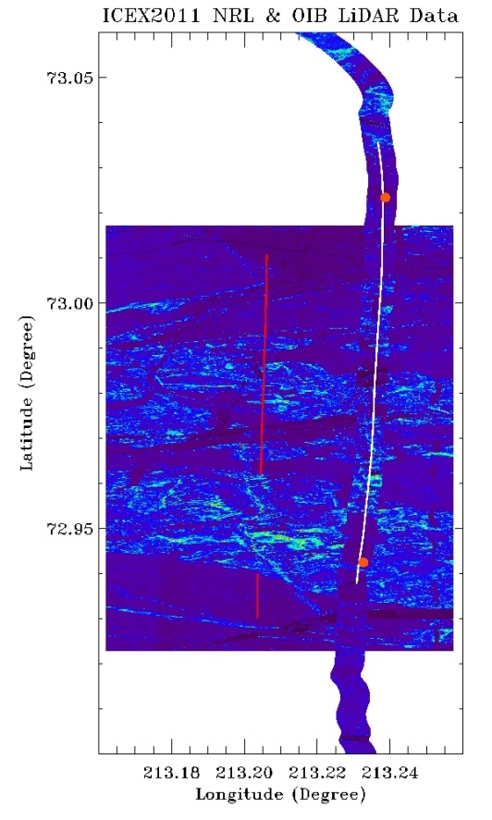
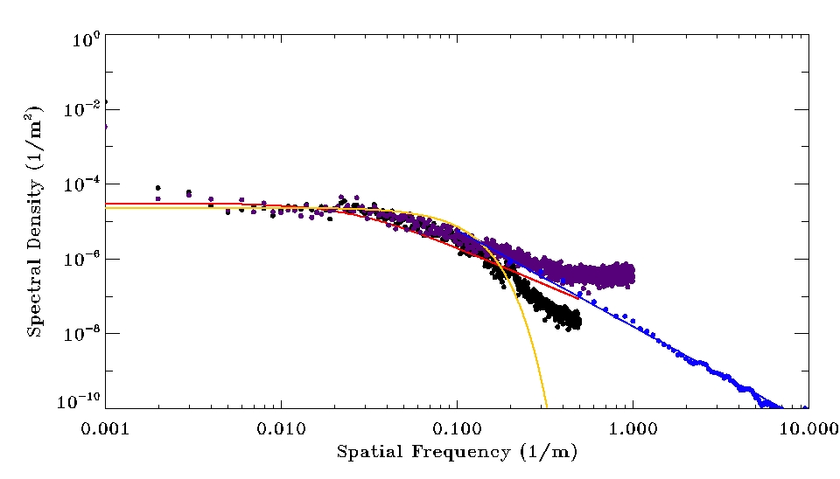
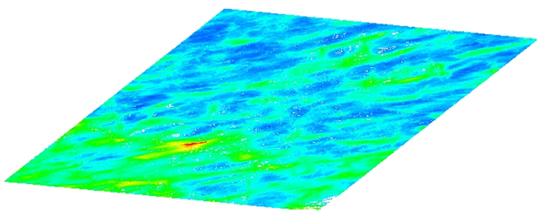
Surface Roughness Analysis Using LiDAR Data
OIB ATM LiDAR
  L=800m, dx=0.5-1.5m
NRL LiDAR
  L=2000m, dx=0.5m
CRREL (Chris Polashenski) 3D Scanner data
  L=30 m, dx = 0.01 m
ATM
CRREL
NRL
The consistency among three data sets suggest that sea ice surface roughness is best represented by the exponential, not Gaussian.
Melt Pond EX, 2009

Slide 5
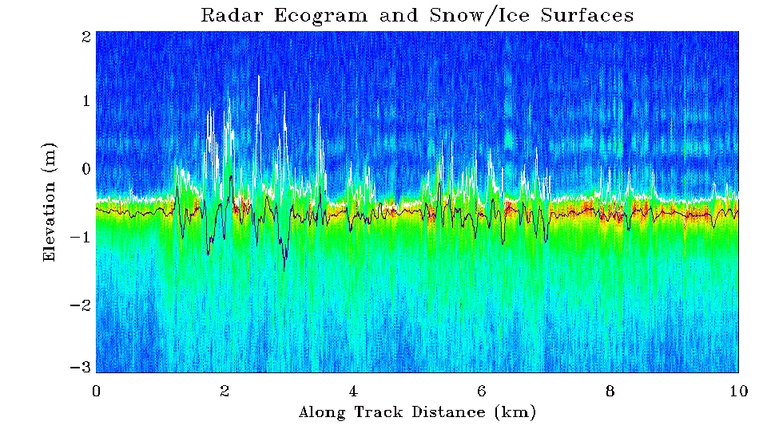
Remote
OIB Combined Ku-Band Radar
and ATM LiDAR Measurements
LiDAR and Radar detected surfaces track each other well in the level snow/ice areas
Significant EM biases exist in the ridge areas, leading to depressed “ice surfaces”

Slide 6
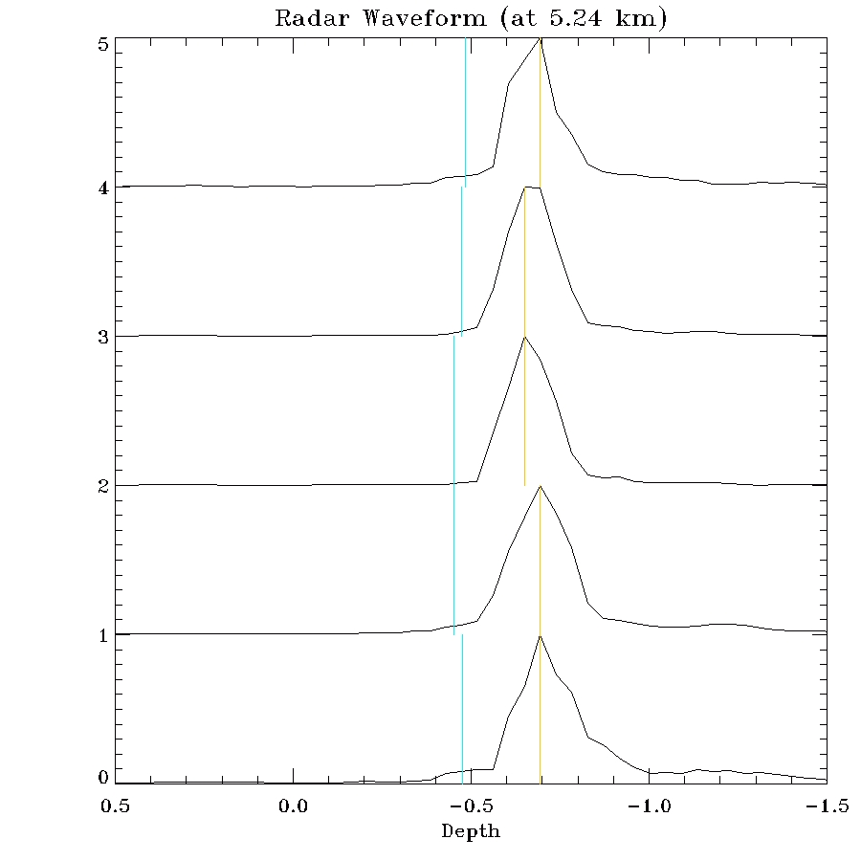
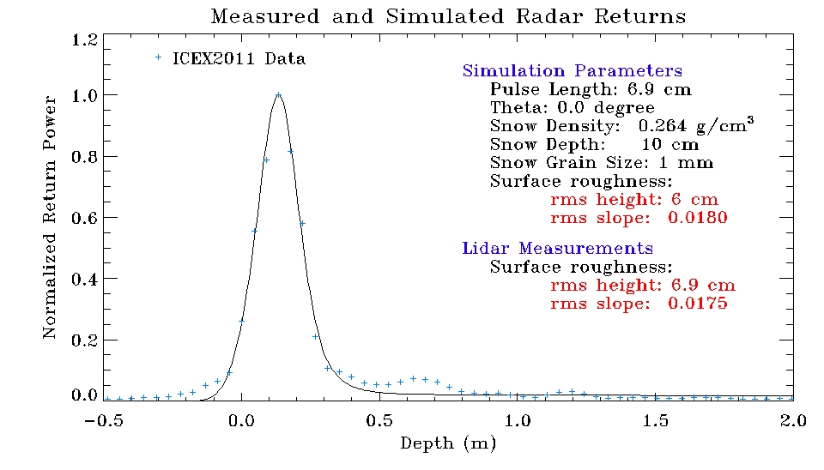
Remote
OIB Ku-band Radar Waveform Analysis
Level Snow/Ice Surface
The radar data was rotated by 180 degrees then shifted by 0.56m, second echo
The model fits very well to the measured radar waveform.
The fitted roughness parameters are close to the ATM LiDAR measurements

Slide 7
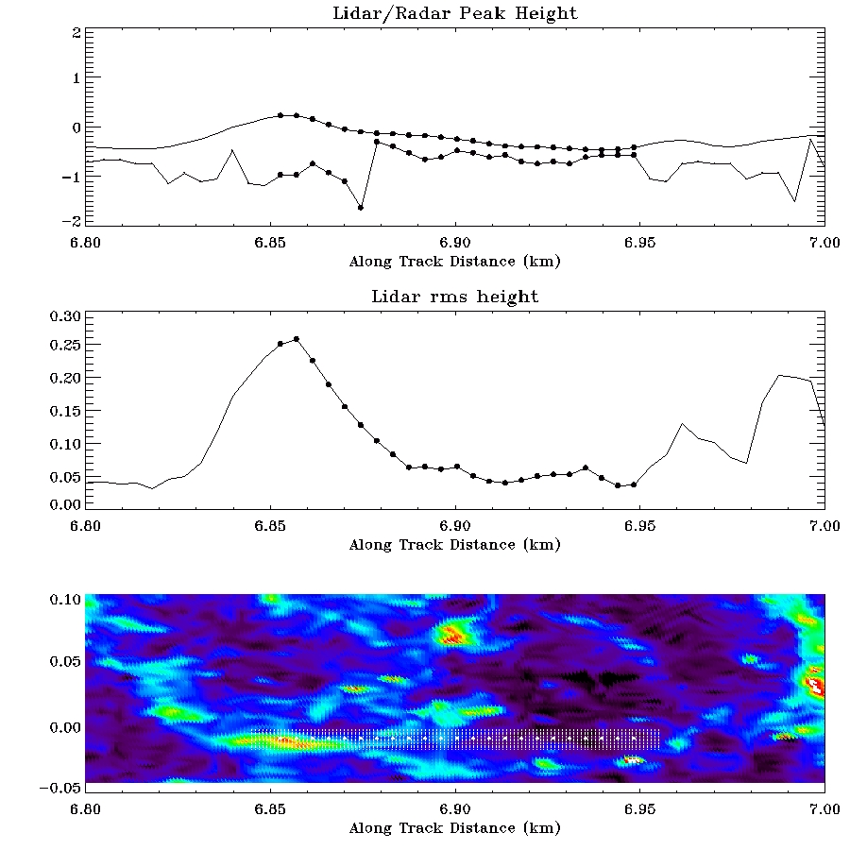
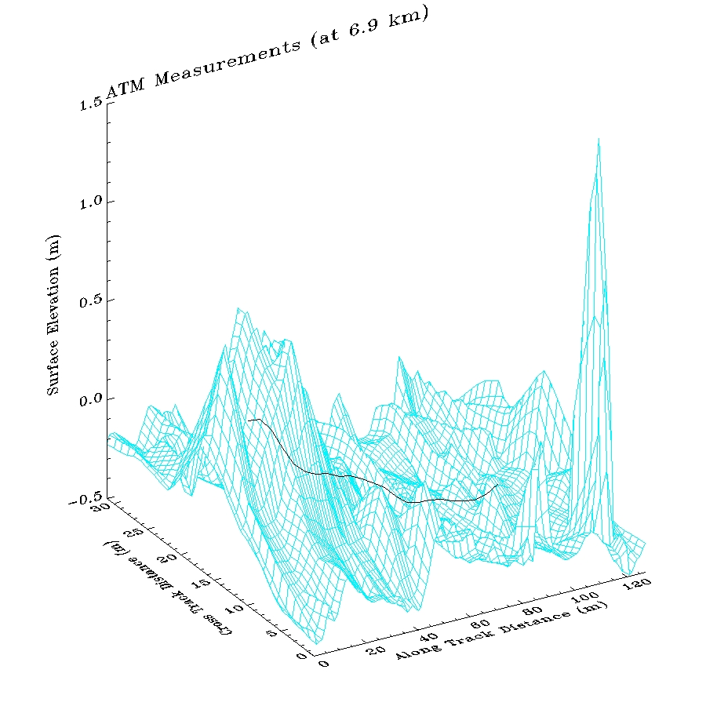
Remote
OIB Ku-band Radar Waveform Analysis
Deformed/Ridge Surfaces

Slide 8
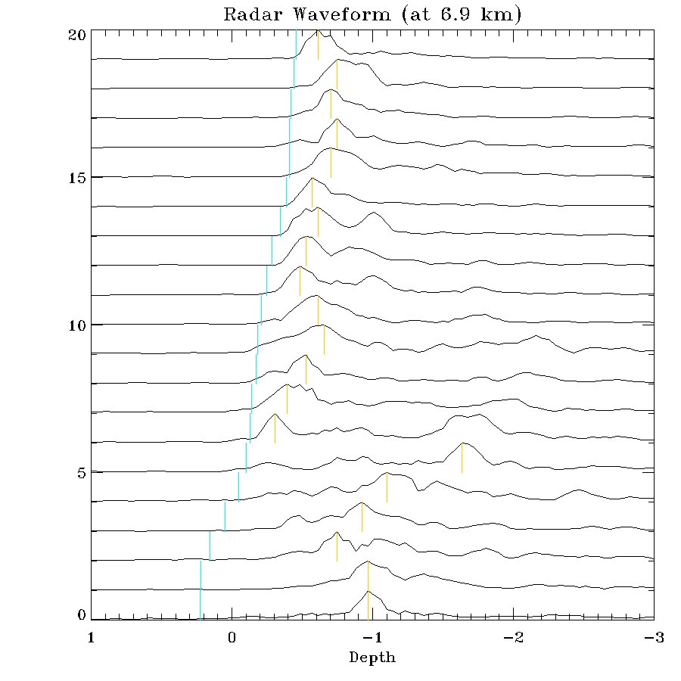
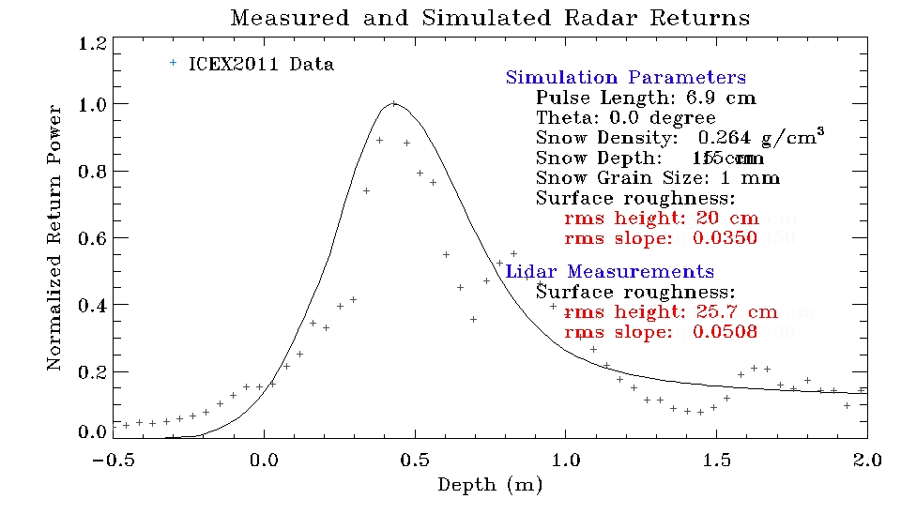
Remote
OIB Ku-band Radar Waveform Analysis
Deformed/Ridge Surfaces
The radar data was rotated by 180 degrees then shifted by 0.54m, 2nd echo
The model fits to the measured radar waveform, but not very well.
The fitted roughness parameters are reasonably close to the ATM LiDAR data

Slide 9
Remote
Rough Surface Parameter Comparisons:
Radar Retrieved vs LiDAR Calculated
In general, the waveform model fit the ku-band data well
The Radar waveform model fitted surface roughness parameters are clearly correlated with LiDAR measured surface roughness
The model has significant challenges in modeling the leading/trailing edges of ice ridges

