Slide 1
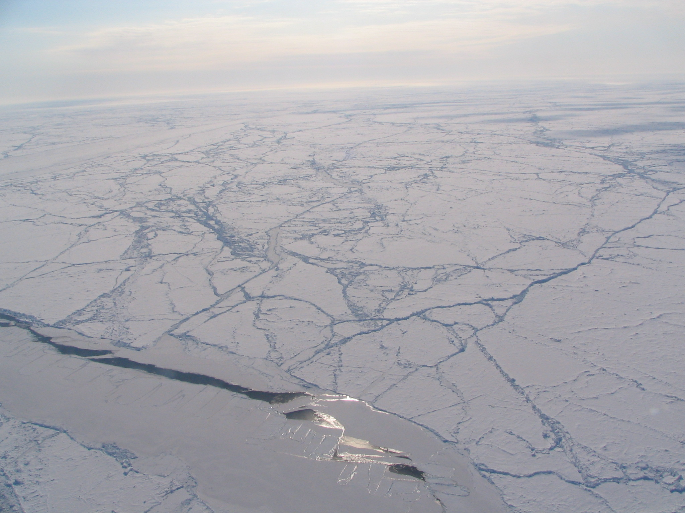
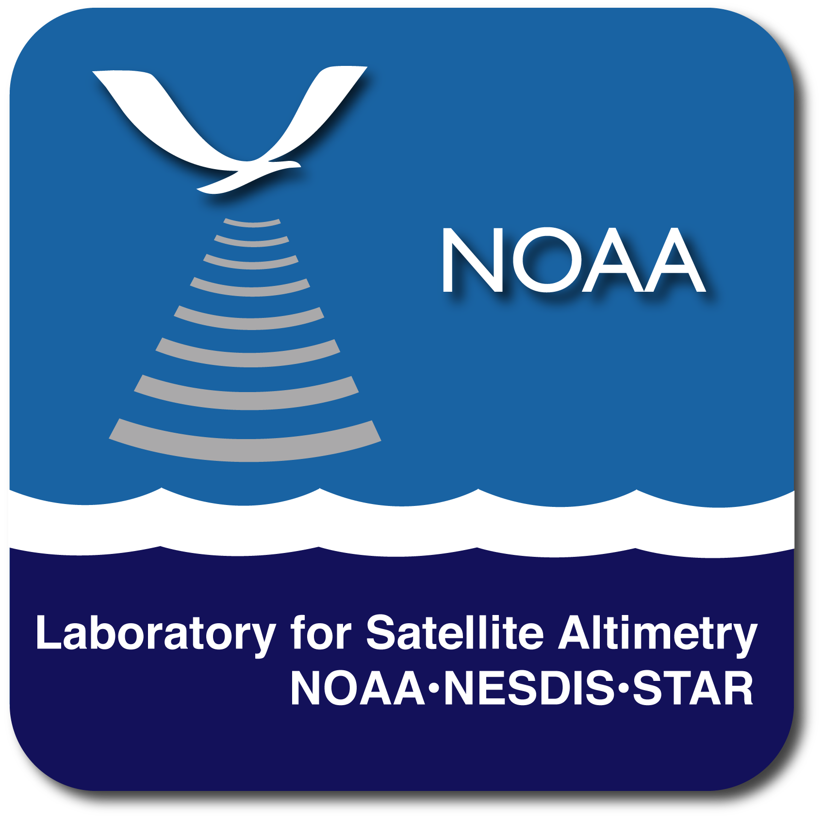
AltiKa - SARAL Radar Altimeter
Recommendation for IceBridge under-flight
Larry Connor¹
Dave McAdoo^{1,2} Sinead L. Farrell^{1,2} John Lillibridge¹
¹ NOAA Laboratory for Satellite Altimetry, NCWCP, Maryland, USA
￼² Earth System Science Interdisciplinary Center (ESSIC), University of Maryland, USA
Photo: Sea Ice in the Connor Corridor
Credit: S. L. Farrell

Slide 2
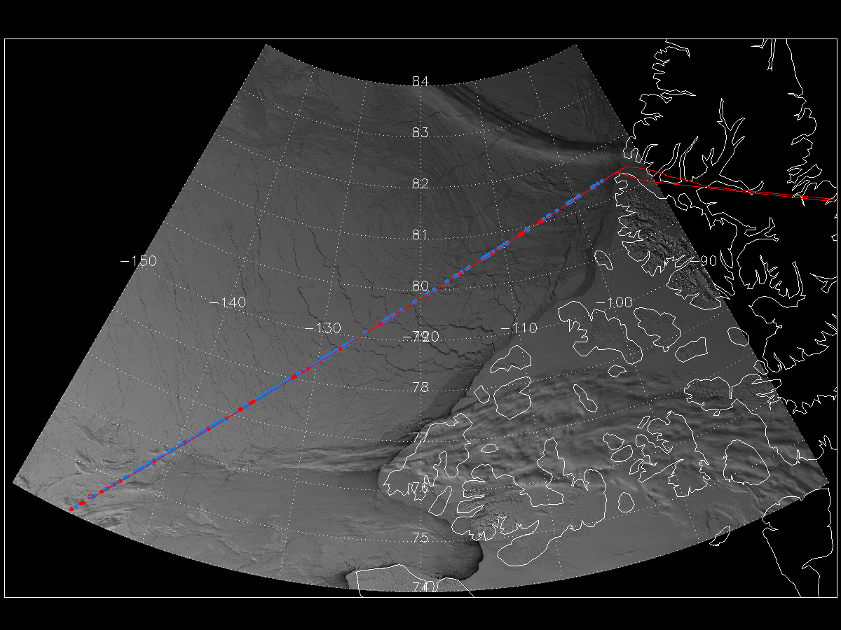
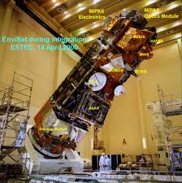
Arctic Sea Ice Thickness – A Seven year Study of
Envisat/RA-2 and IceBridge Airborne measurements
Operation Ice Bridge
Five Envisat underflights spanning 2006-2012
1300+ km flight tracks
Unprecedented measurement timeline
2006, 2010, & 2011
Analysis:
  Freeboard & Sea ice Thickness
  Lead distribution
    - Impact on radar measurements
    2010: Increased lead frequency
2009 & 2012
*
Thule, Greenland
MODIS / RA2
*
- ATM
2010 April 05
RA2 & ATM Sea Ice Profiles
2006
- RA2: lead
- RA2: floe
2009
*
Envisat / RA2
2010
Elevation [m]
2011
2012
Latitude

Slide 3
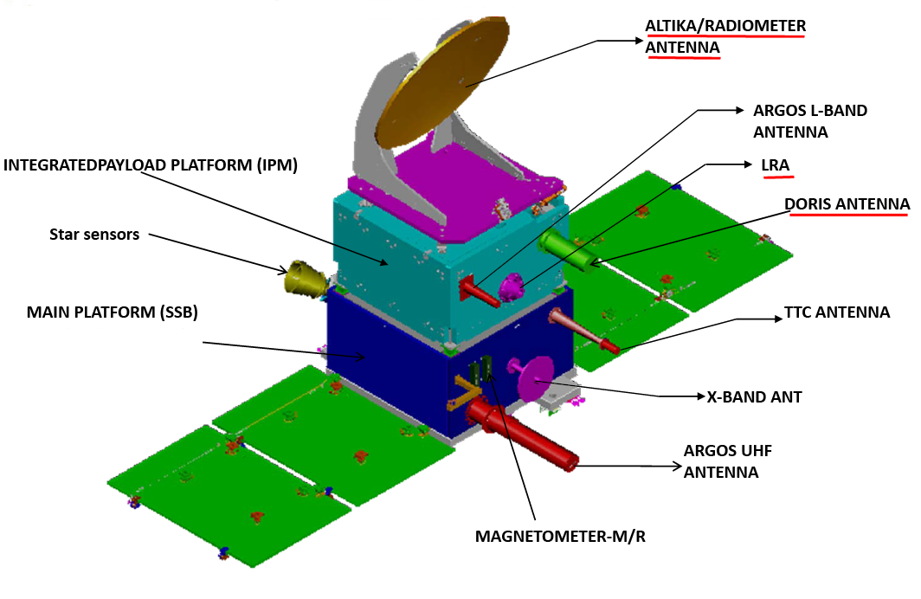
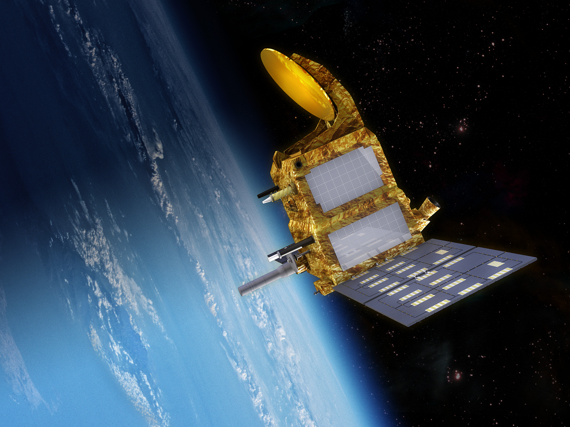
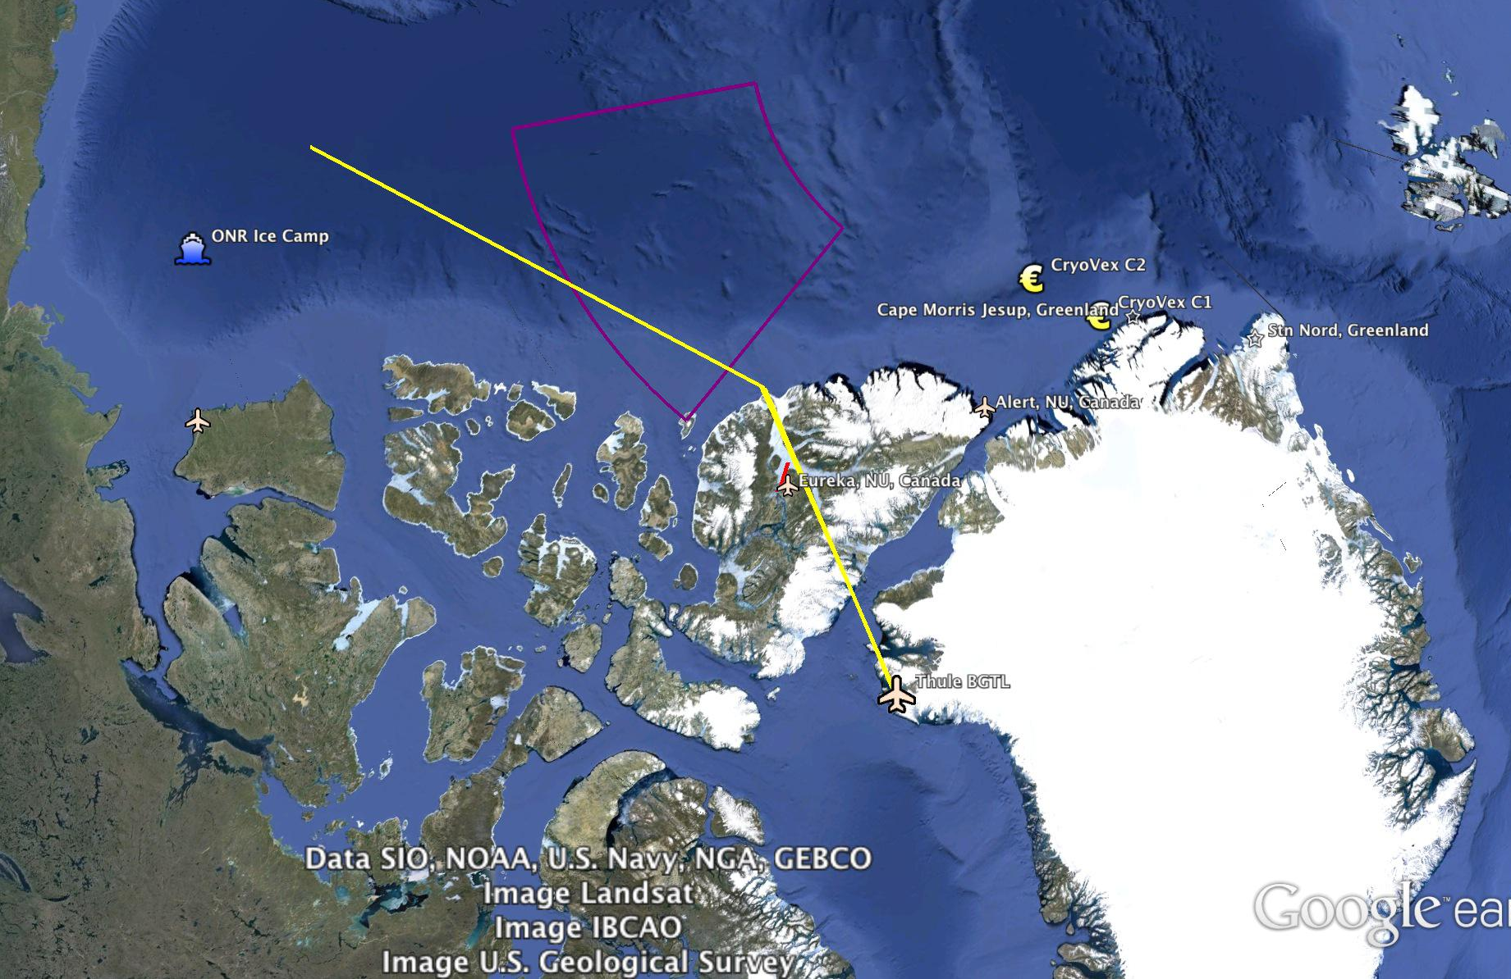
Envisat (2002-2012)
…continuing the record
Altika (2013 – 2018?):
Ka-band Altimeter
(35.75 GHz)
Smaller footprint
Envisat 35-day repeat orbit
Sensitive to precipitation
Sea ice retracking
Fully Operational!

Slide 4
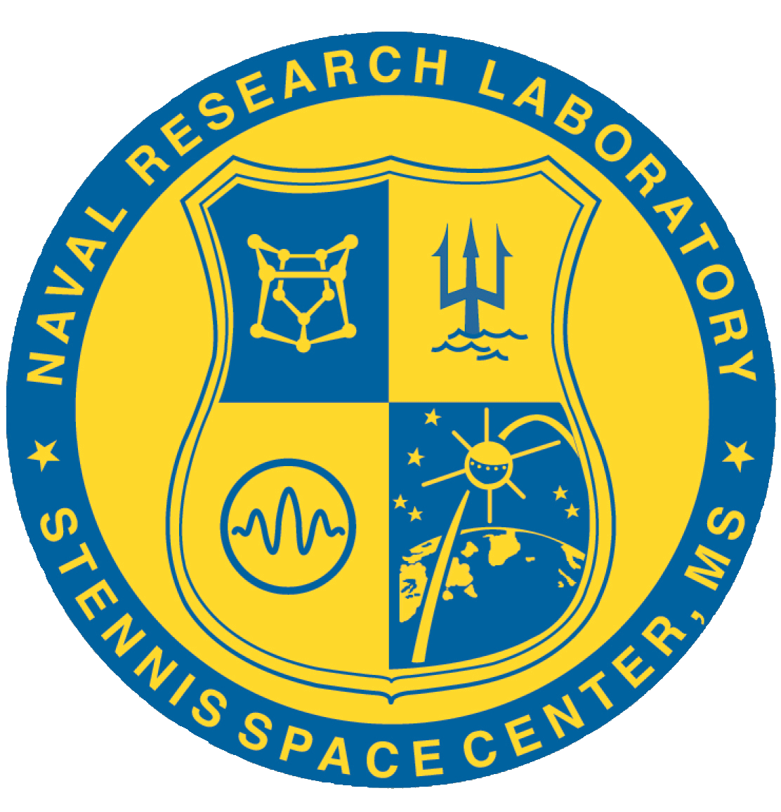
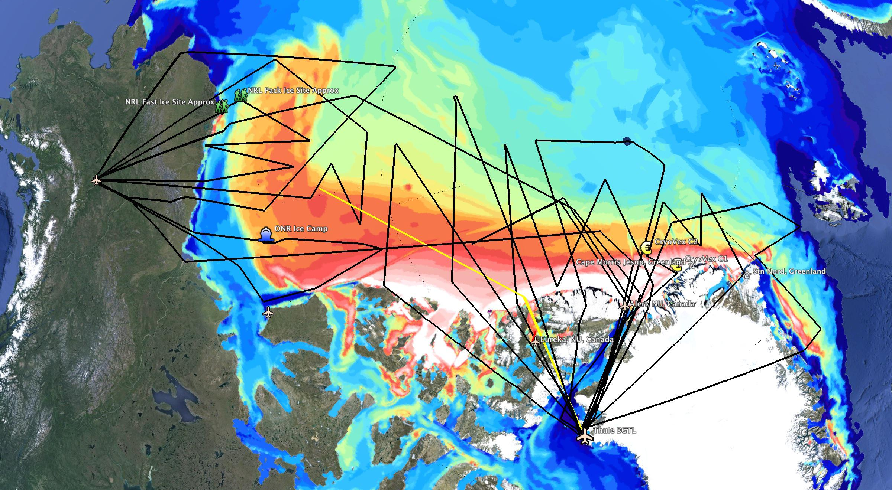
…all together now
Placement of Connor Corridor with respect to other planned flight lines: Traverses the steepest sea ice thickness gradients

