Slide 1
PAMARCMIP 2017 Part of Pan-Arctic Sea Ice Observation Programme Stefan Hendricks Robert Ricker Christian Haas

Slide 2
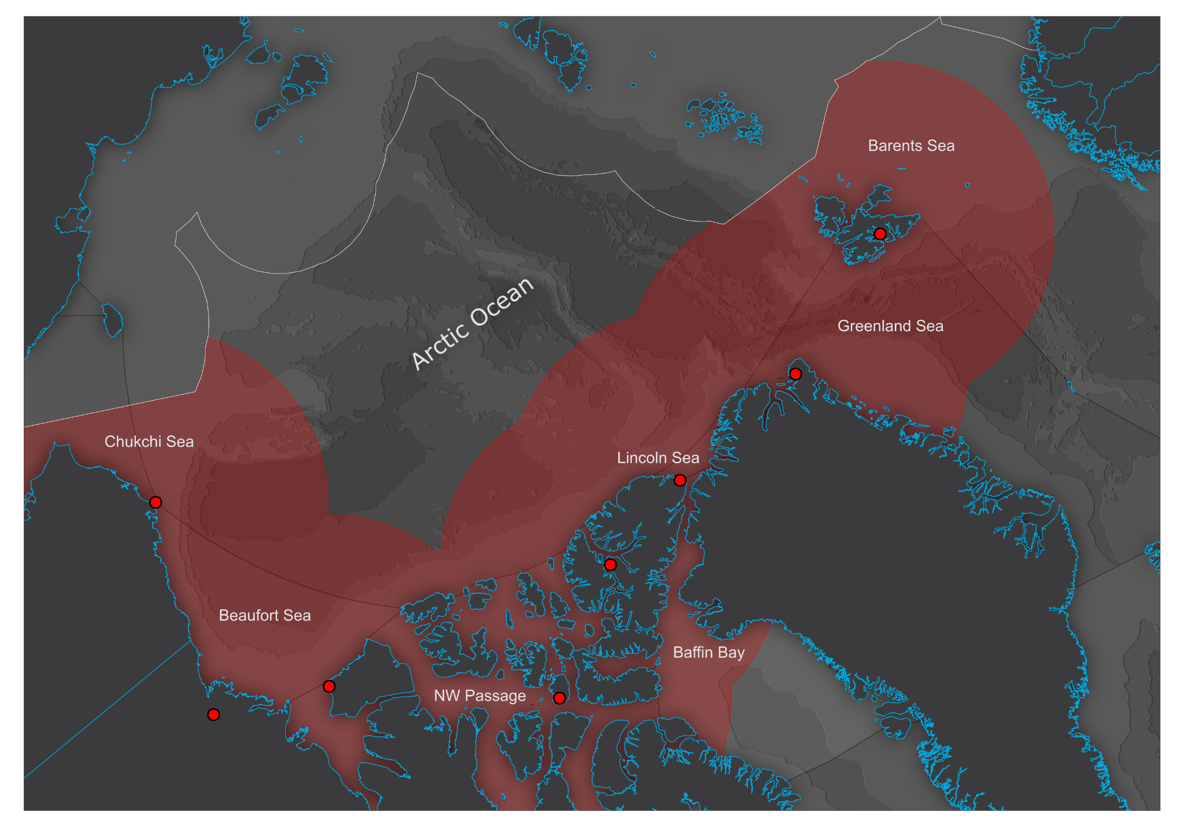
PAMARCMIP Program
Polar Airborne Measurements and Arctic Regional Climate Model Simulation Project
Combined sea ice / atmosphere mission profiles
Two year intervals during Arctic spring
Range of Operations

Slide 3
PAMARCMIP 2015

Slide 4
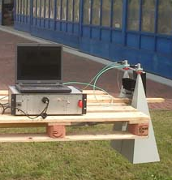
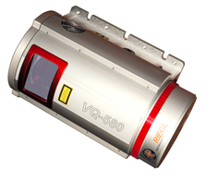
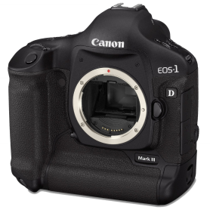
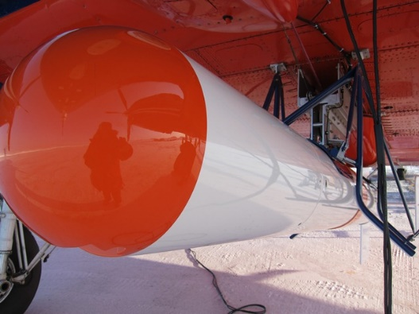
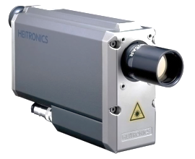
Sea Ice Payload – Polar-5
EM-BIRD
Snow
Radar
Laser
Scanner
KT19
Nadir
Photos
Sea Ice Thickness.
Snow Depth
Freeboard
Surface Temp.
Surface Type

Slide 5
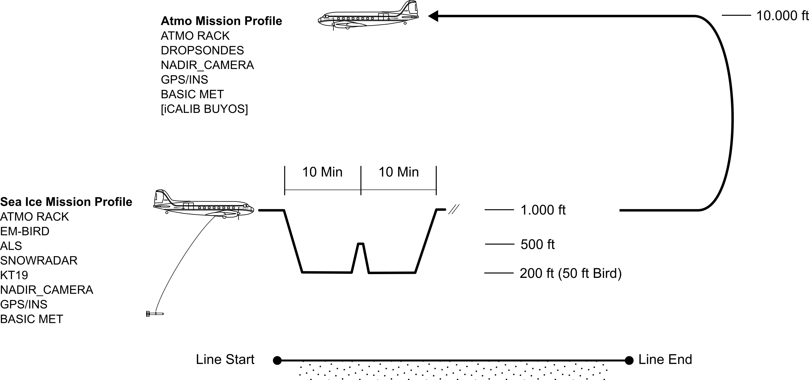
Polar-5 Mission Profile

Slide 6
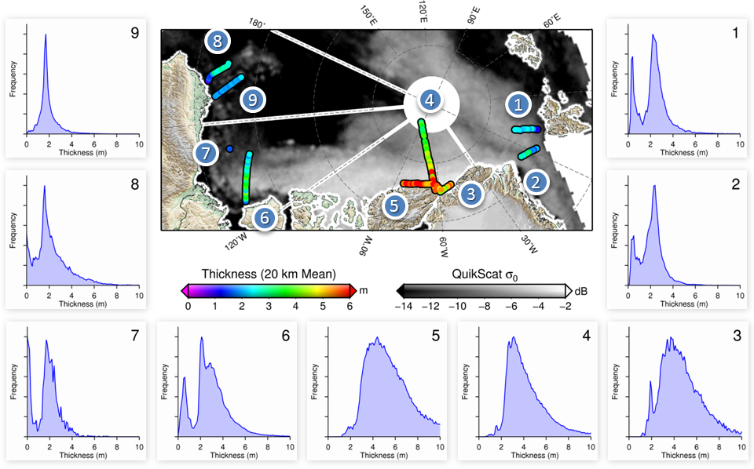
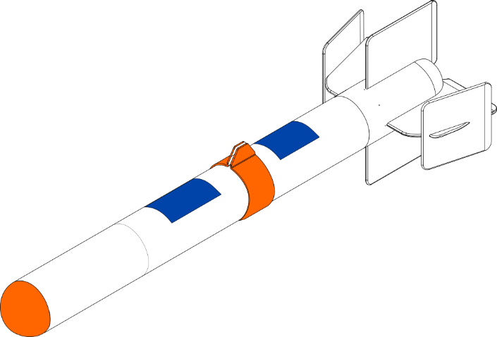
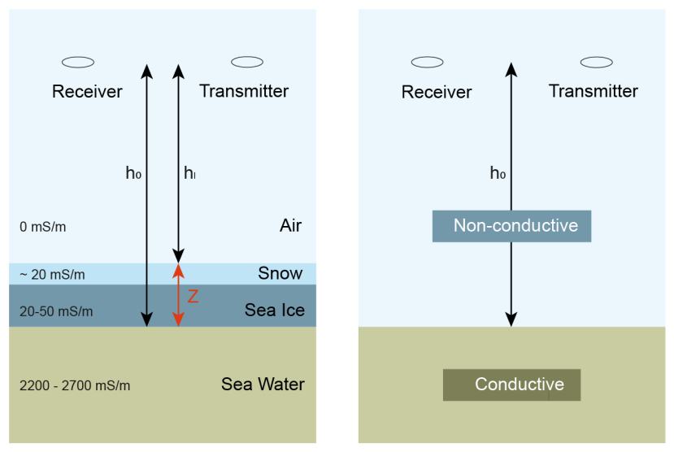
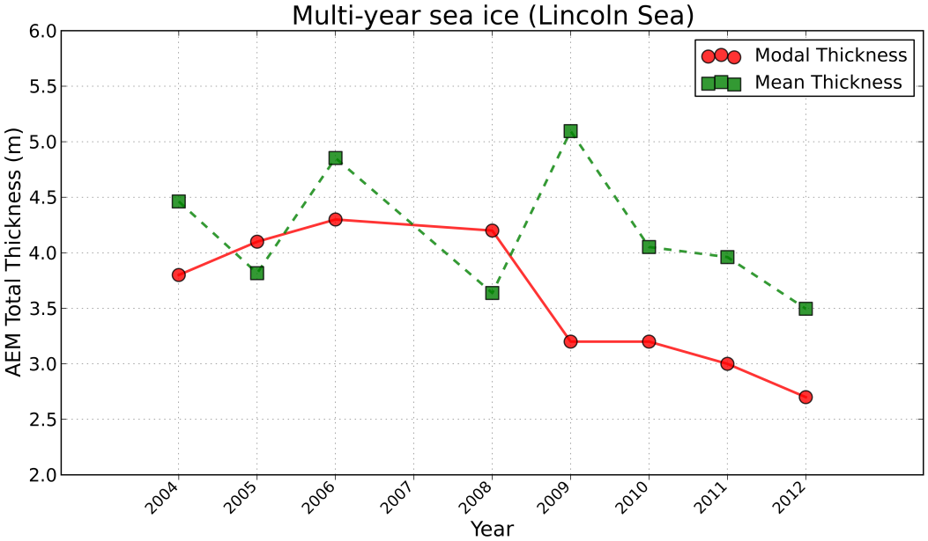
Airbone EM (AEM) Thickness
Data acquired by helicopter surveys and Polar-5 (arrows)

Slide 7
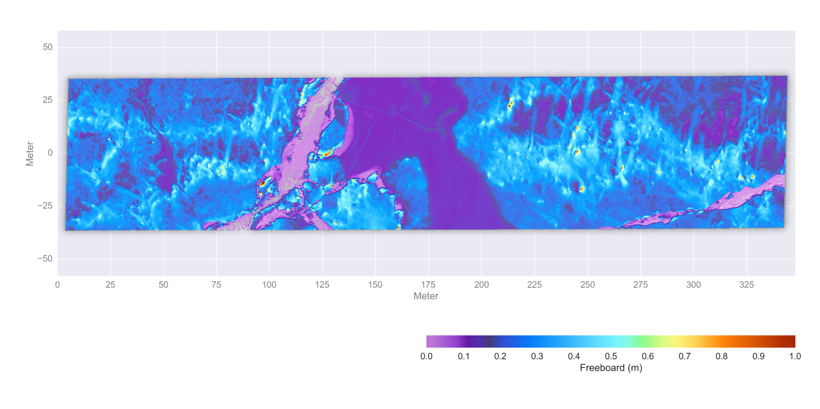
High Resolution ALS DEM
Data Source: SMOSice 2014, Barents Sea
DEM: 20cm × 20cm @ 50kHz, 200 ft
Riegl VQ-580 50 kHz – 380 kHz
 Typical operations: 150 kHz

Slide 8
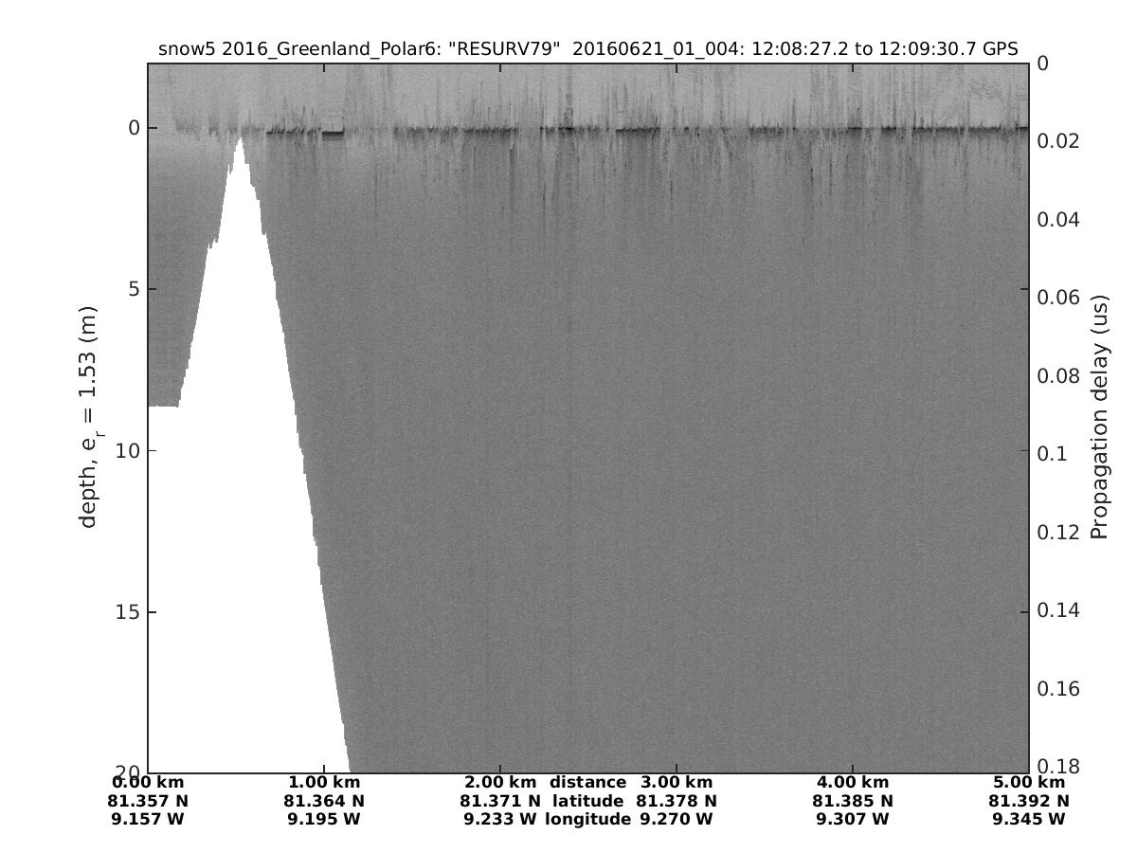
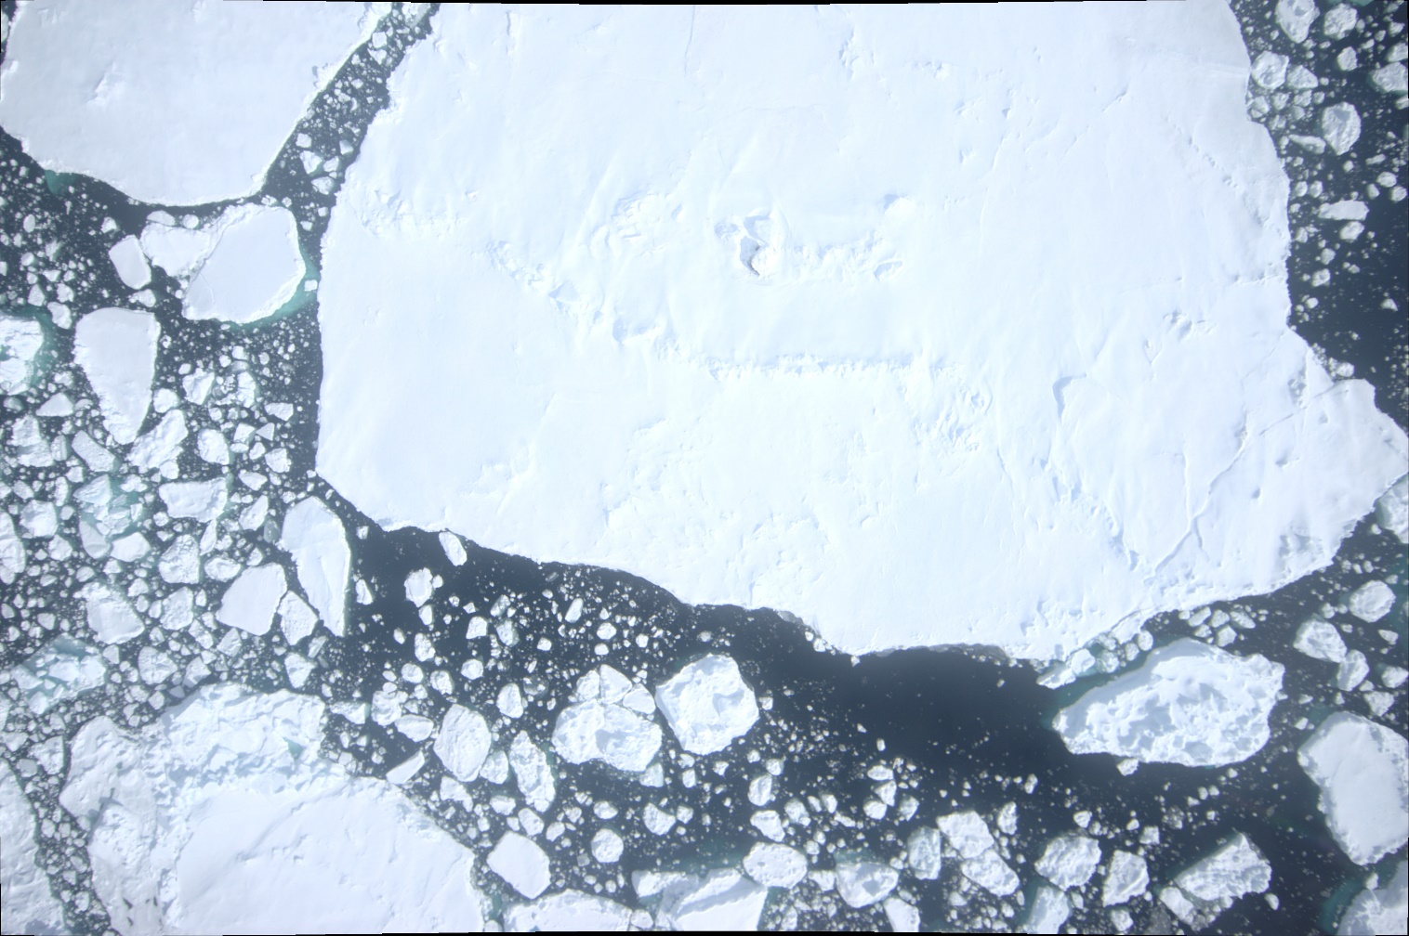
Snow Radar
CRESIS snow radar (2-18 GHz)
Operation in 200 ft verified (no saturation)
Potential interference with 2.4 GHz EM-Bird WLan telemetry
Snow Radar Low Altitude Test – June 2016

Slide 9
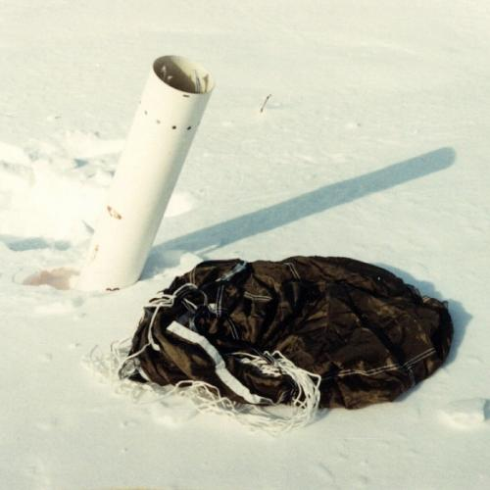
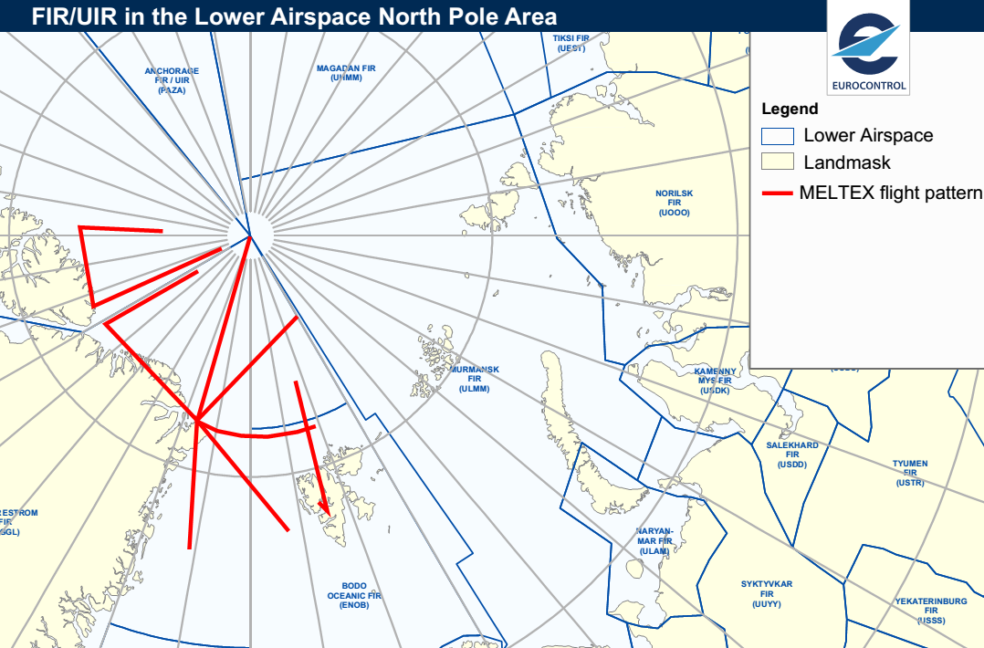
Air Launched Ice Beacons
Motivation: Mark Lincoln Sea surveys for revisit in summer 2017
Deploy MetOcean CALIB buoys during flight
Revisit Target Area
CALIB buyo (www.metocean.com)
Planned AEM for August/September 2017 (MELTEX-III)

Slide 10
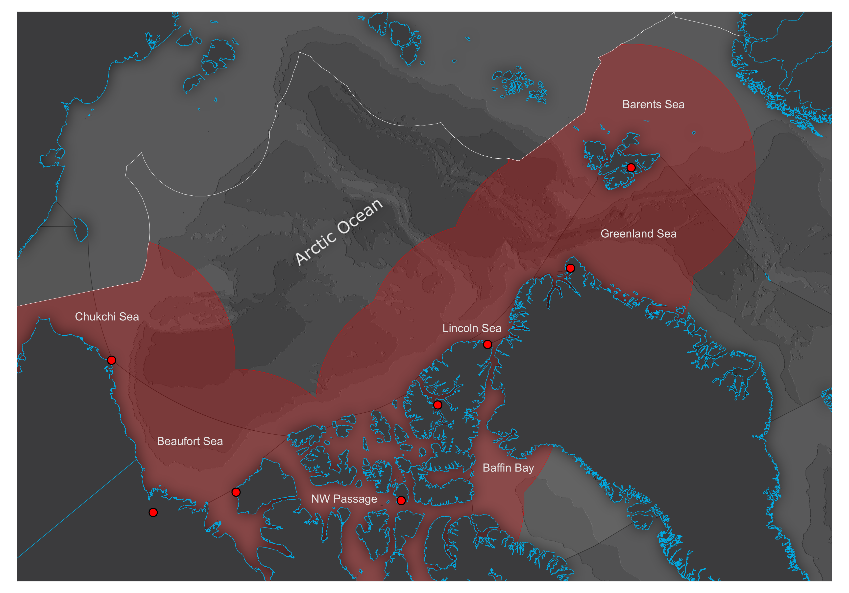
PAMARCMIP 2017
Longyearbyen
15. – 16. March
1 survey
Station Nord
18. – 21. March
3 surveys
CFS Alert
23. – 29. March
5 surveys
Utqiagvik (Barrow)
7. – 10. April
4 surveys
Eureka
31. March
1 survey
Inuvik
2. – 4. April
3 surveys

Slide 11
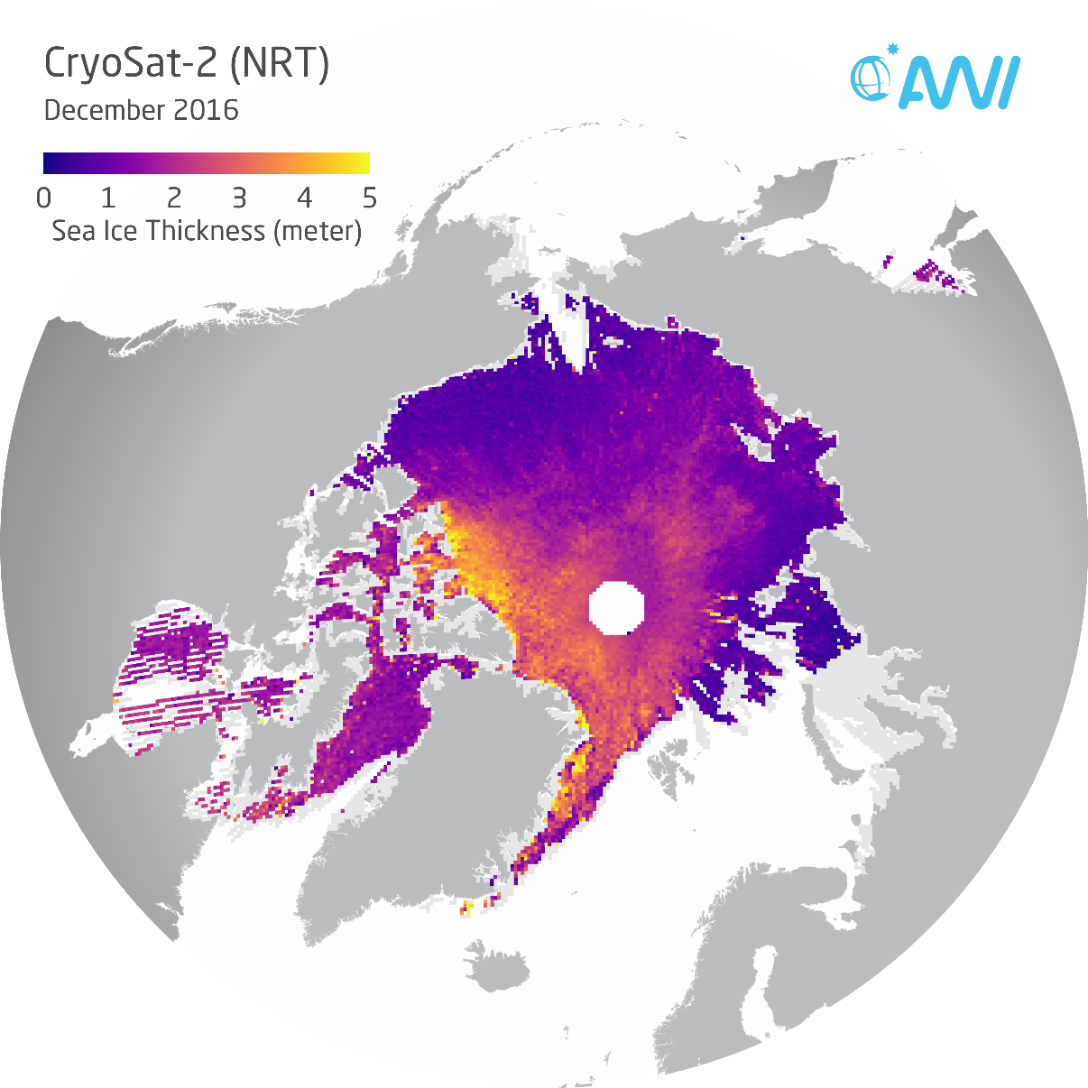
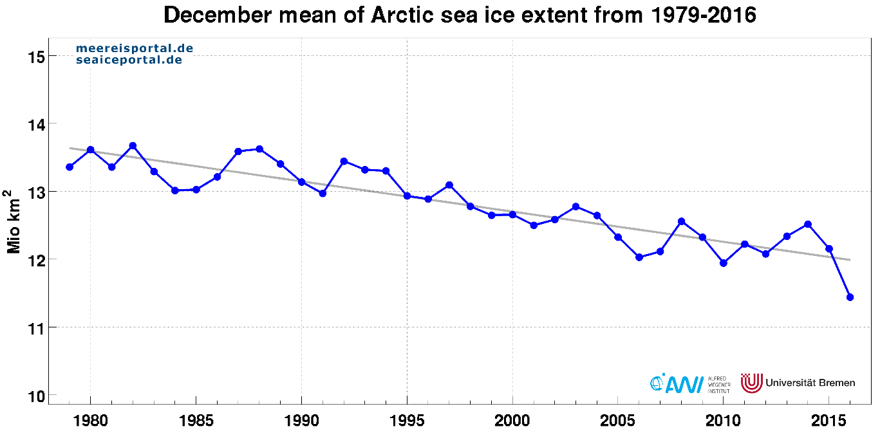
Research Priorities
Continuation of key AEM sea ice thickness time series
Unique Arctic winter sea ice conditions
Single platform measurements of total thickness (AEM), snow freeboard (ALS) and snow depth (SNOW RADAR)
Direct comparison to satellite altimeters (CryoSat-2, Sentinel-3A, AltiKa)
Improving knowledge on freeboard to thickness conversion
Support of CryoVEx 2017 activities (see presentation of Christian Haas)
Inter-comparison of snow radar results with Operation IceBridge

Slide 12
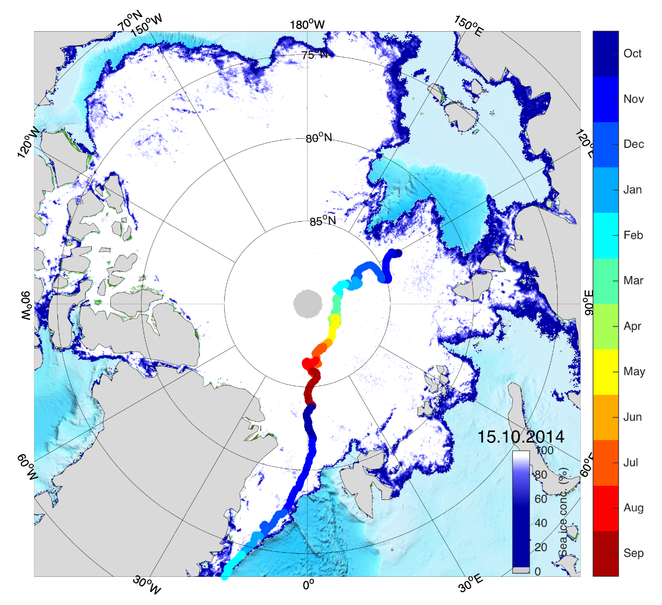
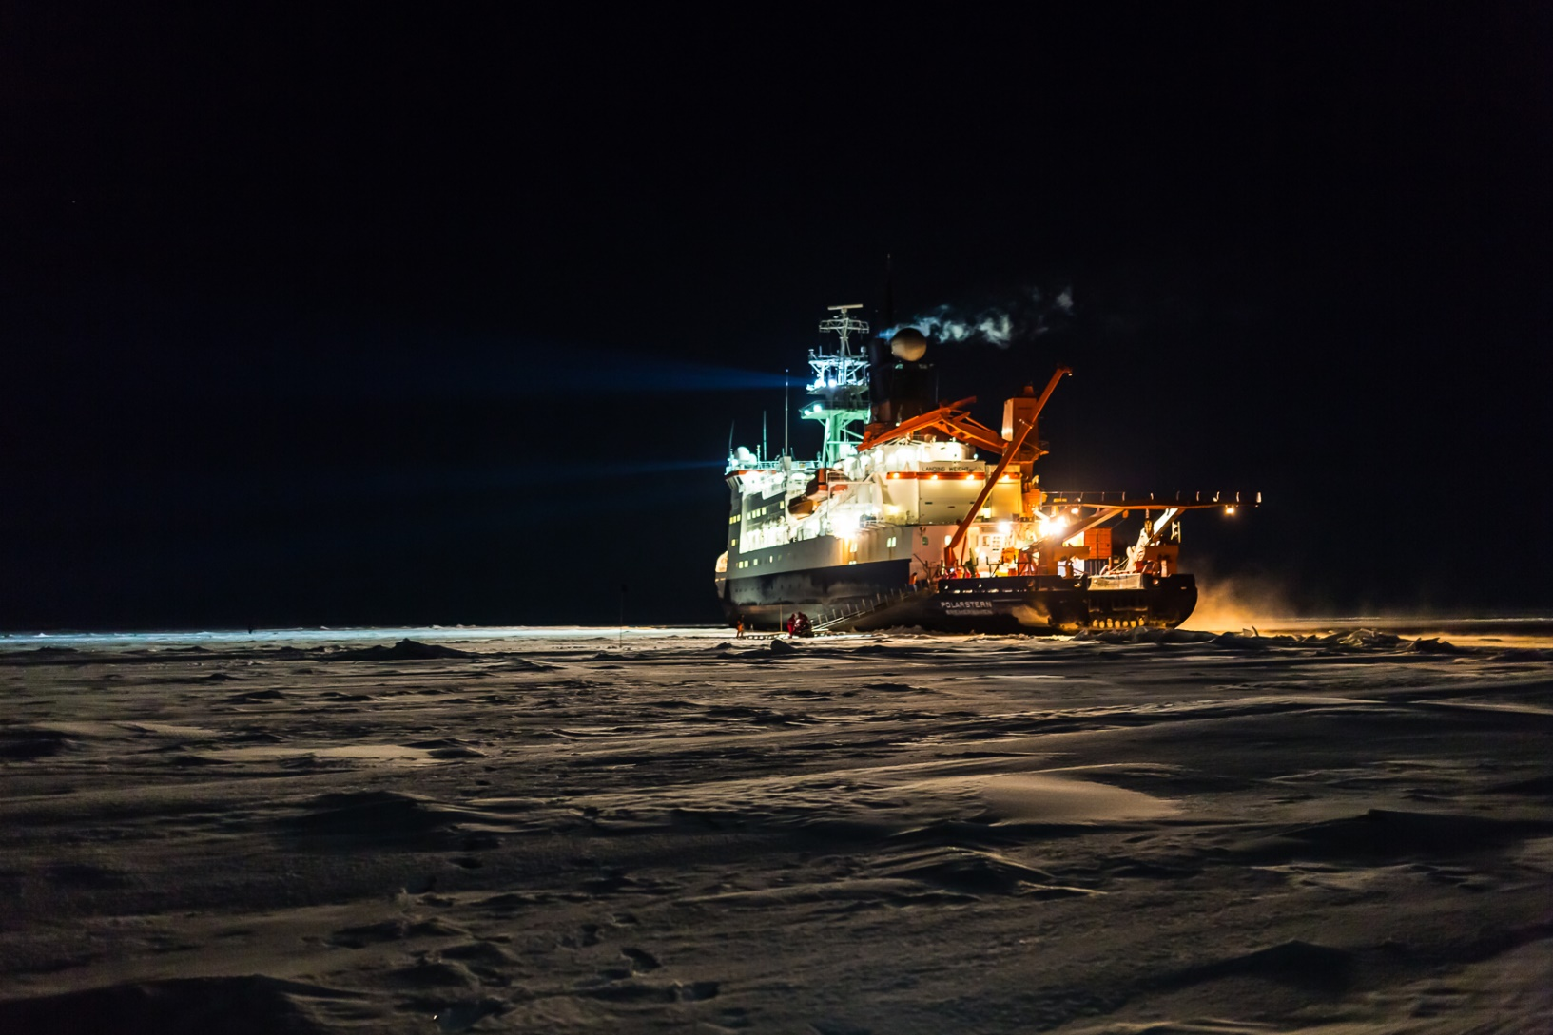
Future Validation Opportunity (MOSAIC)
Multidisciplinary drifting Observatory for the Study of Arctic Climate
Polarstern drift (Okt. 2019 – Okt. 2020)
6 drift legs with resupply & crew exchange
8 berth allocated for sea ice and snow cover (per diem required)
Spring & Summer support airborne campaigns (Polar-5 & Polar-6)
Science & Implementation Plan: http://www.mosaicobservatory.org/

