Slide 1
IceBridge vs. Suomi NPP VIIRS observations
Mark Tschudi & Dan Baldwin, CCAR, Dept. of Aerospace Engineering, University of Colorado
Robert Mahoney, Northrup Grumman, Redondo Beach, CA

Slide 2
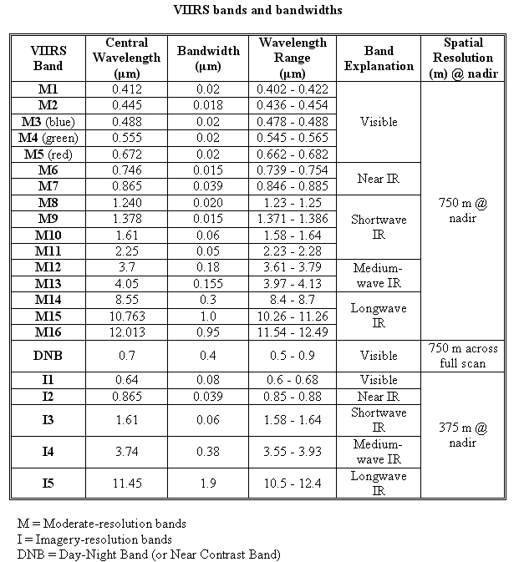
Suomi: named in honor of the late Verner E. Suomi, a meteorologist at the University of Wisconsin who is recognized widely as "the father of satellite meteorology." NPP – National Polar-orbiting partnership VIIRS - Visible Infrared Imaging Radiometer Suite
follow-on to Aqua/Terra (MODIS);
Precedes JPSS
22 bands (compared to 36 for MODIS)

Slide 3
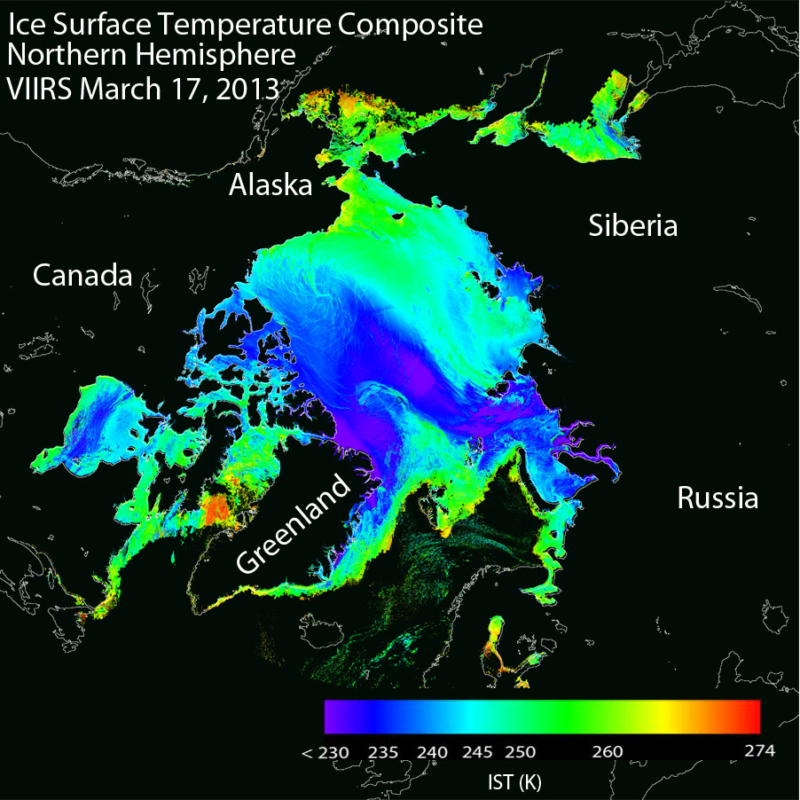
VIIRS Ice Surface Temperature (IST)
provides a “skin temperature” for sea ice- covered areas at 750m res.
produced for clear skies both day and night over Arctic and Southern oceans
MODIS IST heritage
Uses “split window” method with VIIRS channels 11 & 12
Composite of VIIRS IST over the Arctic on 17 March 2013.

Slide 4
VIIRS IST vs. IceBridge KT-19* - daytime#
# separately evaluated due to VCM daytime/
nighttime differences
IST and ST IP performance for day matchups for ST IP computed using the corrected ST IP regression coefficients and reprocessed IST EDR to reflect current IDPS operational coefficients. A 15 minute matchup time window is used.
*Krabill, W. B. and E. Buzay. 2012, updated 2013. IceBridge KT19 IR Surface Temperature. Spring 2012. Boulder, Colorado USA: NASA DAAC at the National Snow and Ice Data Center.

Slide 5
VIIRS IST vs. IceBridge KT-19 - nighttime
IST and ST IP performance for night matchups for ST IP computed using the corrected ST IP regression coefficients and reprocessed IST EDR to reflect current IDPS operational coefficients. A 15 minute matchup time window is used.

Slide 6
VIIRS Sea Ice Characterization (SIC)
produced for clear skies both day and night over Arctic and Southern oceans at 750m res.
Classifications:
Ice free
New/young ice (< 30 cm thick)
Other ice (>= 30 cm thick)
Two algorithms:
Energy (heat) balance based retrieval for night and high solar zenith angles
Reflectance/ice thickness retrieval using modeled Sea Ice Reflectance LUT for daytime
VIIRS Sea Ice Characterization (nighttime algorithm) for March 17, 2013

Slide 7
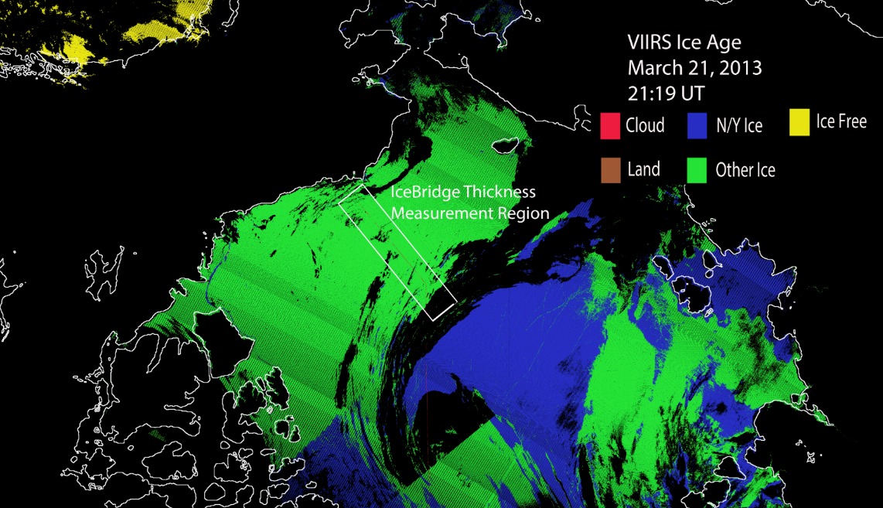
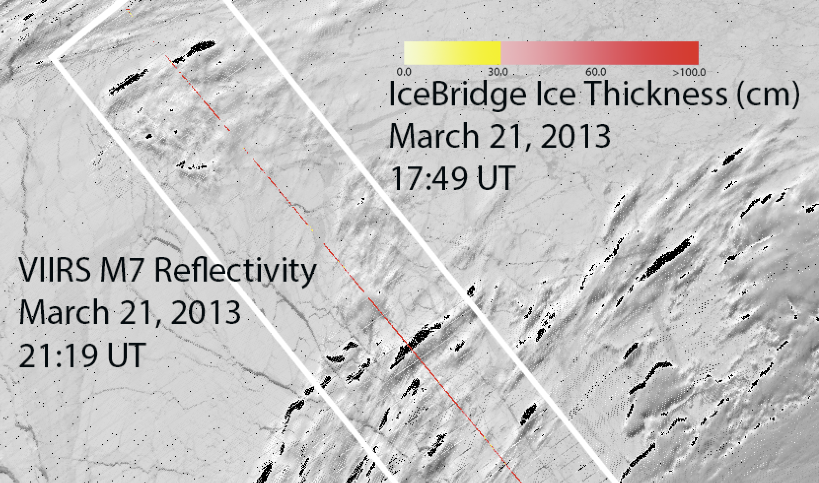
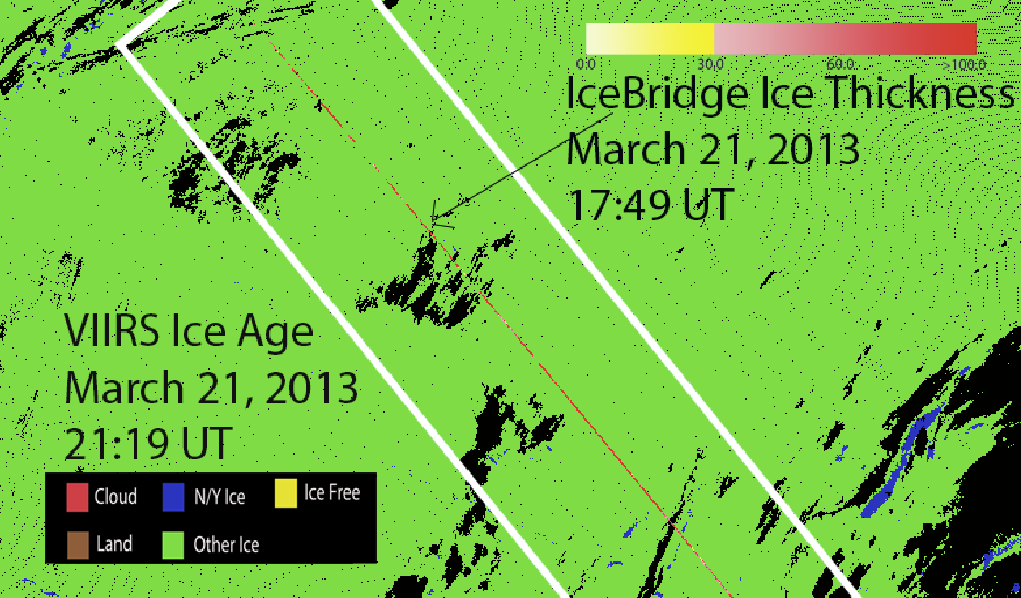
VIIRS Sea Ice Classification vs. IceBridge Ice Thickness*
*Kurtz, N., M. S. Studinger, J. Harbeck, V. Onana, and S. Farrell. 2012, updated 2013. IceBridge Sea Ice Freeboard, Snow Depth, and Thickness. Spring 2013. Boulder, Colorado USA: NASA DAAC at the National Snow and Ice Data Center.

Slide 8
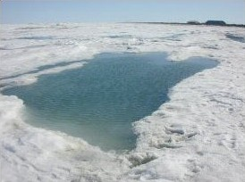
Thanks…
On the Beaufort sea ice near Barrow with Don Perovich, 2004….

Slide 9
Summary of VIIRS Sea Ice Char. EDR Algorithm Overview
Reflectance Threshold Branch (Day Region Algorithm)
Input ice tie point reflectance (I1, I2), VCM IP, AOT IP
Input granulated NCEP gridded precipitable water, total ozone fields
Obtain snow depth for each ice thickness bin obtained from climatology modeled snow depth/ice thickness LUT
Retrieve ice thickness from sea ice reflectance LUT using ice tie point reflectances, modeled snow depth, aot, precip. water and solar and satellite view geometry
Classify by comparing retrieved ice thickness to 30 cm ice thickness threshold
Energy Balance Branch (Terminator and Night Region Algorithm)
Input Ice Temperature Tie Point IP
Input granulated NCEP gridded surface fields (sfc.P, sfc air temp, specific hum. etc…)
Compute snow depth for 30cm ice thickness threshold from heat/energy balance
Classify by comparing computed and climatology LUT snow depth for a 30 cm ice thickness threshold
The Snow-Depth-Ice Thickness Climatology LUT contains:
predicted snow accumulation depths for modeled ice thickness threshold growth times
based on monthly climatology surface air temperatures and precipitation rates

